Slide 1
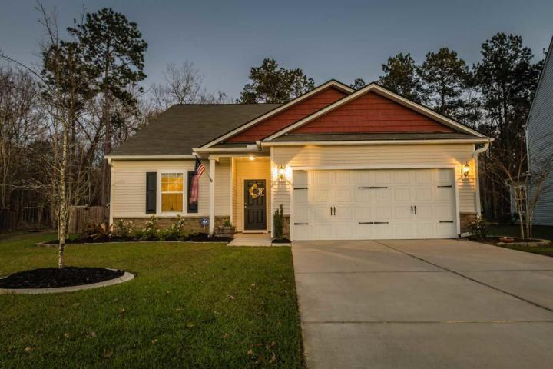
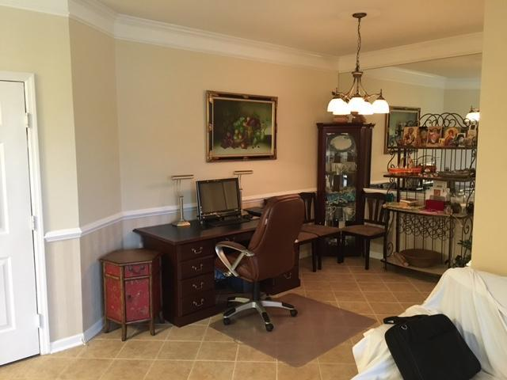
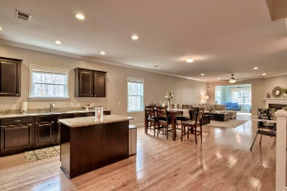
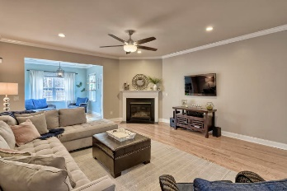
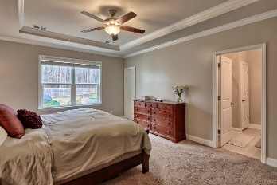
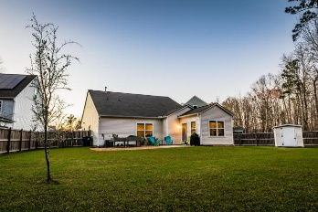
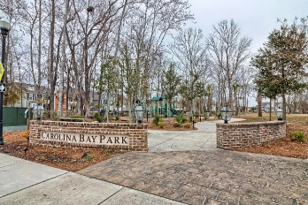


REDUCED PRICE! BRING ALL OFFERS!
2183 Gammon Street
Carolina Bay
Charleston, SC 29414
MLS# 18003985
$359,000
3 Bedrooms | 2 Baths | 2,505sf
Largest 3 bedroom home available on one of the largest lots in Carolina Bay!
Freshly painted interior, like new and ready to move-in. This is a fantastic one story home with on a cul-de-sac! Lot backs up to wooded wetlands for superior privacy! Large fenced back yard! Open kitchen features upgraded cabinets, granite counters, all stainless appliances. Gas fireplace in family room. Wood floors throughout with wall to wall carpet in bedrooms and upstairs bonus room. Carolina Bay features 3 neighborhood swimming pools and a 3 acre centrally located park! Only 25 minutes from downtown Charleston and the airport.
Erik Fender
C 843-830-7346
O 843-856-8800
erik.fender@cbcarolinas.com
Coldwell Banker Residential Brokerage
1127 Queensborough Blvd. 103
Mt Pleasant, SC 29464

