Slide 1
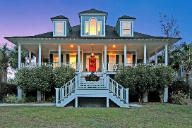
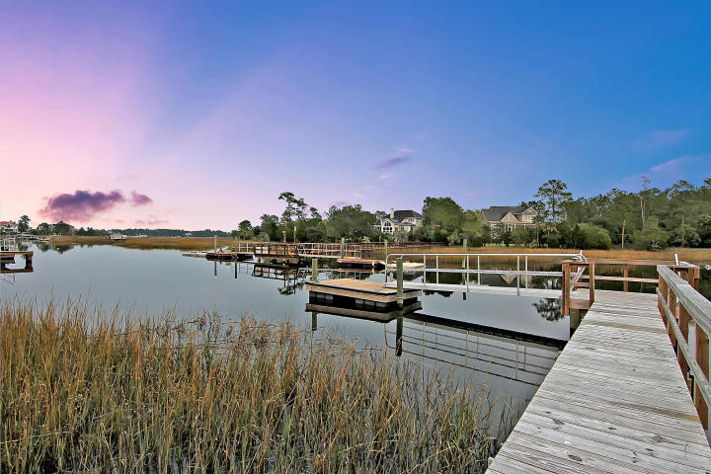
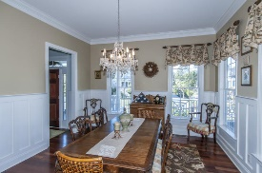
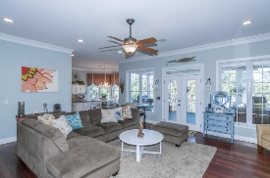
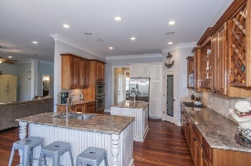
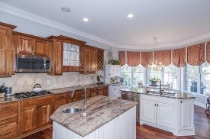
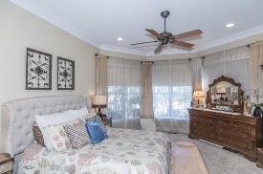
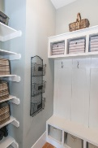
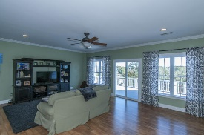
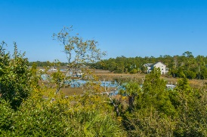
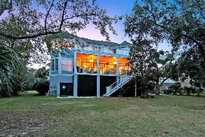
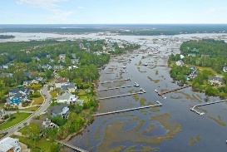


2184 Beckenham Drive
Mount Pleasant ~ MLS# 16029124 ~ $1,075,000
New Deep Water Listing in Masonborough - Park West
Tremendous value at only $1.075 million!
$50,000 Price Reduction
Spectacular low-country design and stunning water views make this home the perfect combination! Take in evening sunsets from your gorgeous wrap-around front porch or either of the rear verandas. All this on deep water with a brand new dock, ramp, and floater on Darrell Creek just minutes from the Wando River! The dock has open water on both sides making it easy to navigate a boat or enjoy swimming off the dock. Out back enjoy not only water but majestic oak tress that provide privacy from neighbors. An outdoor shower and firepit area also add to the easy living lifestyle. Inside the home the cherry hardwood floors give that rich touch and flow throughout the main area and up the stairs. Upon entering you are flanked on either side by the formal dining room (which connects to the kitchen) and den. Both are nicely trimmed with crown molding and additional custom wall trim. Straight ahead you flow right into the great room and adjoining kitchen. The open concept space gives just enough separation while allowing for interaction with friends/family. The kitchen offers beautiful coordinating cabinetry and double islands with granite counters. Glass front cabinets, built in wine racks, and tiled back splash also add an elegant touch . There is also plenty of space near the bay window for a kitchen table or sitting area. The great room flows right out onto the rear screened porch, perfect for outdoor entertaining. The spacious porch is large enough to accommodate several seating areas. Completing the first floor is the spacious laundry room with plenty of storage cabinets and a sink as well as the master suite which offers beautiful water views and a en suite bath with impressive claw foot tub. Upstairs you will find four additional LARGE bedrooms, 2 with their own private baths and an additional full hall bath. In the middle of the back bedrooms is the large media room with access to the upstairs veranda. This outdoor space offers fantastic water and sunset views. The garage underneath is large enough to accommodate several cars, a boat, golf cart, plus loads of storage. It would also be possible to finish off some additional space for a first floor bedroom suite or hang out space. Park West offers wonderful amenities including two pools, tennis courts, a club house, play parks, and miles of walking/jogging trails. Public schools are within the neighborhood as well as shopping, dining, recreational fields, professional offices and a gym. Downtown Charleston and the beaches are only 20-25 min away! Come see this awesome deal for yourself and welcome home!
Additional items:
Wired for central vac, surround sound
2 new tankless water heaters installed in 2014
2 new HVAC systems installed 2014 and 2015
Melodie Smith
(843) 408-5067 M
melodie.smith@carolinaone.com
www.melodiesmithrealestate.com

