Slide 1
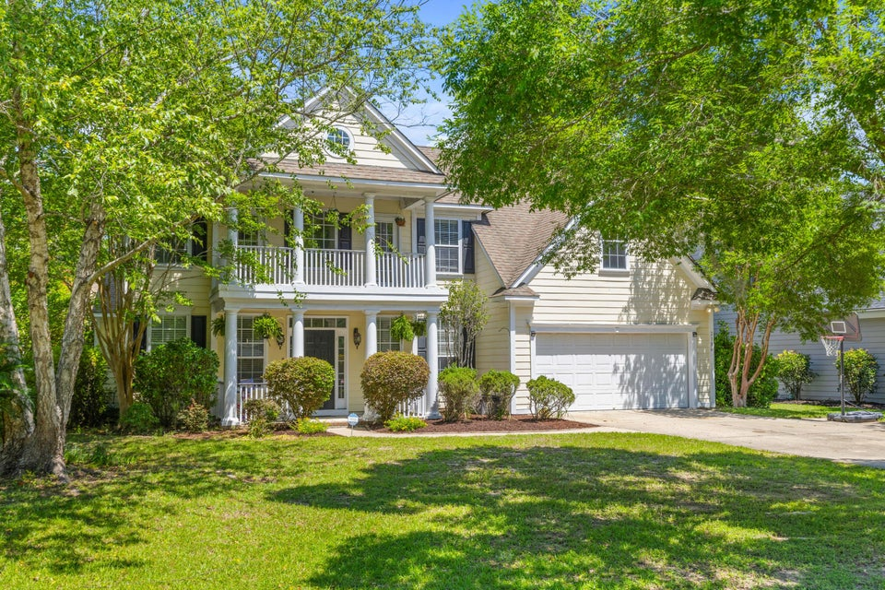
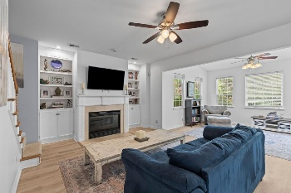
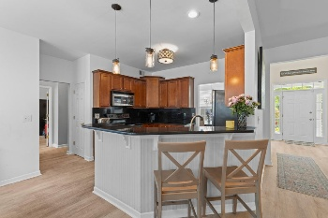
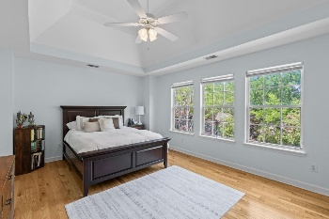
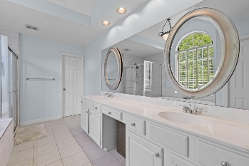
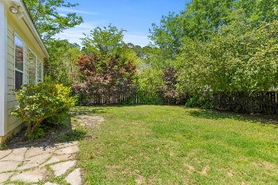

2184 Tall Grass Circle Dunes West · Mount Pleasant, SC 29466 · MLS# 25013597 · $815,000
5 Bedrooms In Dunes West For $815,000!
Welcome to this beautiful residence offering just under 3,000 square feet of thoughtfully designed living space, perfectly situated on a generous corner lot in one of the area's most sought-after neighborhoods. This impressive home features 5 spacious bedrooms and 3 full bathrooms, providing ample space for family and guest set up . Downstairs you will find brand new LVP flooring that covers the open-concept layout that is ideal for both everyday living and entertaining, with seamless flow between the living, dining, and kitchen areas. There is a bedroom and full bath for guests or in laws. Upstairs you will find new hardwood floors and 4 bedrooms. One could easily be converted to a theater room or playroom. Step outside to enjoy the expansive yard—ideal for outdoor entertaining.
Amanda Thomas
843-640-8975
amanda.thomas@agentownedrealty.com
AgentOwned Realty Co. Preferred Group, Inc. | 824 Johnnie Dodds Blvd | Mt Pleasant, SC 29464

