Slide 1

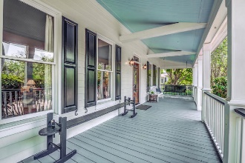
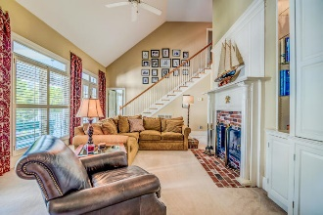
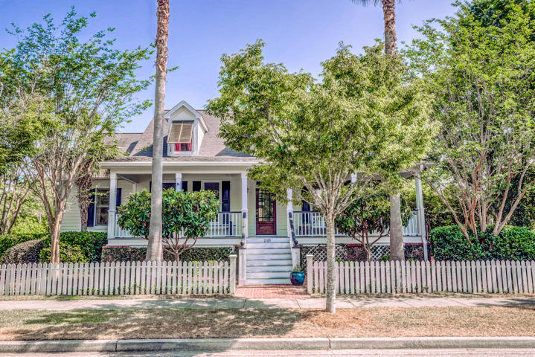
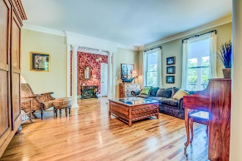
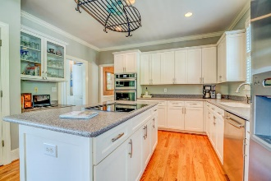
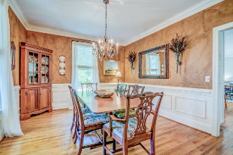
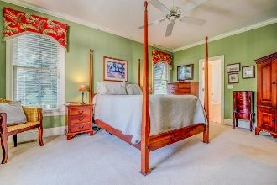
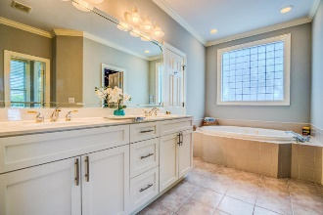
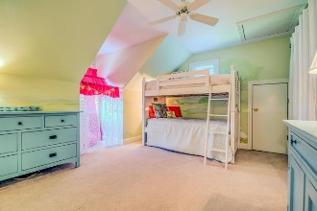
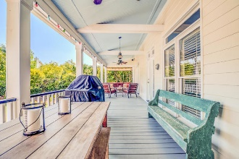
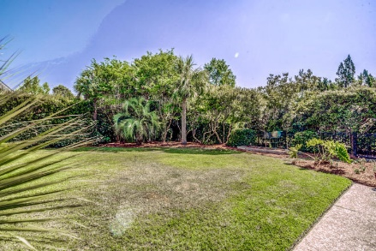
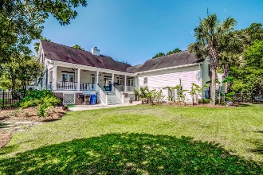
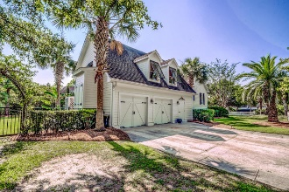


2189 Hartfords Bluff Cir Rivertowne Mount Pleasant, SC 29466 MLS# 19017046 $629,900
New Price!
Motivated Seller!
Nestled into a lush Lowcountry setting of swaying Palmetto trees and native foliage, this charming coastal cottage welcomes you onto a deep rocking chair ready front porch that is the perfect spot for sipping sweet tea while visiting with friends and neighbors. Located in the prestigious Rivertowne on the Wando Neighborhood with three community docks for fishing, boating or just to relax and watch the amazing Wando River sunsets. Enjoy golf at Rivertowne Country Club's Arnold Palmer Signature Course then meet friends at the club for dinner. Additional amenities include neighborhood pool, tennis courts, walking trails and play park all conveniently located to beaches and the world class dining and shopping of historic downtown Charleston.
Asking $1,200,000
MLS# 17023051
3,692 SqFt
4 Bed/3½ Baths
Short Drive to Historic Downtown Charleston & Beaches
Don Dawson 843-514-0452 ddawson@carolinaone.com Carolina One Real Estate • 2713 Highway 17 North • Mount Pleasant, SC 29466
www.TeamDawsonSC.com

