Slide 1
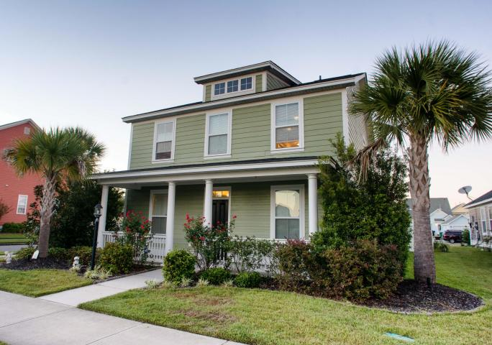
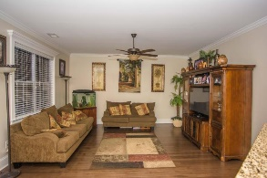
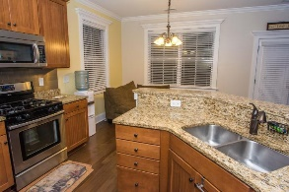
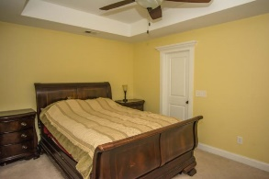
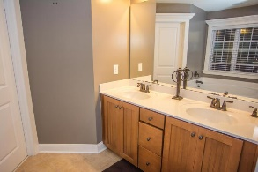
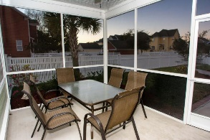
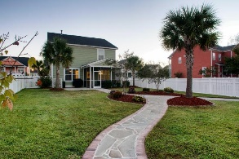
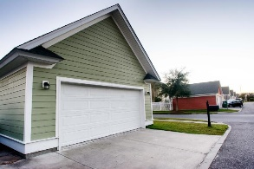
Welcome home!
218 Amaryllis Avenue
White Gables
Summerville, SC 29483
MLS# 15026939
$224,500
Immaculate and move in ready with all the upgrades! Open floor plan! Gorgeous hardwood floors. Spacious kitchen with granite countertops and stainless steel appliances. Double door pantry! Upgraded kitchen cabinets with bronze hardware. Large family room. Formal dining room. Extra room downstairs is the perfect office, workout room with French doors. Master has large walk in closet. Master bath has garden tub, separate shower with upgraded his and her vanity. Ceiling fans in every room. Laundry room and LOFT are upstairs. Screened in porch. Beautifully landscaped and fenced in backyard! 2 car garage with attic storage space. Community has much to offer with clubhouse and pool, tennis courts, basketball court, soccer field, walking trails, 2 playgrounds, RV and boat storage.
David Hickman | 843.505.0456 | davidisyouragent@gmail.com | www.omnicarolinarealestate.com
Omni Carolina Real Estate | 126 Eston Dr | Goose Creek, SC 29445

