Slide 1
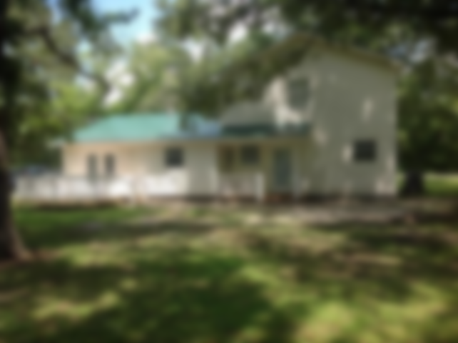
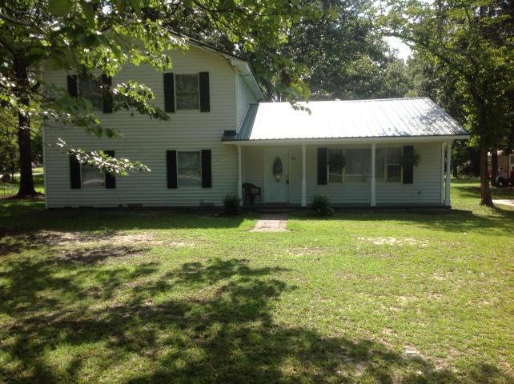
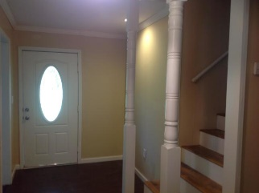
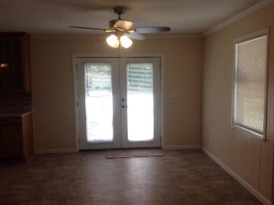
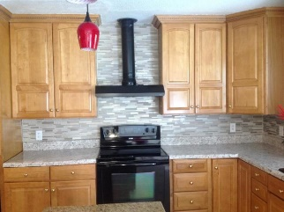
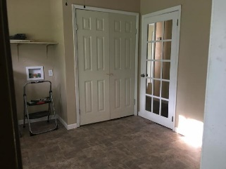
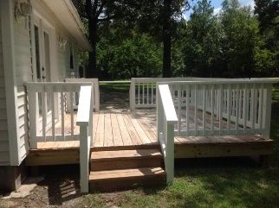
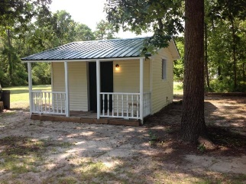


Recently Renovated!
This 5 Bedroom And 3 Full Bath Home Sits On A Large Corner Lot
218 Anvasback Road
Eutawville, SC 29048 | MLS# 19019981 | $185,000
SOME RECENT RENOVATIONS TO INCLUDE NEW METAL ROOF, HVAC UNIT AND NEW PAINT. NO HOA WITH NEW CARPET IN THE BEDROOMS, NEW VINYL IN THE KITCHEN AND UTILITY ROOM AS WELL AS NEW LAMINATE EXCEPT THE STAIRCASE. KITCHEN IS A DREAM WITH ALOT OF CABINETS FOR STORAGE. A MUST SEE. THIS PROPERTY IS RIGHT OFF OF HWY 6 AND BETWEEN SUMMERVILLE/CHARLESTON AND ORANGEBURG. BUYER AND BUYERS AGENT PLEASE VERIFY ANY AND ALL INFORMATION OF IMPORTANCE.
Carla C Davis
Mobile - (843) 437-4873
gaweber@tds.net
AgentOwned Premiere Group
141 A N. Main Street
Summerville, SC 29483

