Slide 1
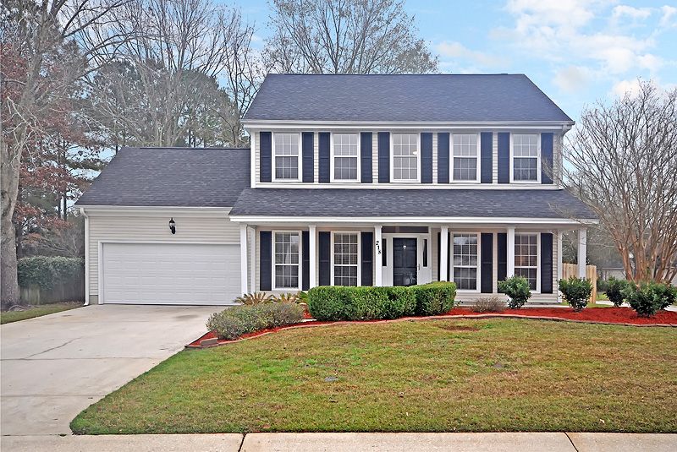
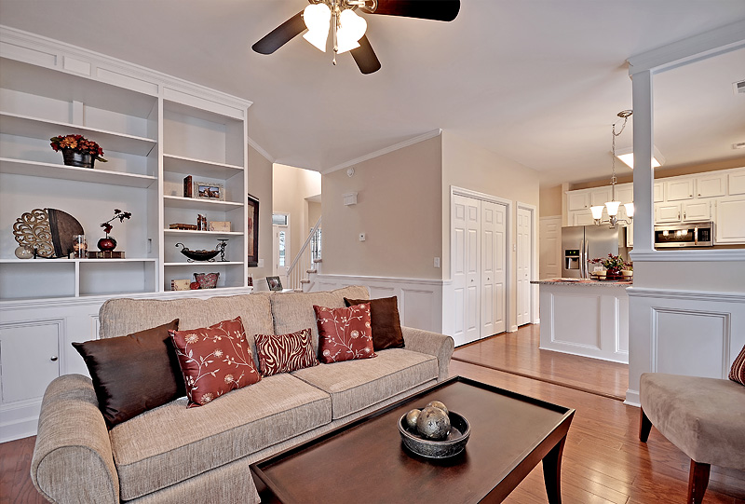
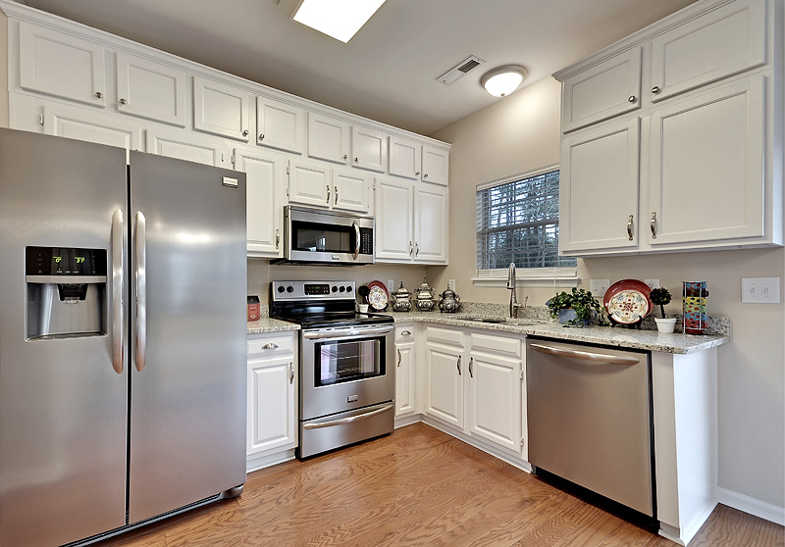
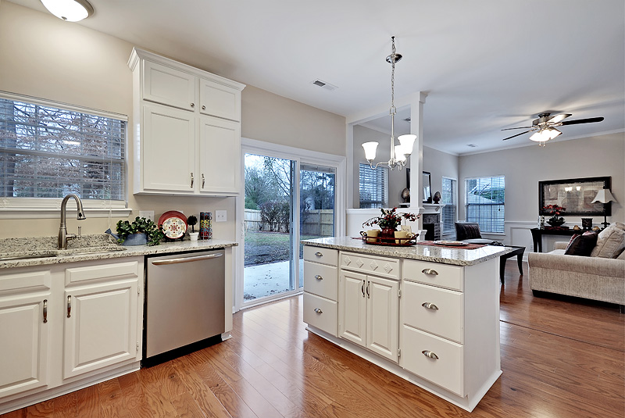
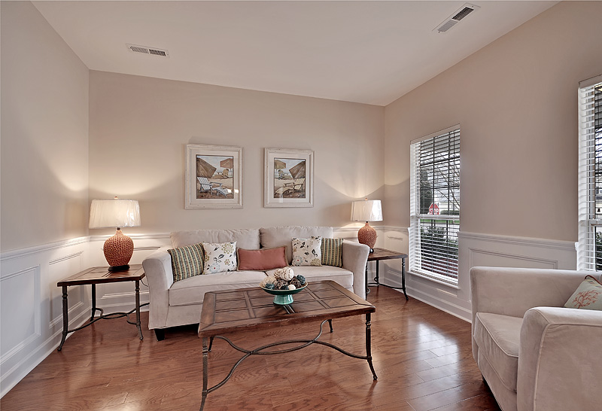
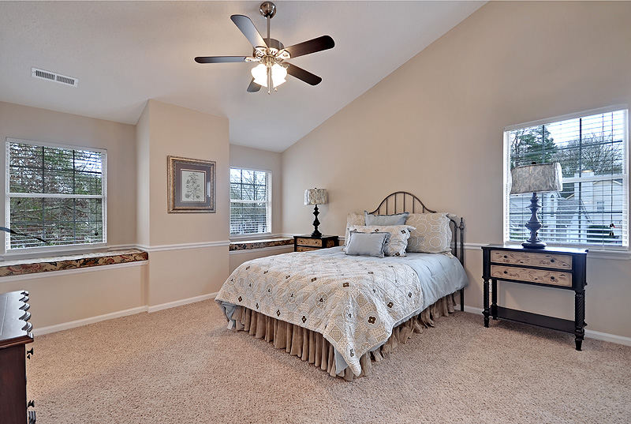
218 Candleberry Circle ~ Crowfield
$215,000
Priced to sell! Completely-Renovated 4 BR/ 2.5 BA Crowfield home! The entire Interior just painted! New Architectural Roof! New Garage Door/ Opener! New Water Heater! New Premium Wood Floors downstairs, Tile & New frieze pad/ carpet! Nice kitchen w/ ample cabinets, New granite tops w/ all New Stainless Steel appliances! Living Room, Back Den w/ Fireplace & a separate FROG/ 4th Bedroom! Formal Dining & small bartop eating area. Master Bath w/ new double vanity & tile tub/ shower. Fully-Fenced/ Gated Yard. Oversized 2-Car Garage.
Bedrooms:
Bathrooms:
Fireplace:
Garage:
Lot Type:
4
2.5
YES
2-Car
Corner
Home Sq. Ft:
Year Built:
New Roof:
New Water Heater:
Type of Floors:
2045
1990
2015
2015
Wood, Ceramic Tile, Carpet
Greg Cook
Anchor One Realty, LLC
843-343-3030
gcook@anchorpropertiesofsc.com

