Slide 1
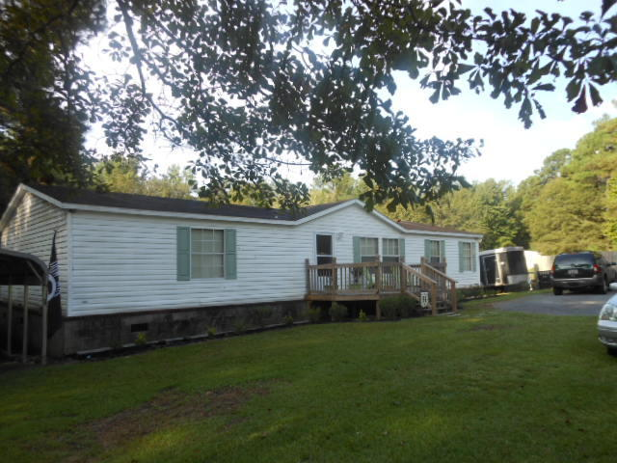
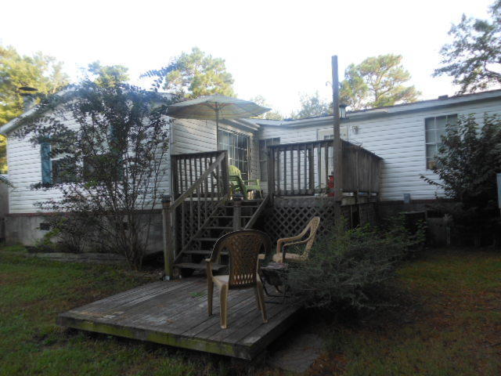
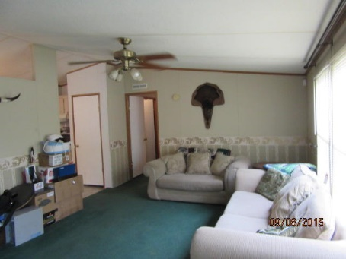
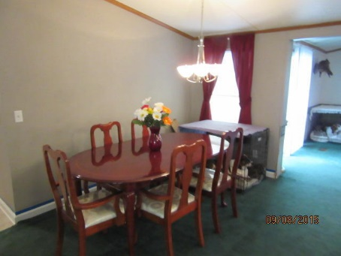
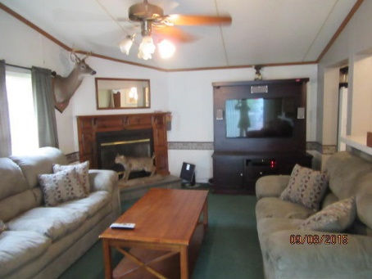
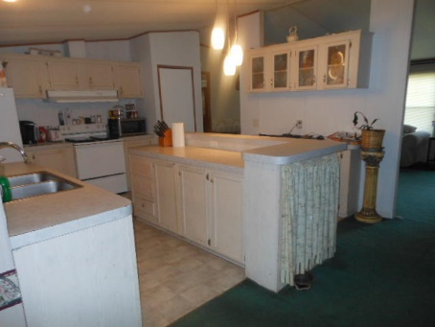
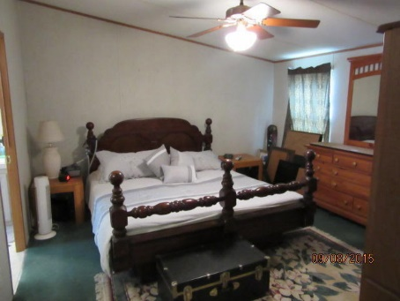
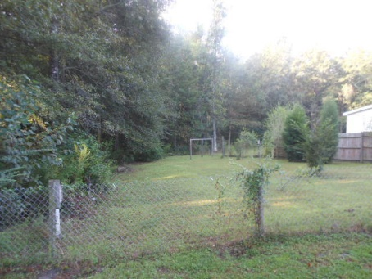
~ Almost an Acre in Summerville ~ $109,900 ~
218 Dunmeyer Hill Road
Summerville, SC 29485 | MLS# 15023299
Lots of privacy! Property adjoins a 4 acre vacant parcel on left, never to be developed...See deer and turkey in your back yard! Only 4 miles to I-526 at College Park Rd. And 10 minutes to down town Summerville this is a triple wide and has open floor plan. Gorgeous split bedroom plan with 3 bedrooms and 2 full baths. Like new 1999 Fleetwood mobile home which is 55x42--formal living room--separate dining room--separate great room with fireplace--the kitchen features a center island with an eating counter--kitchen is open to dining room and to the great room--very open and airy--sliding glass doors from great room open to a wood deck overlooking the almost 1 acre. The master bath has double vanities as well as garden tub and separate shower--
Rick Willis
843-327-3017
rwillisteam@gmail.com
The Group, LLC

