Slide 1
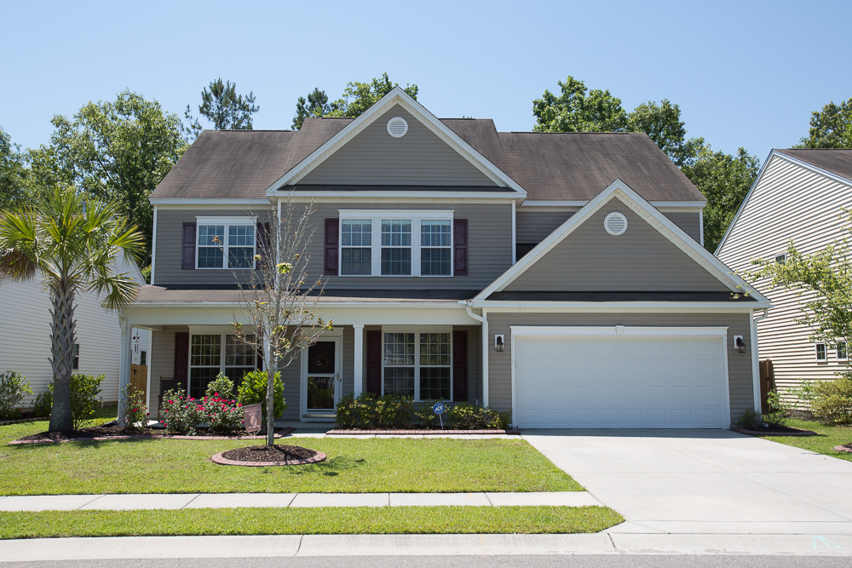
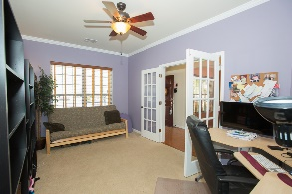
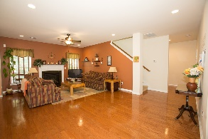
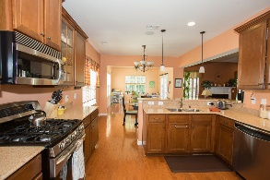
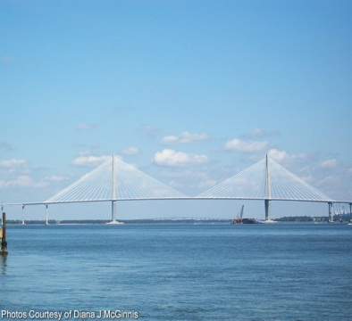
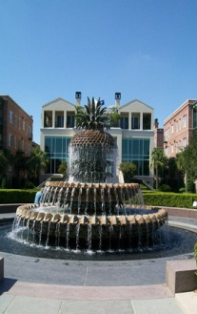
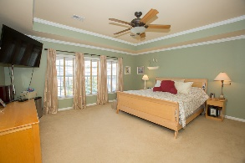
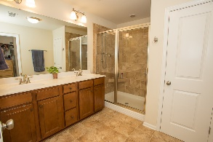
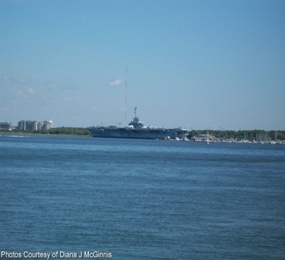
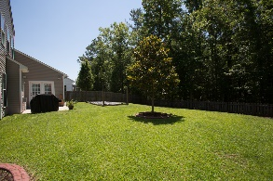


OPEN HOUSE
Sunday May 21st
1:00 - 4:00
$450,000
$450,000
218 Mayfield Drive
Brickhope Plantation · Goose Creek · MLS# 17012832 · $299,900
Rodney Hancock
(843) 437-1347
rodneyhancock08@gmail.com mortgageprofessionalsonline.com
NEW ON THE MARKET AND PRICED TO SELL
This lovely home in Brickhope plantation is located on a beautiful oversized lot, with a fenced yard perfect for entertaining and privacy. Upon entry you will notice how well this home is kept. Front the foyer there is a formal dining room to the left and home office on the right. The family room is ideal for gathering and relaxing as well. Kitchen has it all, including an eat-in kitchen that is adjacent to a sun room, ideal for reading. Mother-in-Law suite on the first floor with full bathroom. Upstairs you will find the huge master bedroom and three other rooms. Don't forget about the bonus room.
AgentOwned Charleston Group
902 Savannah Hwy
Charleston, SC 29407
Real Estate ● Mortgage Insurance ● Business Brokerage

