Slide 1
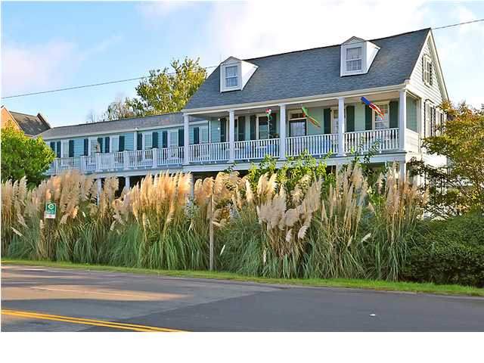
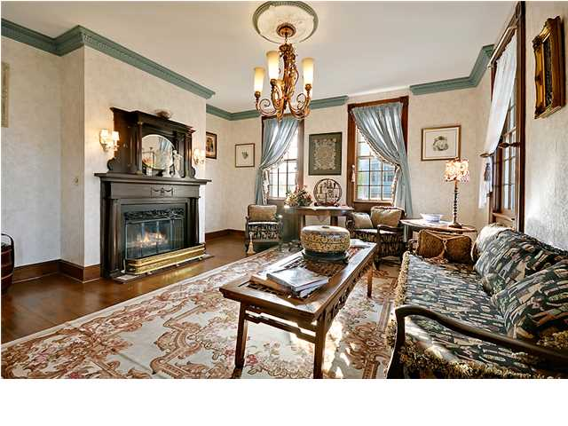
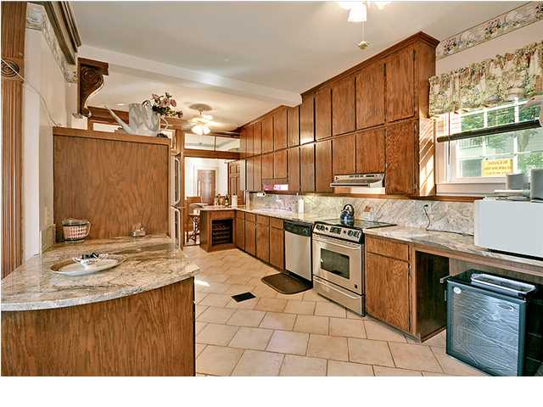
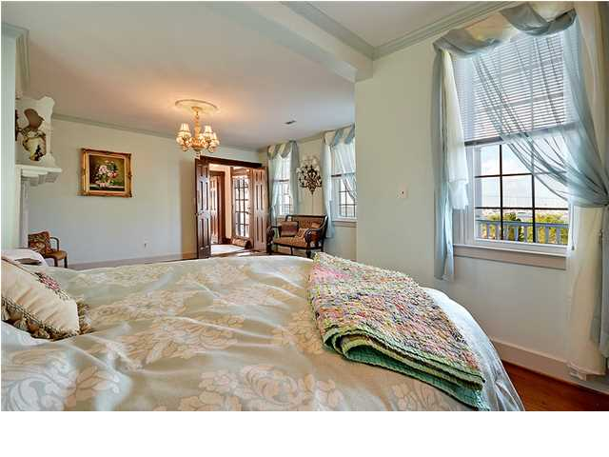
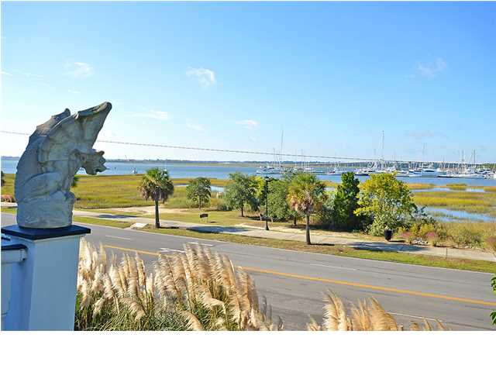


ORIGINAL MASTERPIECE!!!
218 Wentworth St
Harleston Village
Charleston
MLS# 1327495
$1,265,000
Beautifully restored home with waterfront views (Gorgeous Sunsets and Ashley River views) located within a short walk of The Market, Broad Street, Fine Dining, Historic Sites and downtown events. This magnificent, Circa 1839 home is situated on a private, professionally landscaped, (Iron and Square Pillar) fenced lot and offers 84 feet of Southern Piazza Porches.
This Classic home offers, original wood floors, on the second and third level, 5 large bedrooms including the spacious master bedroom suite with a private bathroom, 2 additional full bathrooms, the main floor offers the stunning high ceilings with crafted plaster and wood moldings, authentic wood flooring in the formal living room, elegant dining room, the kitchen has been improved with crafted wood cabinets, granite counter tops, stainless appliances. Attention to detail is enhanced through-out including five fireplace (two working) and mantles, distinctive chandeliers and more.
A list of additional improvements are available. Age, sqft, taxes, acreage,HOA/dues and schools are approx. buyer to verify. See Addendum for addition improvements
Bill Everett, Jr
Broker
Office 843-767-7777
Direct 843-693-8539
Fax 843-576-5352
RE/MAX Pro Realty, 9209 University Blvd, Charleston, SC 29406

