Slide 1
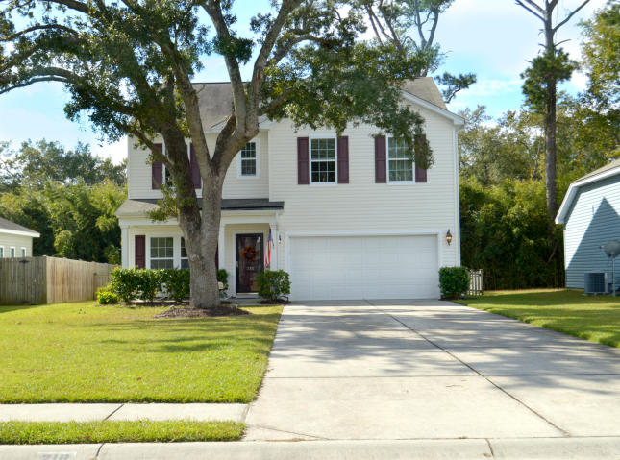
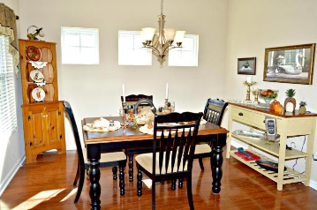
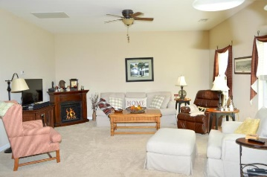
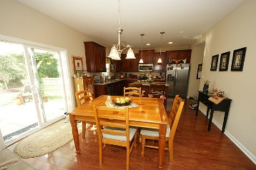
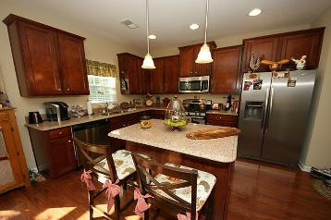
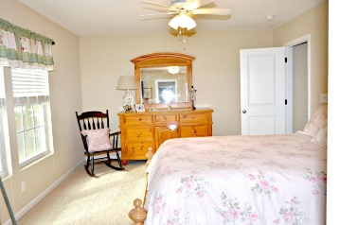
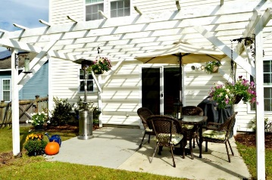
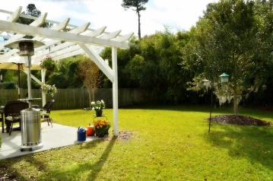
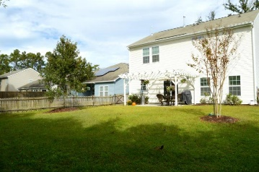


218 Withers Lane Bellwood - Ladson, SC 29456 MLS# 17026265 - $229,000
Open House Lunch ~ Friday, Oct 3 from 11 - 1
Handyman Special… Bring your hard hats!
Charming Gem!
New Pics! New Price!
Welcome home to 218 Withers! This beautifully maintained home is tucked away in centrally located Bellewood subdivision. The home is zoned for DD2 schools and brand new Eugene Sires Elementary is about a mile away. The home has great curb appeal and a large lot with a fenced in yard. The home has been lovingly maintained and as you enter you will be charmed by the hardwood floors through the entry way and dining room. The dining room is light and bright and great for entertaining. The floorplan flows into the family room with plenty of windows and is open to the eat in area and kitchen. Sliding glass doors give you a great view of your private back yard. The pergola on the patio adds a charming touch. The kitchen features cherry cabinets, a gas range and solid surface countertops. The home has 3 well appointed bedrooms upstairs. There is a loft area that can be used as a playroom, workout area or flex space. Words can not describe the charm of this great family home. Come and see it today!
Diana Johnson
(843) 345-6485 djohnson@carolinaone.com www.ahomeincharleston.com
Hillary Jones
(843) 709-4666 hillaryjones@sc.rr.com | www.hillaryjoneshomes.com
Carolina One Real Estate | 1530 Old Trolley Road | Summerville, SC 29485

