Slide 1
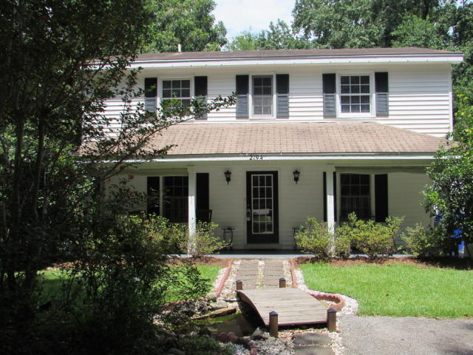
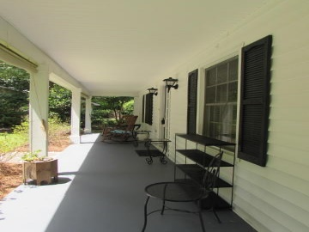
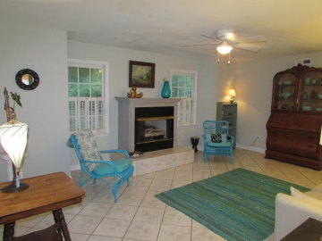
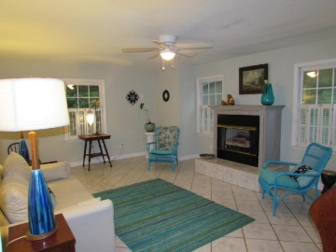
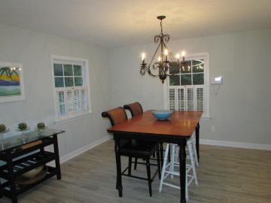
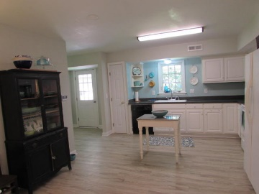
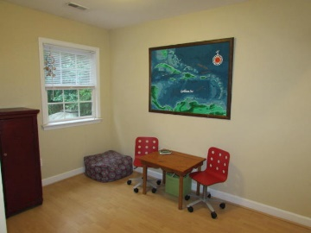
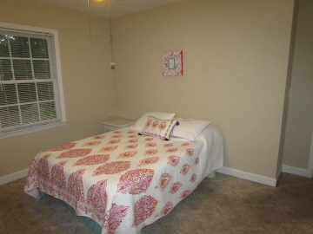
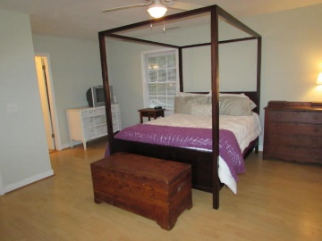
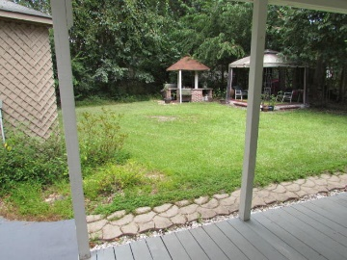


2194 Becky Road · Pierpont · Charleston · MLS# 15020607 · $235,900 ·
55 and Better!
Cute &
Affordable!
Step into this charming freshly painted beauty and make yourself at home! Set on a cul-de-sac with a large lush yard that includes a brick wood burning grill. There are also two covered patios one on the front and back that make the perfect places to sit back and relax. The kitchen and dining area are open and perfect for entertaining. Three spacious bedrooms are located upstairs as well as a small loft area for either a office space or extra space for the kids toys. And if you need a space for your exercise equipment or a ''man'' cave there's a great workshop room just a few steps away from the the back door.
Heather Broadwell-Derexson
(843) 303-2065 – C heather.derexson@carolinaoneplus.com
www.Lowcountryhomesbyheather.com
Carolina One Real Estate
900 N Main St.
Summerville, SC 29483

