Slide 1
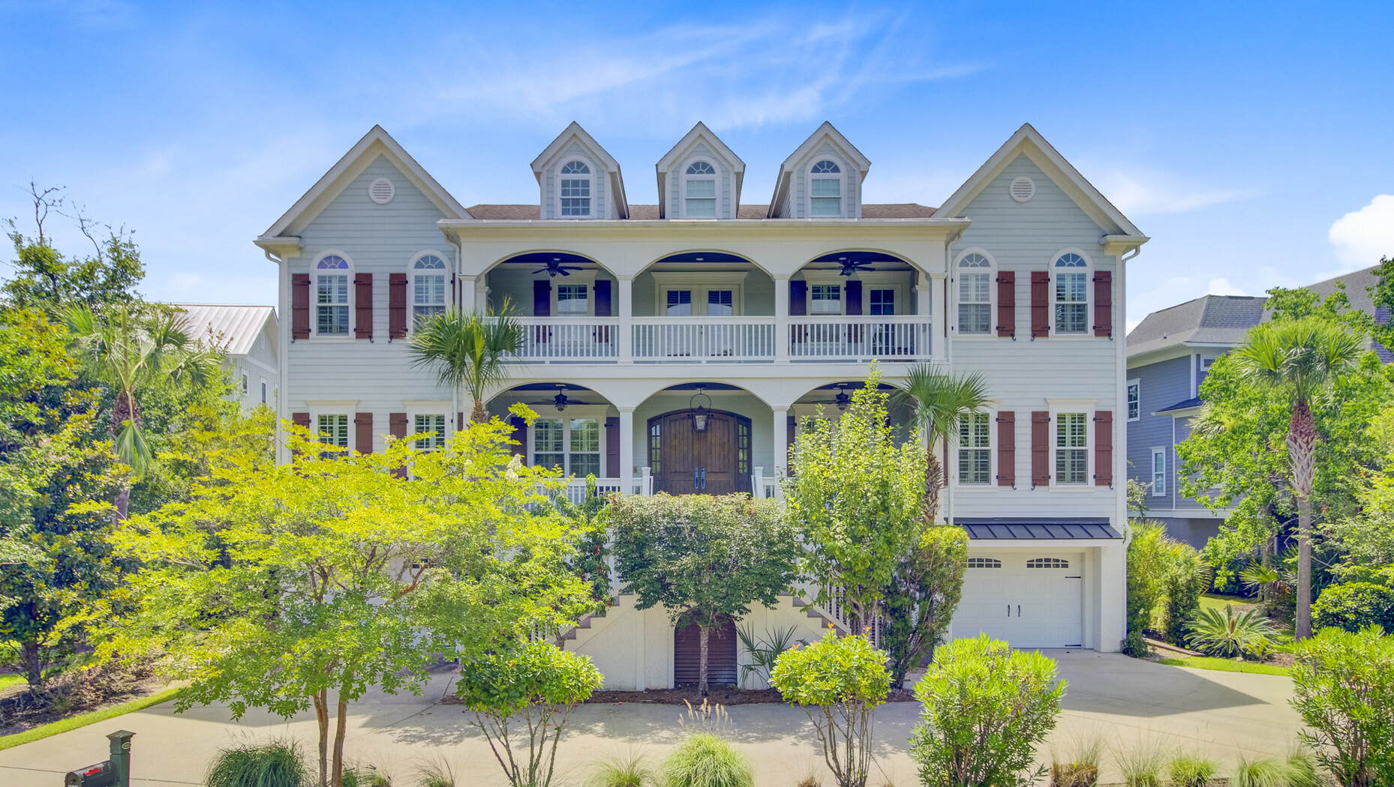


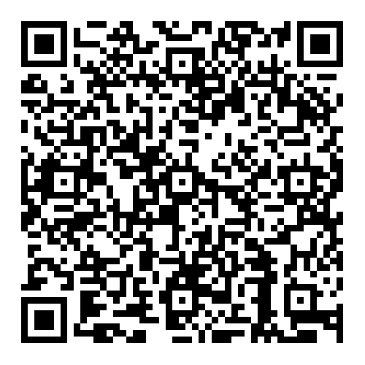

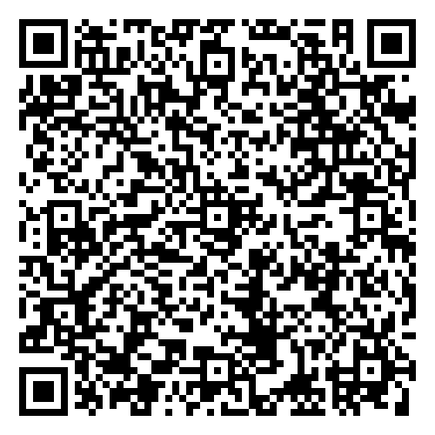

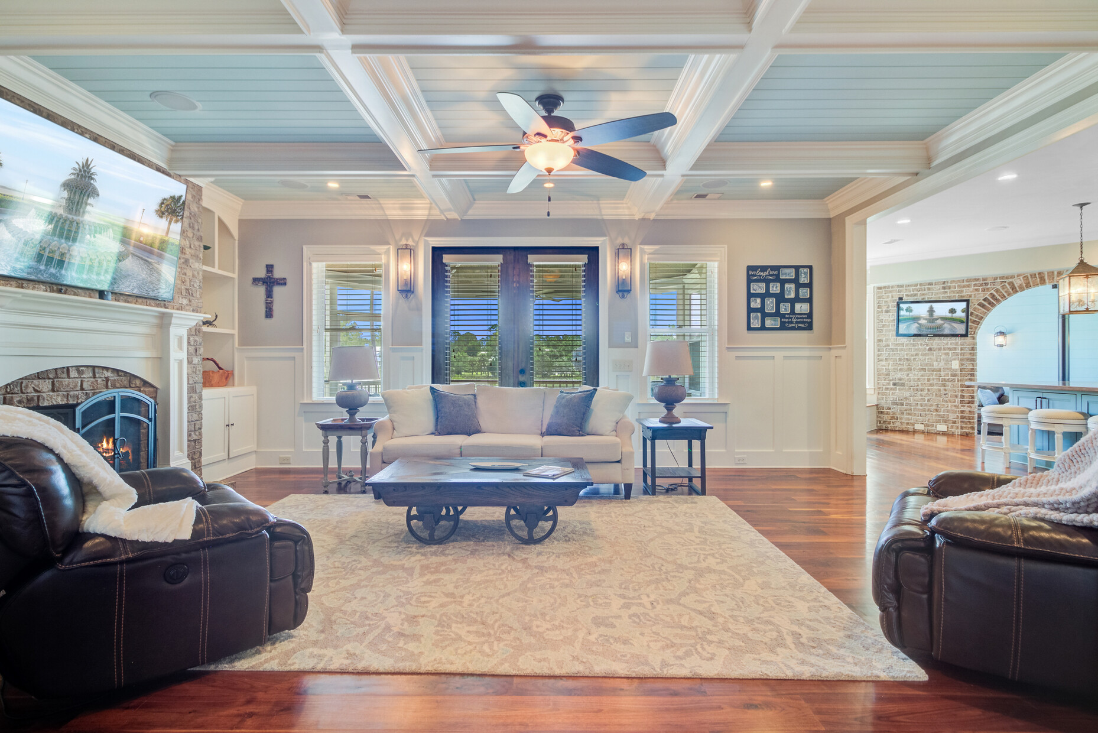
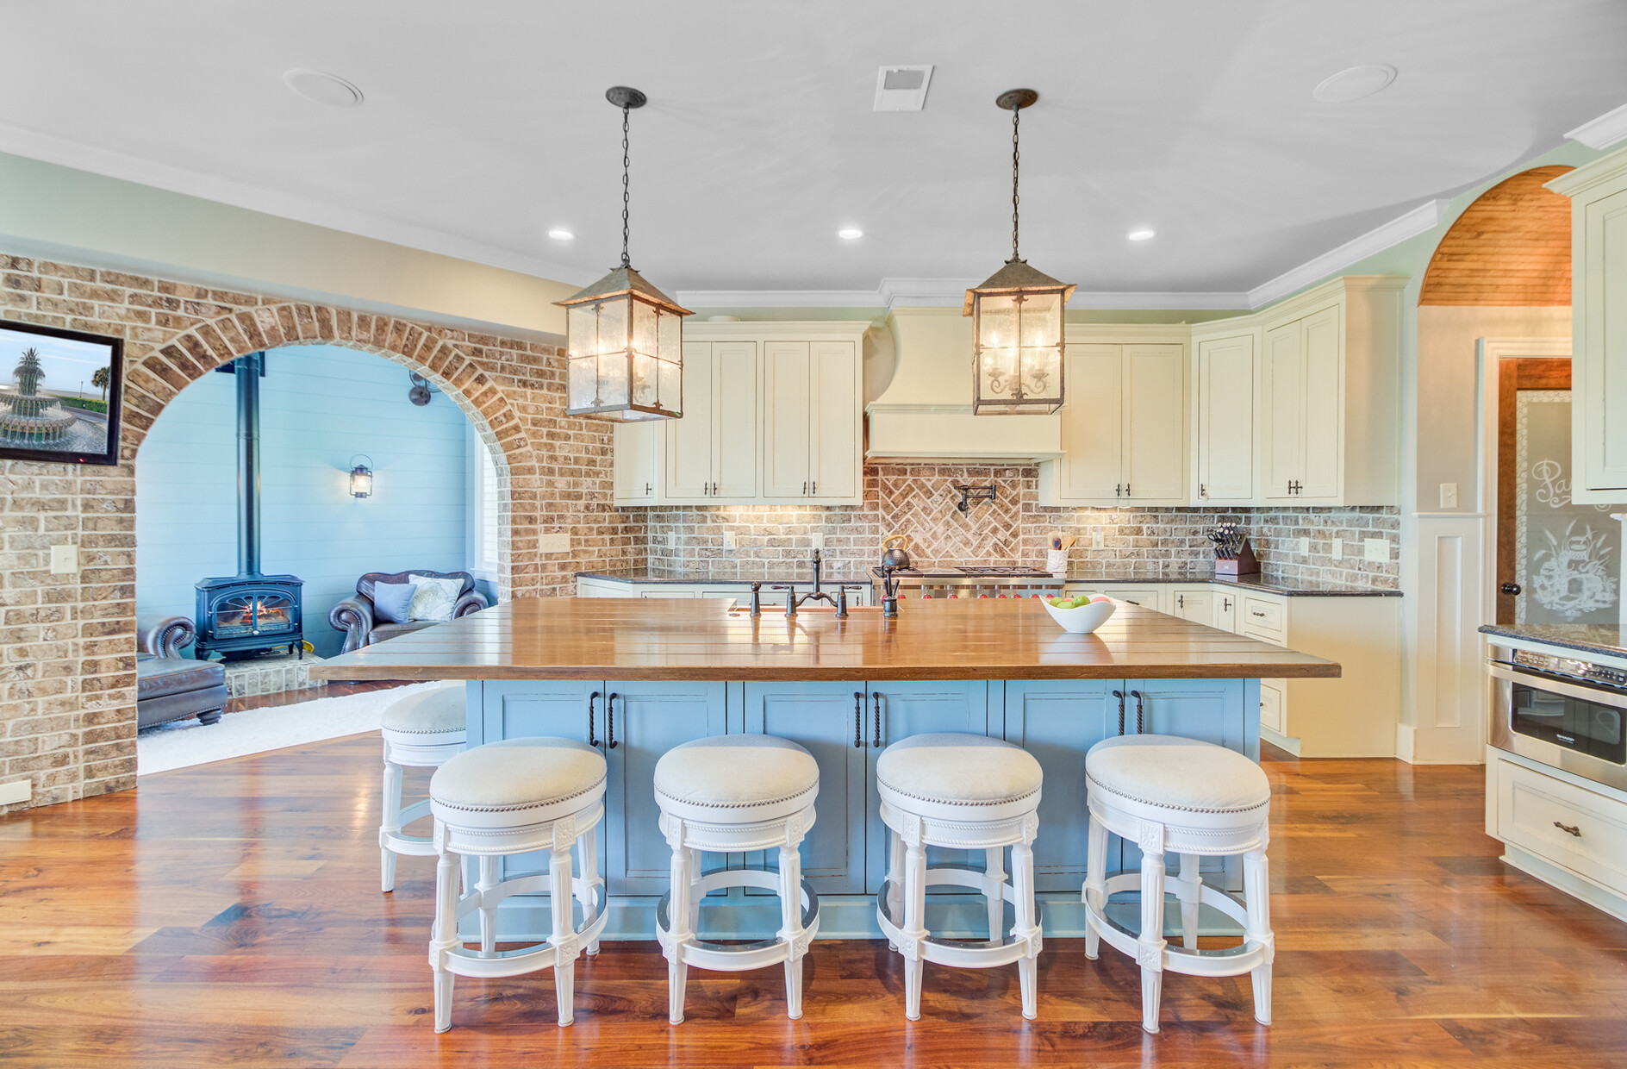
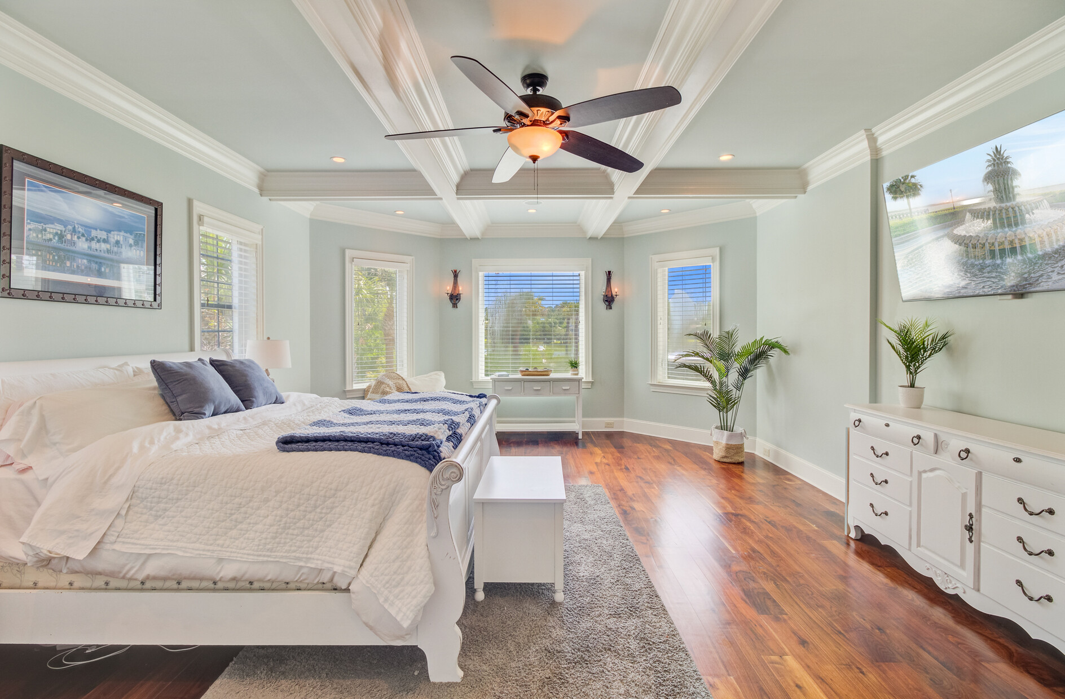
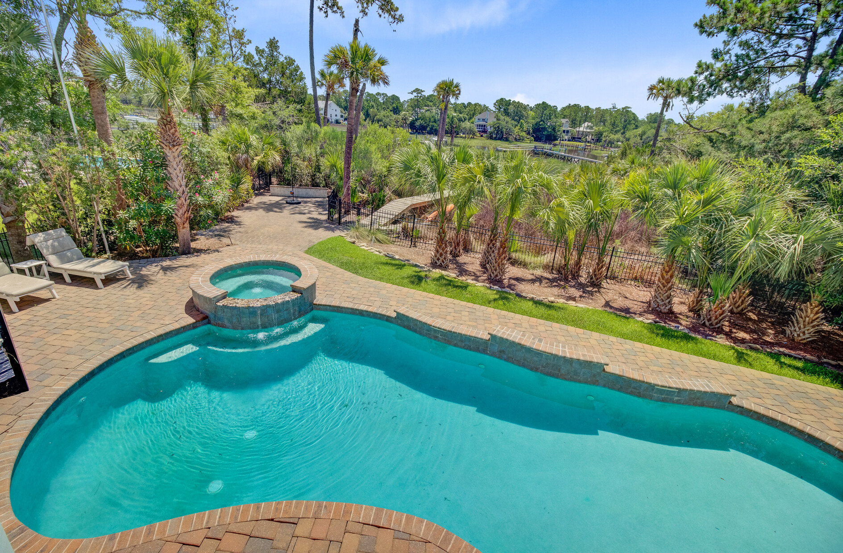
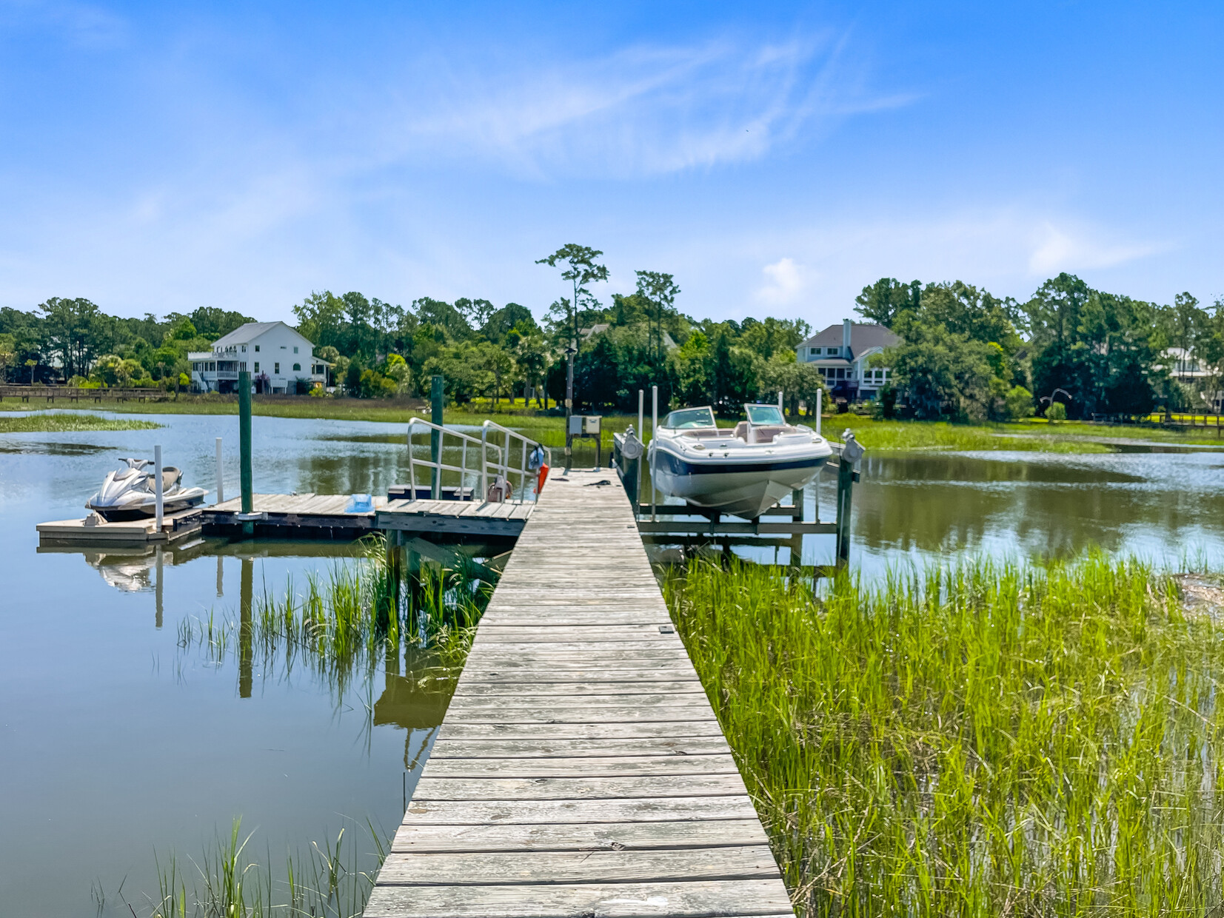



JUST LISTED - WATERFRONT LUXURY IN MOUNT PLEASANT'S PARK WEST!
2196 Beckenham Drive
Park West | Mount Pleasant, SC 29466 | MLS# 25020041 | $3,888,000
Video Tour
Virtual Tour
🏡 Lowcountry Luxury Meets Waterfront Living in Park West’s Masonborough
SELLERS ARE OFFERING 2.5% TO A BUYER AGENT
Experience the perfect blend of Lowcountry charm and modern luxury in this 7,900+ sq ft custom-built masterpiece at 2196 Beckenham Drive, Mount Pleasant. Set in the highly coveted Masonborough community, this elevated Southern beauty is on Darrell Creek with Wando River access from your private dock—complete with boat lift, floater, and jet ski pad.
Inside, you’ll find:
✅ Chef’s kitchen with massive island, copper farmhouse sink, and high-end appliances
✅ Private in-law/nanny suite for multigenerational living or guests
✅ Quaint keeping room off kitchen and lower level theater room and for endless entertainment
✅ Outdoor paradise with pool, spa, covered patio, private dock & serene marsh views
✅ Luxurious primary suite on the main level with spa-like bath & huge walk-in closet with washer and dryer
Located just minutes to Isle of Palms, Sullivan’s Island, award-winning schools, and 30 minutes to Downtown Charleston—this home offers a rare opportunity for luxury and lifestyle in one of the Lowcountry’s most desirable neighborhoods.
📲 Appointments can be requested through ShowingTime. Questions? Call Ellen O’Neil Properties at 843-300-8530 before this one-of-a-kind property is gone.
Video Tour
Ellen O'Neil
Broker/Owner, ABR, e-PRO, CNE
Charleston Realtor of Distinction
843-300-8530
www.EllenONeilProperties.com

