Slide 1
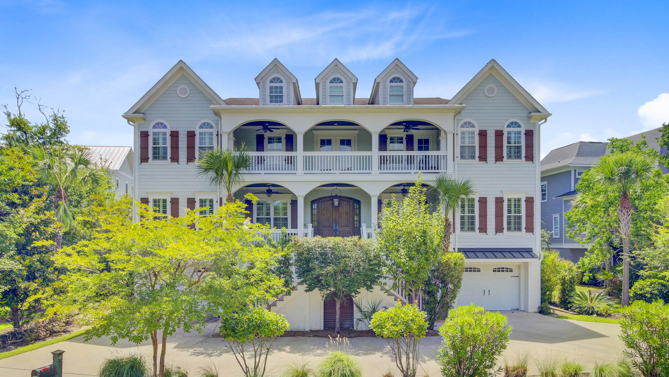



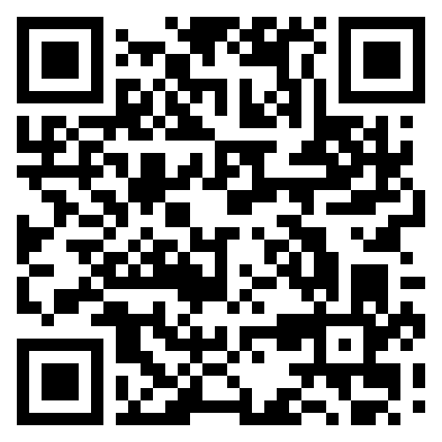
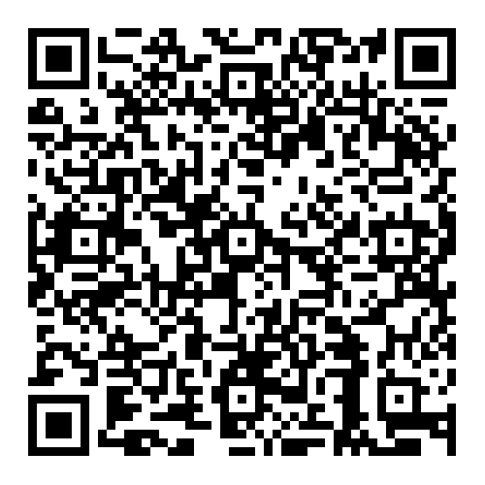
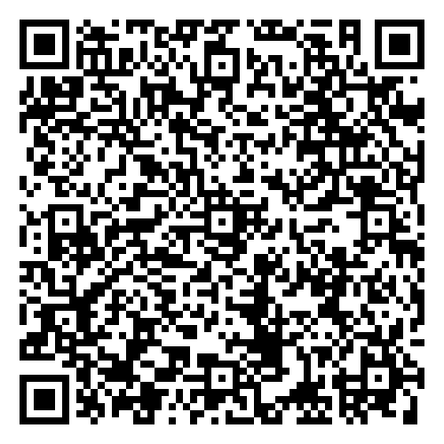
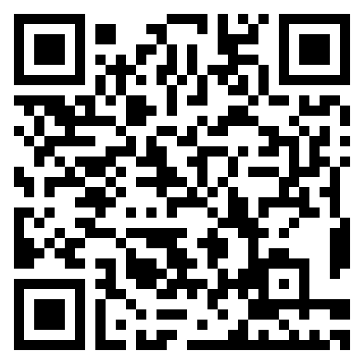

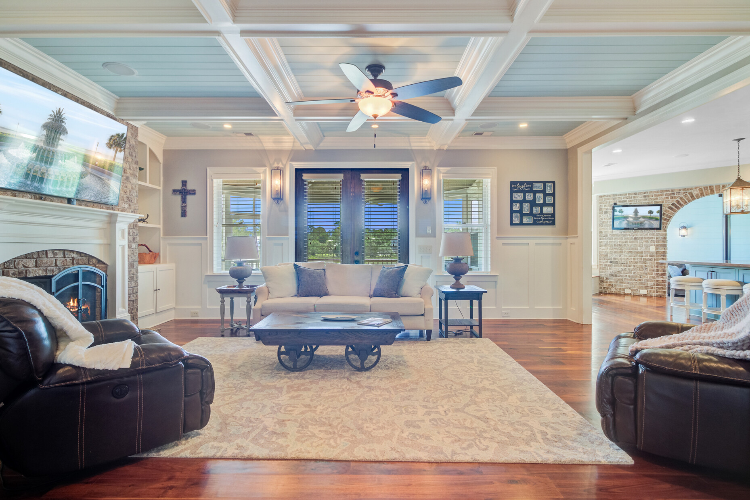
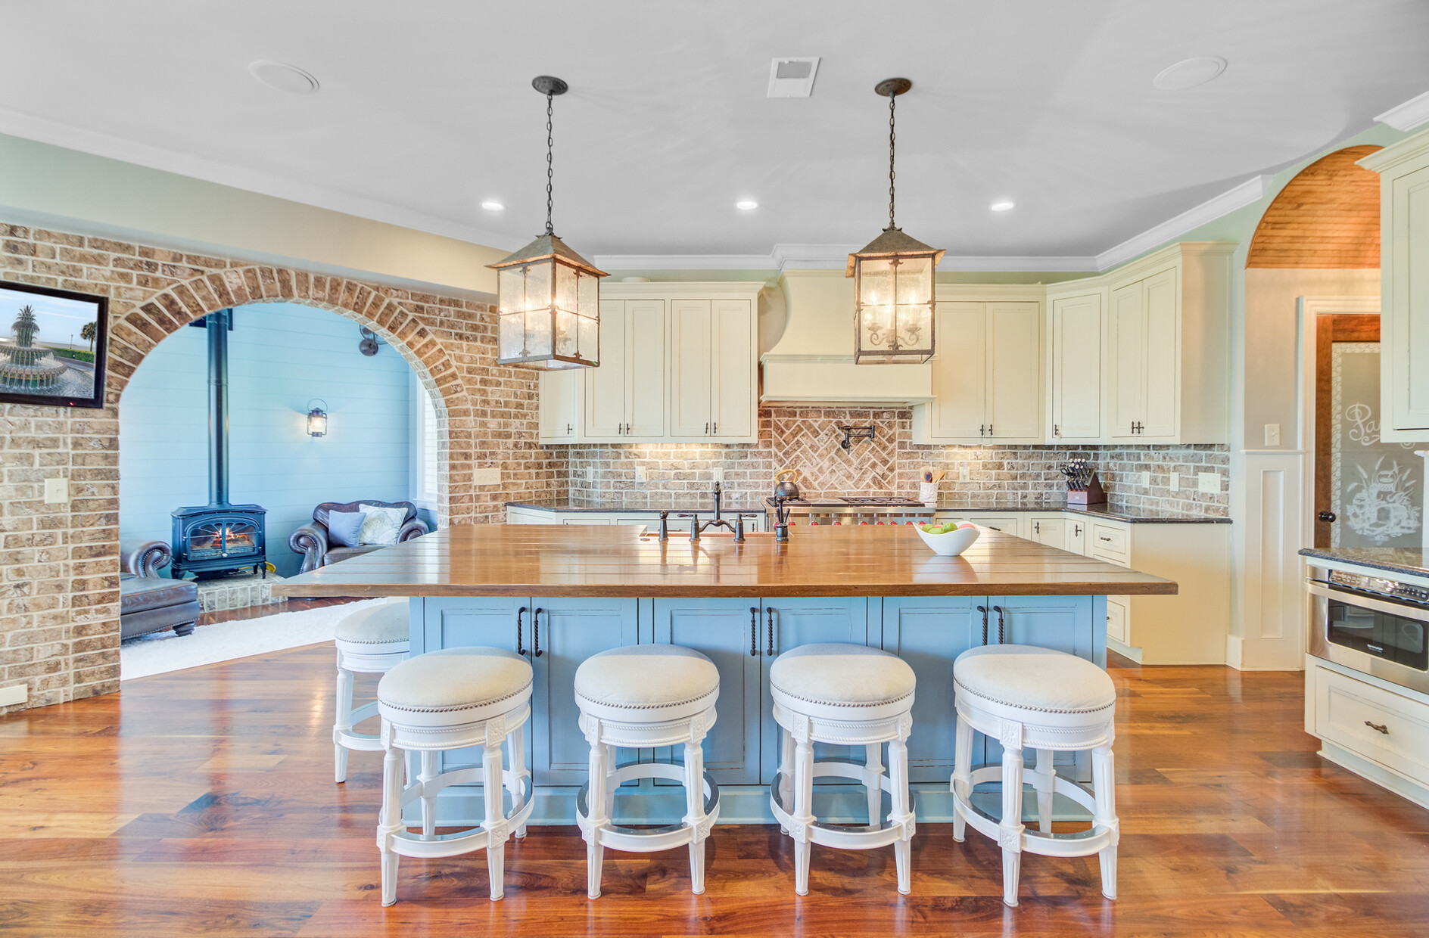
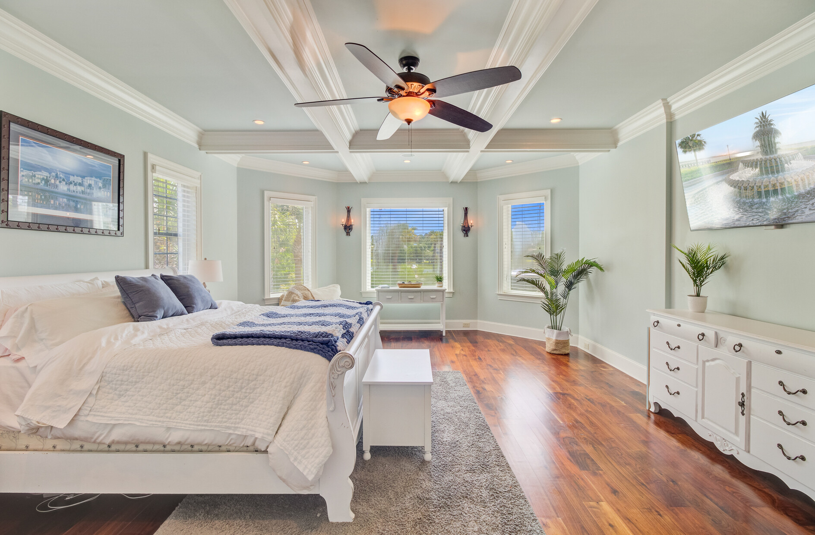
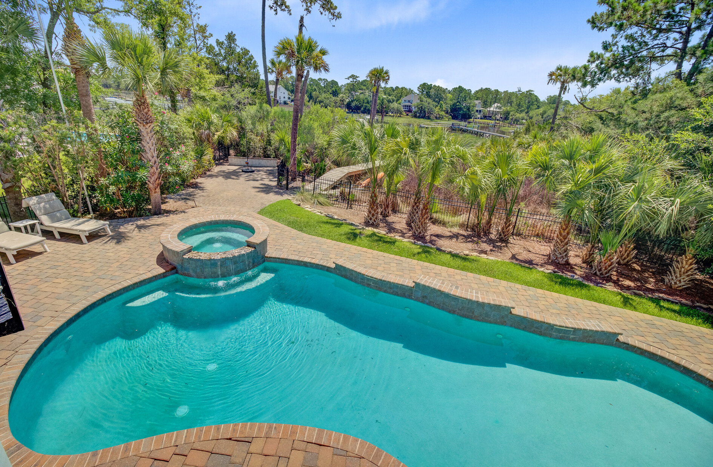
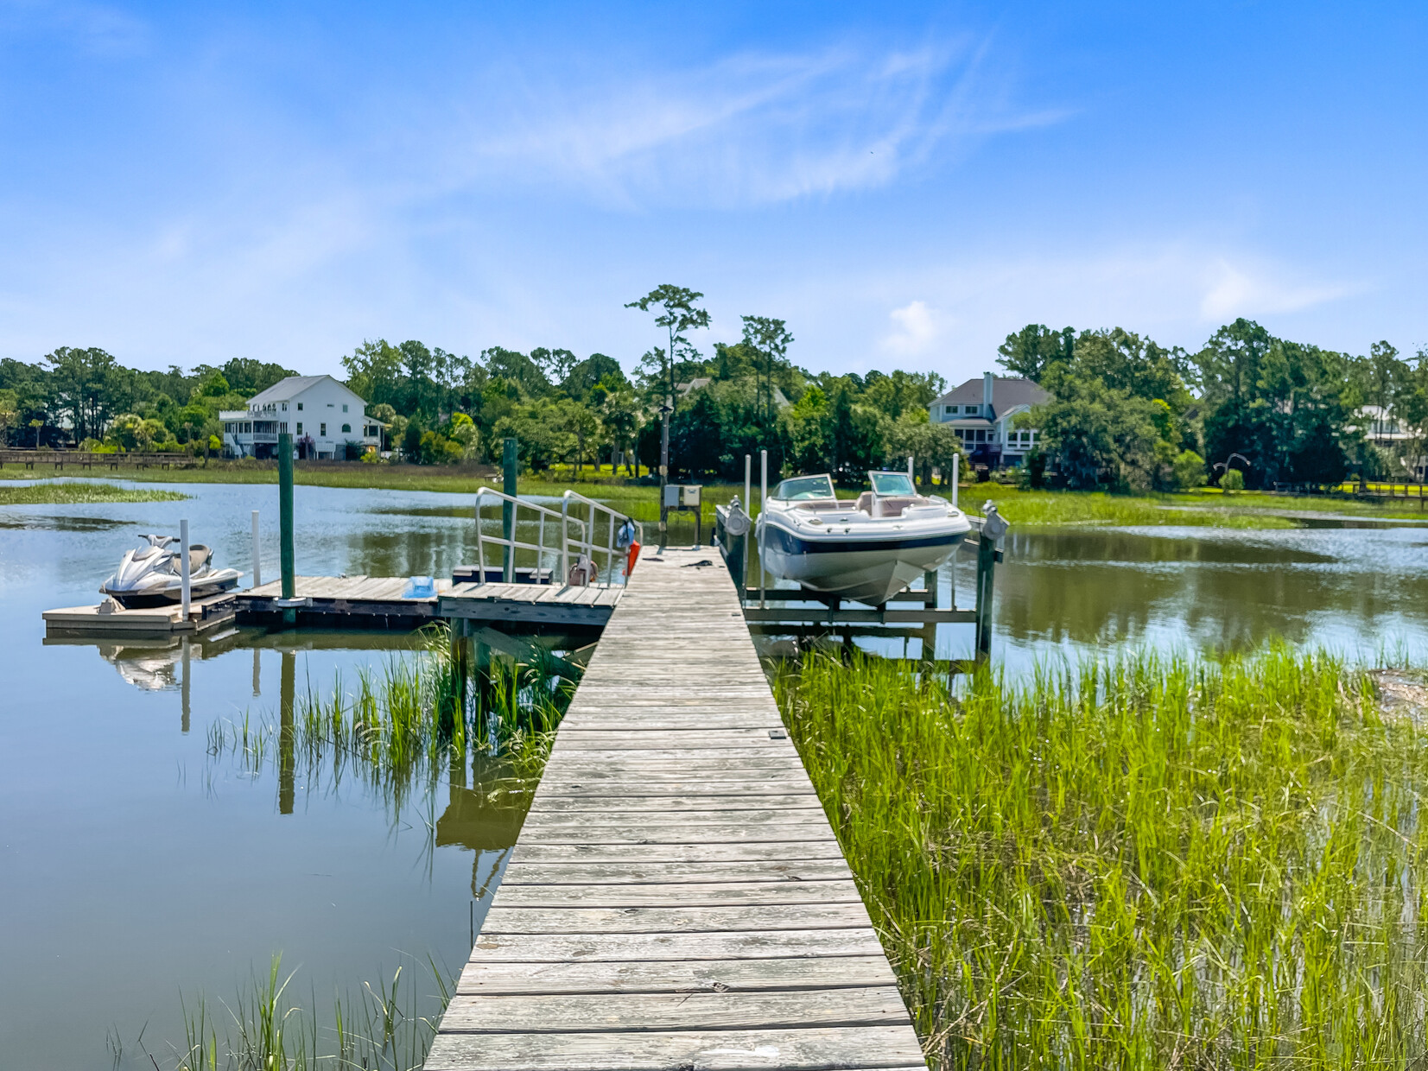



SIGNIFICANT PRICE IMPROVEMENT – WATERFRONT LUXURY IN MOUNT PLEASANT!
2196 Beckenham Drive
Park West | Mount Pleasant, SC 29466 | MLS# 25020041 | $3,599,000
Storybook
Video
🏡 This exceptional 7,900+ sq ft custom-built home in Masonborough at Park West combines timeless Lowcountry charm with unmatched luxury. Featuring 6 bedrooms, 6.5 baths, a chef’s kitchen, theater room, private dock with boat lift, and resort-style outdoor living with pool & spa—this home is designed for comfort, style, and unforgettable memories.
With a significant price improvement, now is the perfect time to make this Charleston masterpiece yours.
📲 Call Ellen O’Neil directly at 843-300-8530 to arrange your private tour or ask questions today!
Don’t wait—this rare opportunity won’t last!
Property Website | Storybook | Video Tour
Ellen O'Neil
Broker/Owner, ABR, e-PRO, CNE
Charleston Realtor of Distinction
843-300-8530
www.EllenONeilProperties.com

