Slide 1

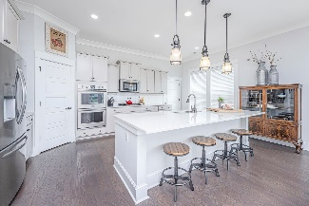
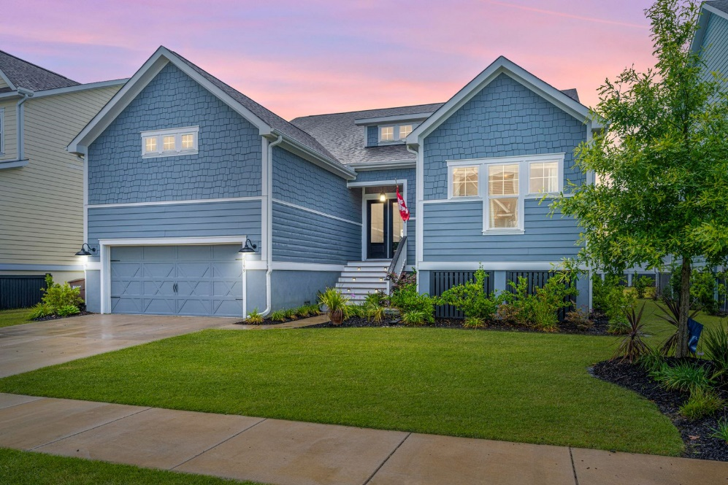
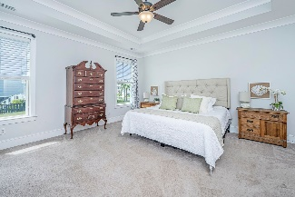
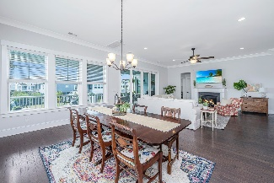
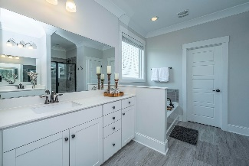
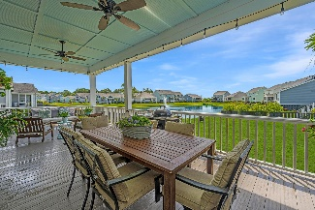
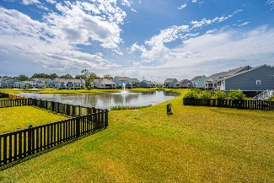
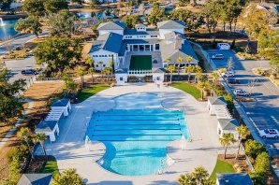
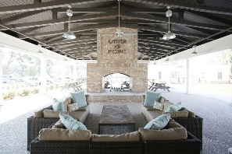
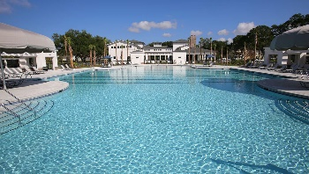
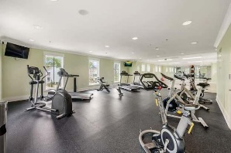
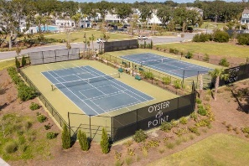


New Listing In Oyster Point
2199 Midden Drive Oyster Point | Mount Pleasant, SC 29466 | MLS# 21015148 | $875,000
Welcome Home! This beautiful Lowcountry, 5 bedroom, 3.5 bath home is located in the highly desirable neighborhood of Oyster Point. With first class amenities and a prime location, this home is sure to impress. Enter through the 8 ft. double doors into the grand foyer, with beautiful hardwood flooring, which opens to a large family room with a fireplace and a spacious dining area that can easily accommodate a large group. The ''chef's'' kitchen comes equipped with an oversized island with quartz countertops, tons of cabinetry, stainless appliances, double wall ovens, gas cooktop, glass subway back splash, and a large pantry. The laundry room is conveniently located off the kitchen. This home is an entertainer's dream with sliders that open onto an oversized back porch overlooking a beautiful pond and a neighborhood green space. The spacious owner's suite with tray ceiling is located on the first floor with pond views and access to the back porch. The owner's bath has dual vanities, spa garden tub, walk-in shower, and a large walk-in closet. Also located on the first floor are 2 additional bedrooms with walk-in closets, separate vanities, and a Jack/Jill bath. The second floor offers 2 large bedrooms with walk-in closets and an additional full bath, along with a loft for entertaining or a playroom/office. The two-car attached garage has tons of storage with built in shelving. Oyster Point's amenities include: an Olympic size zero entry pool, tennis courts, pickle ball courts, clubhouse, firepit, over 3 miles of walking/jogging/biking trails, fitness center, playground, kayak storage and a community dock; Conveniently located in the heart of Mt Pleasant, this home is 4 miles to beach, 1.5 miles to shopping at Towne Center, and a 15-minute drive to downtown Charleston.
Debbie Rogers (843) 990-2915
deborah.rogers@carolinaone.com
www.DebbieRogersSellsCharleston
Carolina One Real Estate | 2713 Highway 17 North | Mt. Pleasant, SC 29466

