Slide 1
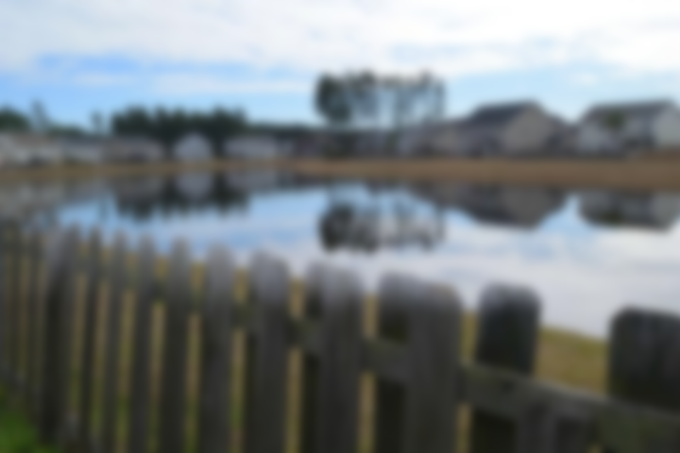
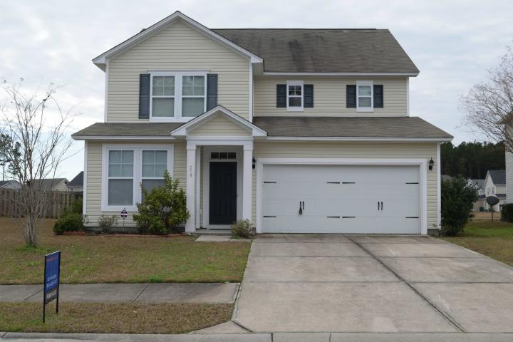
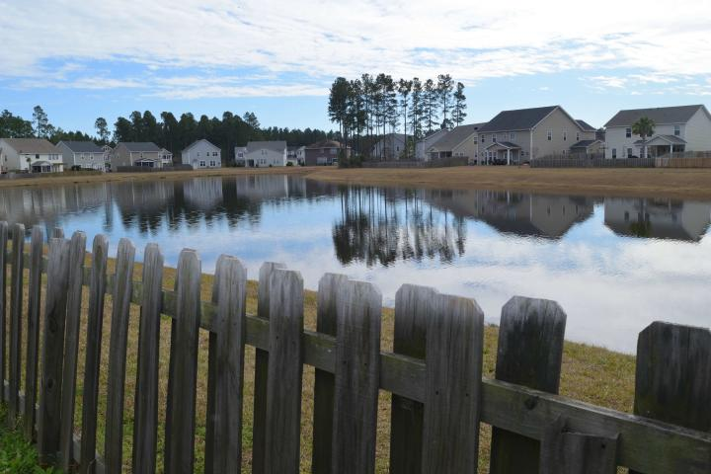
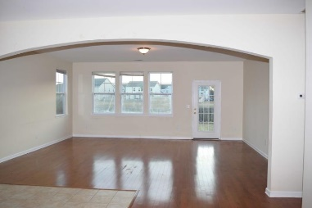
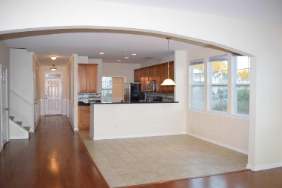
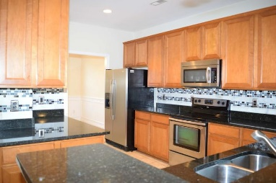
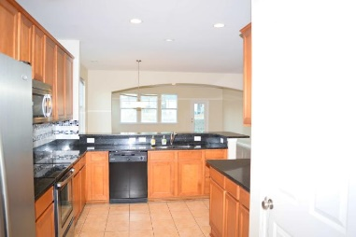
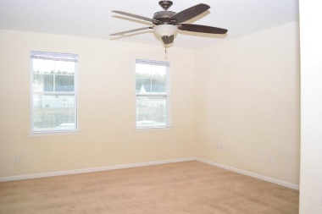
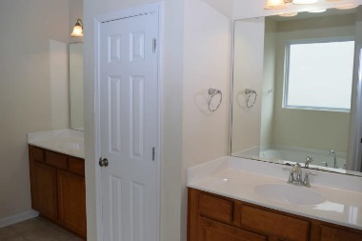
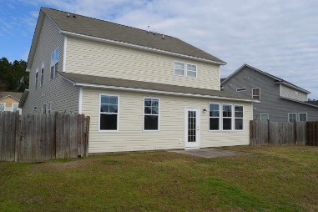
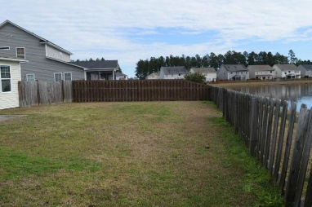
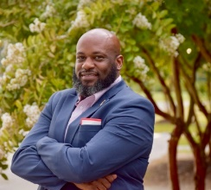

Open House Thursday 11a-2p
Check Out This Beautiful New Home
And Enjoy A Light Lunch
PRICE REDUCED!!! Must see!!!!!
219 Laurel Crest Way
Cane Bay Plantation | Summerville, SC 29486 | MLS# 20002520 | $300,000
This beautiful spacious home has 4BRs 2.5BAs with a HUGE entertainment room and a Master Down! Has 42" Maple Cabinets with crown molding, All Stainless Appliances including 25 cu. ft Satina Refrigerator, Granite countertops with stainless under mount sink, ceramic tile in kitchen / café area. Energy Star Certified home. Separate shower and garden tub in master bath, adult height dual vanities in master bath. Rinnai tankless hot water heater.
Kevin Kizer
C 843-743-6992 | O 843-410-9247
kevin.kizer357@gmail.com
Dream Realty SC LLC
3204 Heaton Dr
Ladson, SC 29456
www.kevinkizerhomes.com

