Slide 1
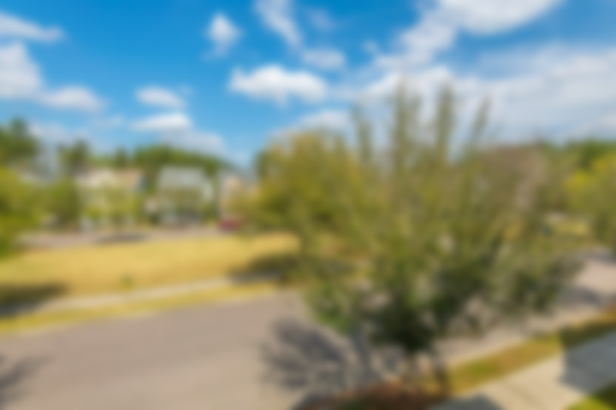
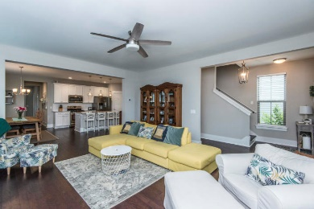
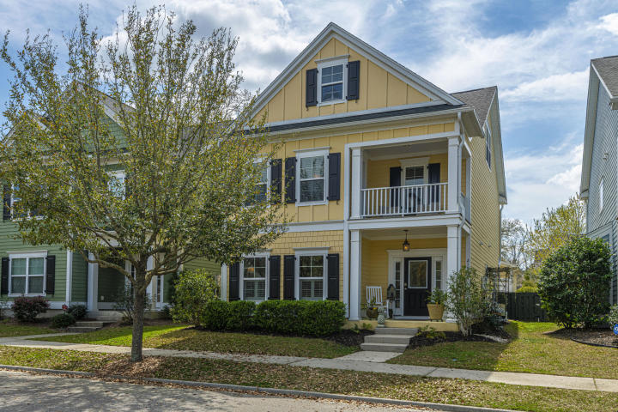
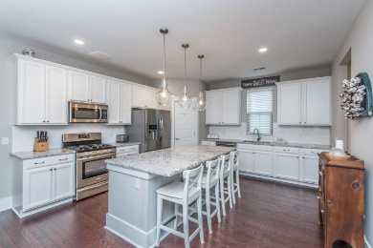
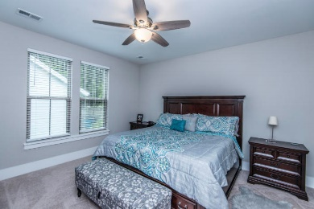
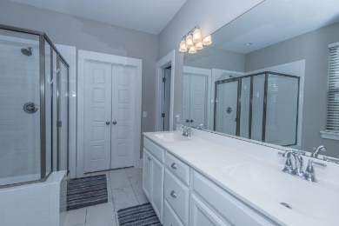
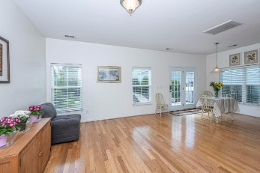
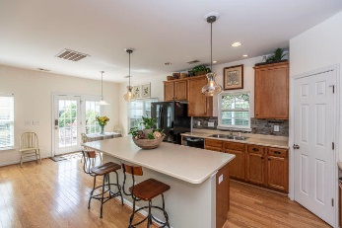
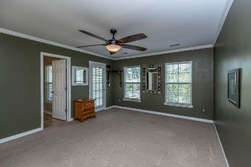

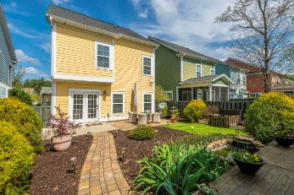


Move in Ready!!
219 Lotz Drive
The Ponds ~ Summerville, SC 29483 ~ MLS# 20008116 ~ $285,900
If your Buyer is looking for a Slower pace and a Move-in-Ready home, Bring them Now!
This beautiful, well kept home with a balcony over looking a park, in The Ponds, is ready for you NOW! The Ponds offers miles of walking trails, a lake for kayaking, numerous opportunities for social gatherings. Everything you need for relaxation when you leave work and need to unwind and live a little. When you enter this 3 story home, you are greeted by a spacious foyer and hardwood flowing throughout the downstairs. The private office is to the left (could be used as a formal dining room if prefer). Past the half bath you enter into the main living area, where you will spend quality family time. The kitchen with an island, ample cabinets, 2 pantries, is open to the family room. Patio is located off the eat-in area for extended entertaining or grilling. Or for quiet/reflective moments you can sit in the back on the deck next to the Koi pond. Back inside, upstairs on the second floor find the spacious master bedroom with its own private balcony for early morning coffee or an adult beverage to unwind at the end of the day. Master bath has a garden tub, separate shower, granite counter with dual sinks, walk-in closet and a water closet. Two additional secondary bedrooms, a full bath and the laundry are down the hall. Continue to the third floor to find the 4th bedroom (has a closet) or could be a bonus room with another Full bath! There are storage areas in the 3rd floor, as well as numerous closets throughout the home. This home has the space you need indoors, and the life style you need outdoors. This home has lots of extras, including a vent over the stove to the outside.
Call today for your private showing and to see the details in person.
Laurie Loparo
(843) 442-1290 | laurieloparo@gmail.com
www.lauriesellscharleston.com
Carolina One Real Estate | 873 Orleans Road, Ste 102 | Charleston, SC 29407-5753

