Slide 1
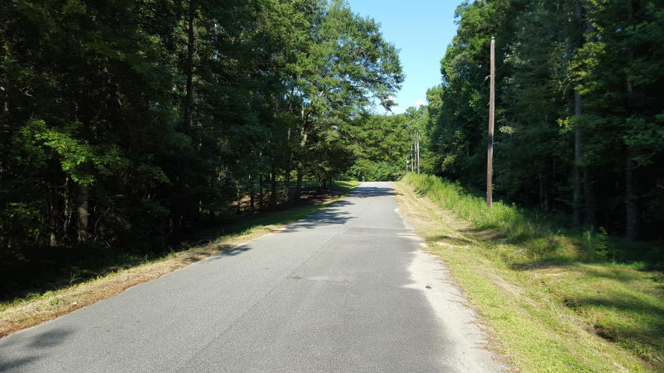
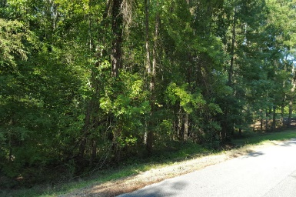
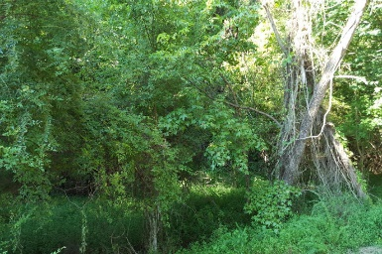


219 Ridge Lake Drive
Summerville, SC 29483 ~ MLS# 15021649 ~ $38,000
Beautiful1.47 acre
Wooded Lot in Dorchester 2
This is a beautiful wooded lot just waiting for your home!
Country life minutes from town!
NO HOA!
Road ends in a cul-de-sac and there are some beautiful homes built in this area!
This lot was previously permitted for a septic system.
Christopher McCormick
Office - 843-974-6200
Cell - 843-224-3204
cjmccormick@carolinaone.com
Carolina One Real Estate
900 N Main St
Summerville, SC 29483

