Slide 1

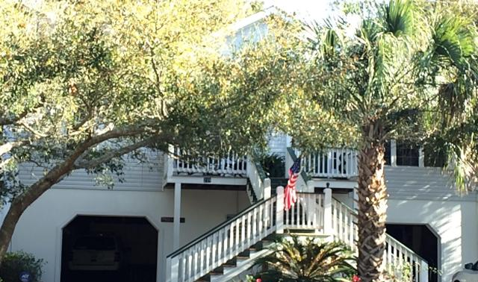
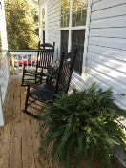
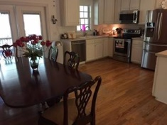
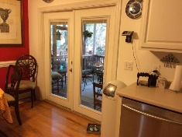
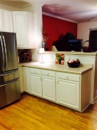
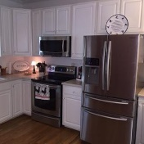
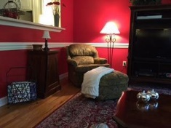
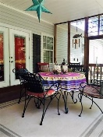
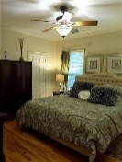
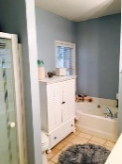

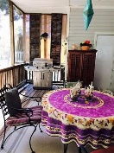
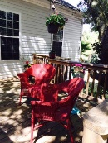
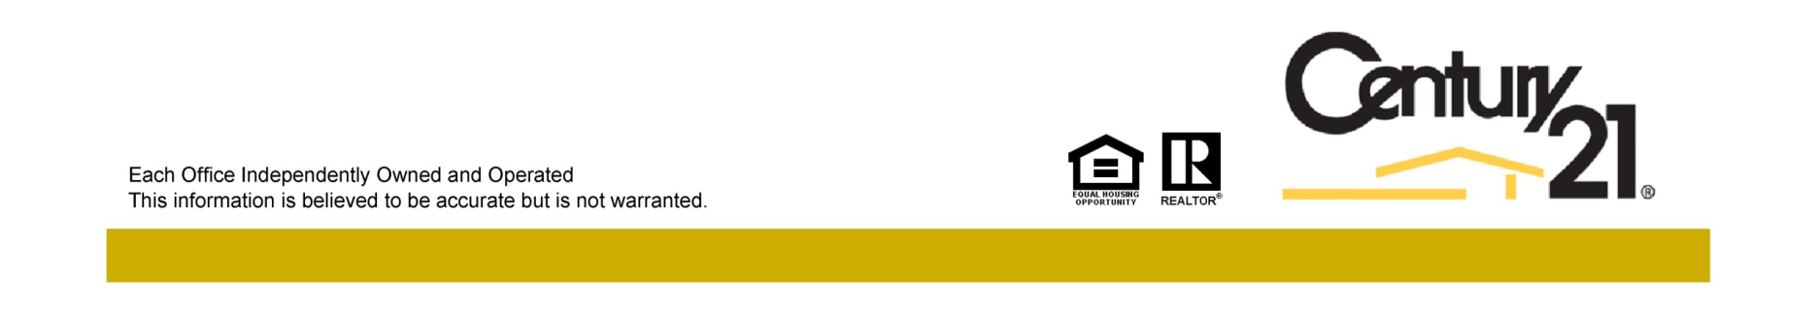
Just Reduced
Jane Locke, Realtor
M (843) 819-3508
lockejaneb@aol.com
www.century21properties.com
219 W Indian Avenue | Folly Beach, SC | MLS# 16008764 | $769,500
Want to own your own dream home at the beach? This home is move-in ready - just bring your toothbrush. This is a fully furnished turn-key home ready for you and your family. Only a 3 block walk to the ocean or to downtown Folly Beach or a short drive to the historic city of Charleston. Enjoy quiet solitude on your screened porch or deck overlooking your private wooded backyard. All hardwood and tile floors throughout, with ceiling fans in every room. Lower level includes a work out room and spacious 2 car garage that has lots of storage, and plenty of room for a golf cart, kayaks, bicycles or even a motorcycle. This freshly painted home has many brand new furnishings allowing you to move in tomorrow. This is a once in a lifetime opportunity to experience beach living at its finest!
Century 21 Properties Plus | 3301 Salterbeck St Suite 100 | Mt. Pleasant, SC 29466

