Slide 1

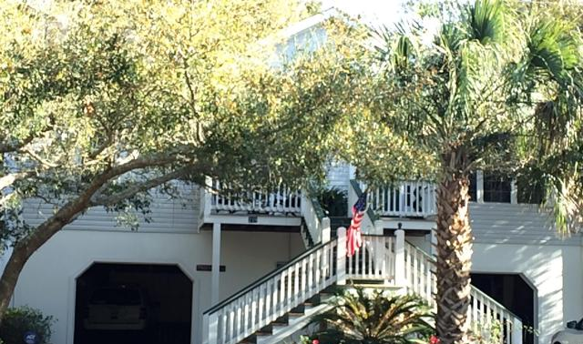
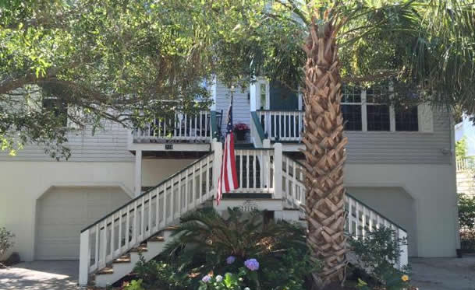
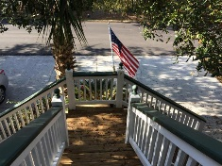
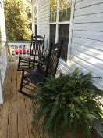
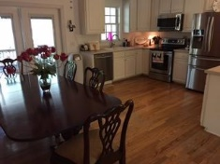
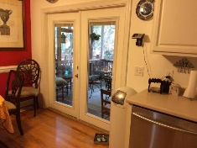
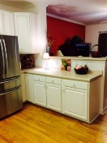
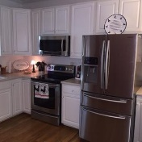
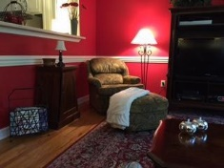
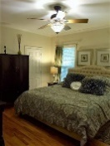
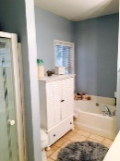
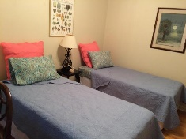
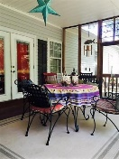
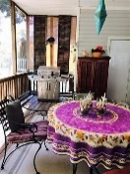
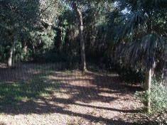
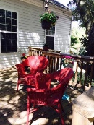
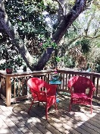
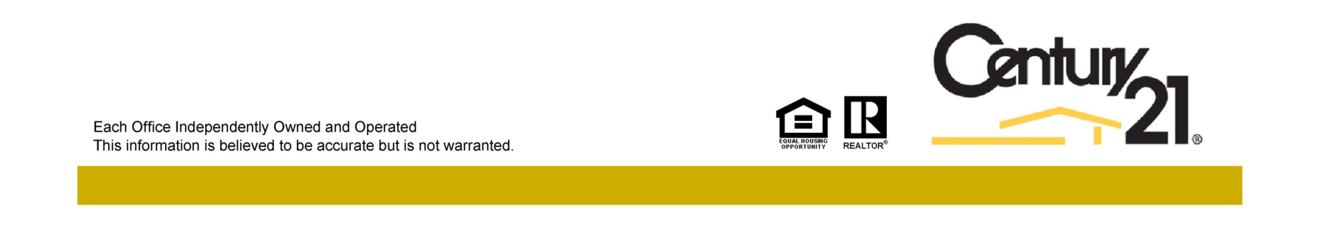
Major Price Reduction!
Jane Locke, Realtor
M (843) 819-3508
lockejaneb@aol.com
www.century21properties.com
219 W Indian Avenue | Folly Beach, SC | MLS# 16008764 | $629,000
DRAFT
Want to live in paradise? Only a 3 block walk to the ocean or to downtown Folly Beach or a short drive to the historic city of Charleston. Enjoy quiet solitude on your screened porch or deck overlooking your private wooded backyard. All hardwood and tile floors throughout, with ceiling fans in every room. Lower level includes a work out room and spacious 2 car garage that has lots of storage, and plenty of room for a golf cart, kayaks, bicycles or even a motorcycle. This freshly painted home is waiting for you to enjoy. Just make an offer. This is a great opportunity to experience beach living at its best. Sellers must relocate so come check out this nice home.
Century 21 Properties Plus | 3301 Salterbeck St Suite 100 | Mt. Pleasant, SC 29466

