Slide 1
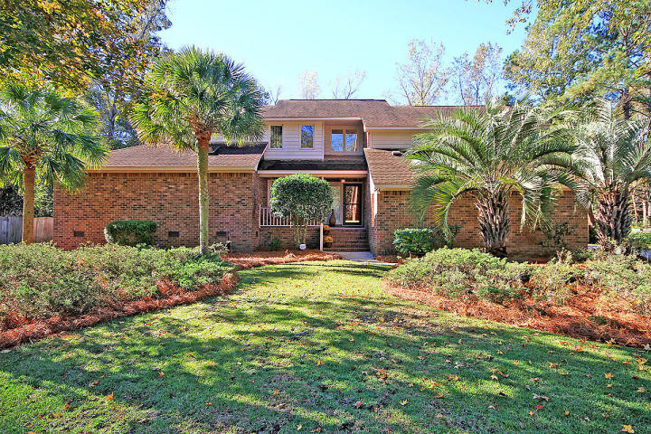
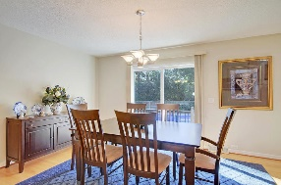
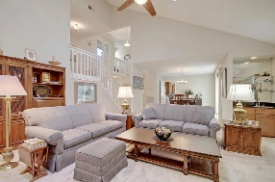
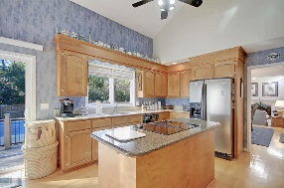
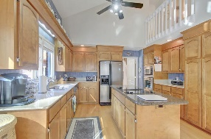
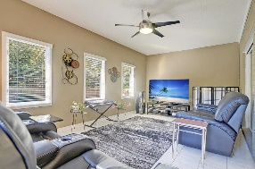
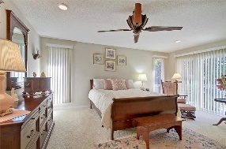
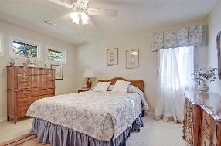
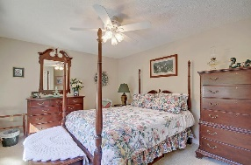
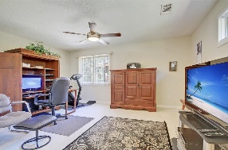
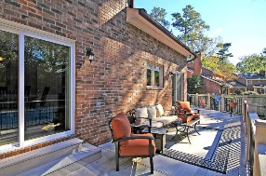
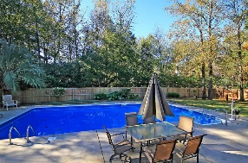
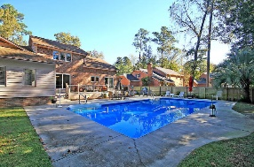


Summerville Beauty with Inground Pool!
219 Brandywine Drive
Ashborough East
Summerville, SC 29485
MLS# 20031310
$425,000
4 Bedrooms | 2½ Baths | 3,050 sf
Welcome home! This house is the one you've been waiting for! Located in the established neighborhood of Ashborough East and in the Dorchester District 2 schools, this home has so much to offer including a built in pool! Upon entering, you'll notice the open floor plan with tons of natural light and vaulted ceilings. The living room has plush carpeting, fireplace and a wet bar. Off of the living room is a large sunroom, perfect for relaxing in. The dining room has sliding doors offering access to the back deck. The kitchen offers ample storage, island, sink overlooking the backyard pool area and a large eat in area with back deck access. The master is located on the first floor and also has access to the back deck, a sitting area, large master bath with a walk in closet, huge jetted tub, dual vanities and separate commode area. The laundry room is just down the hall with a sink, room for an additional refrigerator and more storage. Upstairs, you'll find a large bedroom which could be used as a bonus room, that offers attic storage. Down the hall are two more good sized bedrooms with ample closet space as well as a full bathroom. Head back downstairs and outside to view the amazing backyard! This backyard is paradise on earth! Huge 20X40 in-ground pool with surround patio and completely fenced in. Large grassy area still gives you plenty of room to play! Ashborough East is a sought after neighborhood offering a community pool, tennis courts, playground and walking trails. It is conveniently located to plenty of shopping and a short drive to the airport, Boeing, Bosch, Mercedes and Volvo. Come see this home today!!
Larry & Kathy Mazalatis
Larry Cell 843-693-0529
Kathy Cell 843-693-0159
Office 843-871-9133
AGENTOWNED PREMIERE GROUP | 1800 TROLLEY RD | SUMMERVILLE, SC 29485

