Slide 1

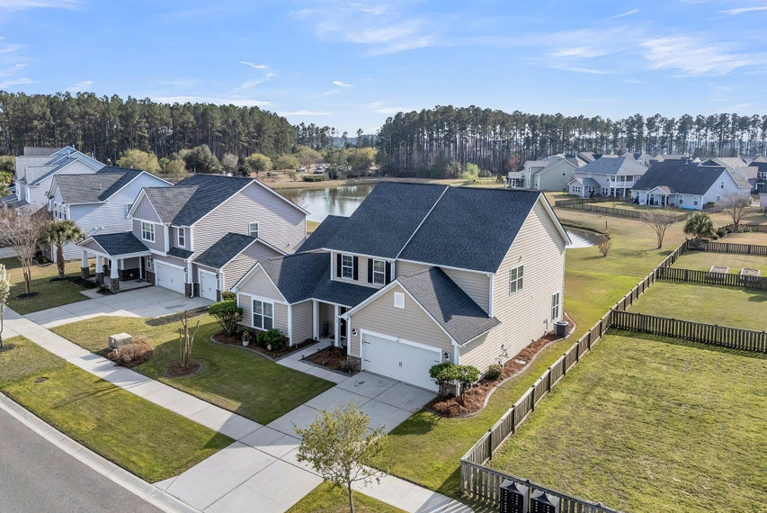
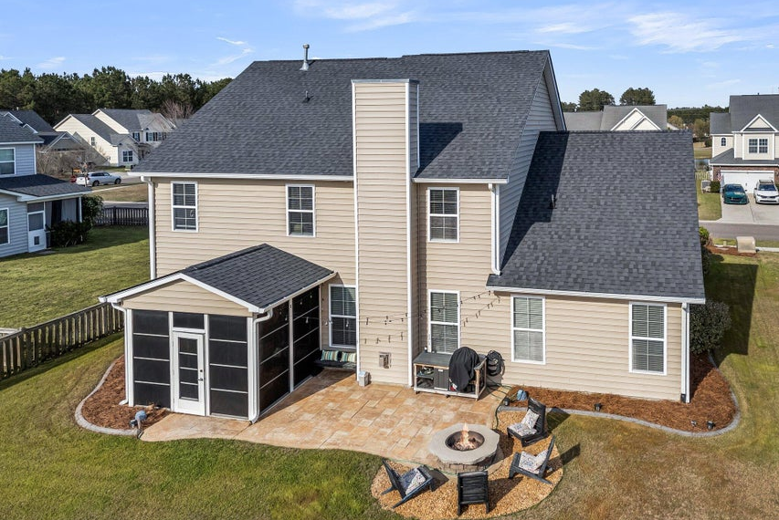
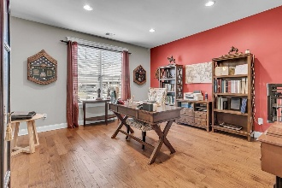
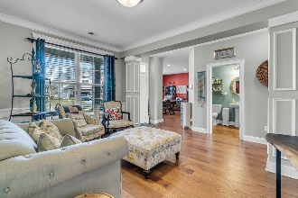
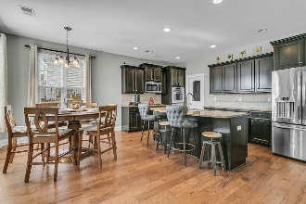
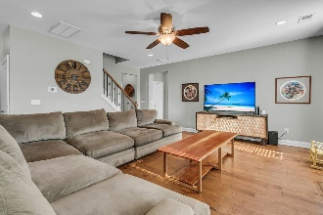
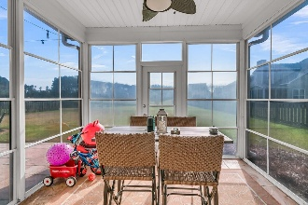

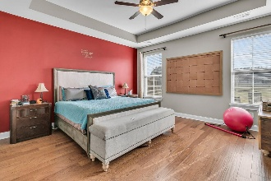
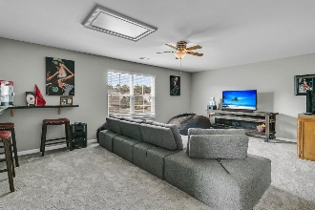
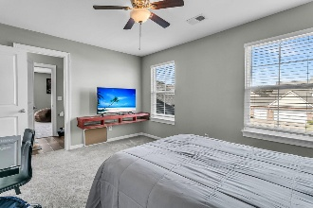
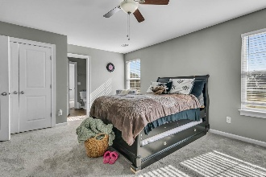
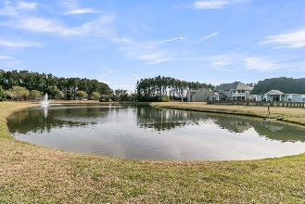
Room to Grow in Cane Bay
Gourmet Kitchen, Loft, & More!
Debbie Cromer
ABR, RSPS, REALTOR, CRS
(843) 437-6342
debbie@debbiecromer.com
www.debbiecromer.com
219 Daybreak Boulevard
Cane Bay Plantation | Summerville, SC 29486 | MLS# 25007647 | $468,000
Exceptional pond-view 4 BR / 3.5 BA home in Cane Bay with 3,170 sq ft of living, built 2013 and loaded with upgrades. The foyer opens to a private study (perfect for remote work) and a separate dining room for entertaining. The gourmet kitchen shows double wall ovens, gas cooktop, granite tops & espresso-maple cabinets, all flowing into the living area with fireplace. Enjoy morning coffee or evening fire-pit gatherings from the screened porch and paver patio with tranquil pond views. Downstairs features the primary suite w/ tray ceiling & deluxe bath; upstairs you'll find three bedrooms, two full baths & a versatile loft. Extras: hardwoods in main living, upgraded trim package, roof replaced 2019, tankless water heater, 2-car garage, just 0.22 acre lot backing to water + trees.
Newly priced at $468K … one of the best value 3,100 + sq ft homes in Cane Bay.
TAKE A VIRTUAL TOUR | PROPERTY WEBSITE
Century 21 Properties Plus | 1090 Park West Blvd; Ste 103 | Mount Pleasant, SC 29466

