Slide 1

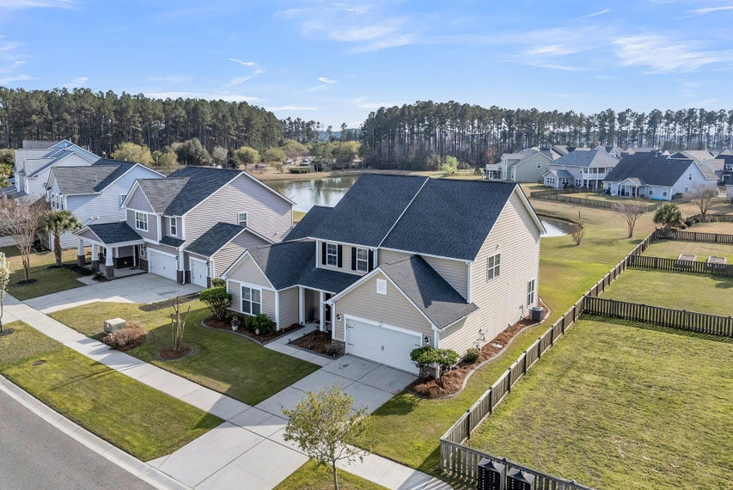
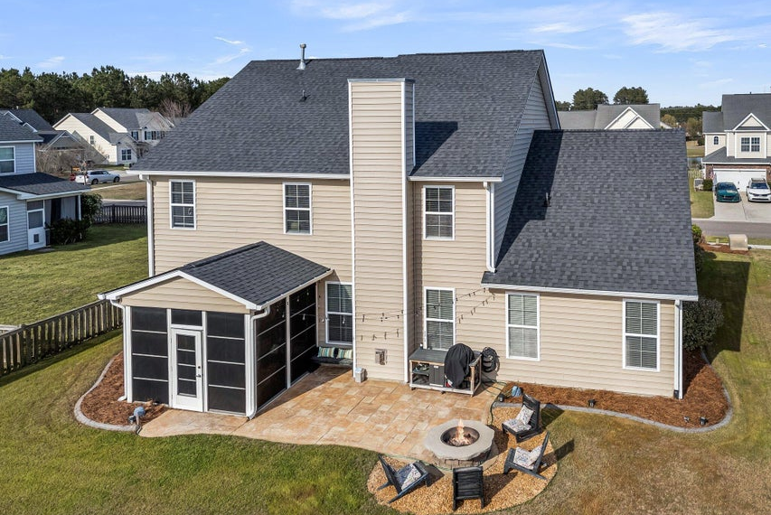
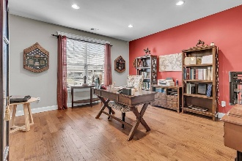
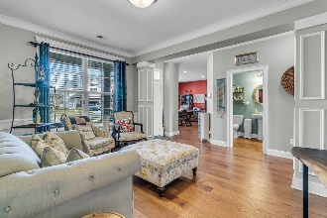
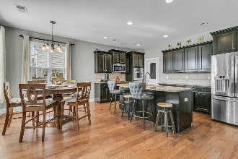
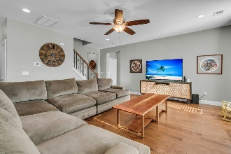
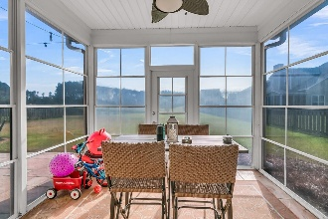

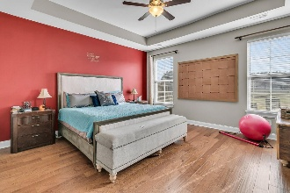
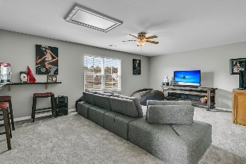
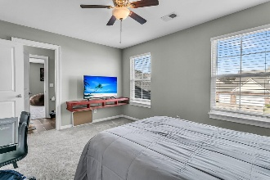
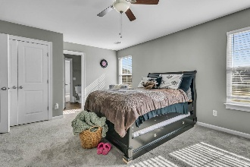
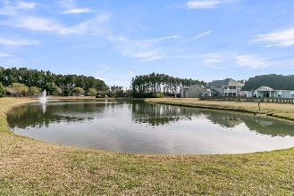
Easy Show + 2.5% to You!
Price Improved!
Debbie Cromer
ABR, RSPS, REALTOR, CRS
(843) 437-6342
debbie@debbiecromer.com
www.debbiecromer.com
219 Daybreak Boulevard
Cane Bay Plantation | Summerville, SC 29486 | MLS# 25007647 | $485,000
Great new price on this spacious 4-bedroom, 3.5-bath home in the heart of Cane Bay Plantation that offers a functional layout & beautiful finishes throughout. The foyer opens to a private study—ideal for working from home—and a separate dining room perfect for entertaining. The gourmet kitchen features stainless steel double wall ovens, gas cooktop, granite countertops, ceramic tile backsplash, espresso-finish maple cabinets w/ crown molding & double pull-out shelves, all flowing into a cozy breakfast nook & large family room w/ gas fireplace. Enjoy tranquil pond views from the screened porch or gather on the paver patio w/ fire pit. The downstairs primary suite boasts a tray ceiling & deluxe bath, while upstairs you'll find three spacious bedrooms, two full baths, & a versatile loft.
Additional highlights include hardwood floors in the main living areas, an upgraded trim package w/ RB-3 casings & 5 1/4" baseboards, a roof replaced in 2019, & a newly installed tankless water heater for added efficiency.
TAKE A VIRTUAL TOUR
Century 21 Properties Plus | 1090 Park West Blvd; Ste 103 | Mount Pleasant, SC 29466

