Slide 1
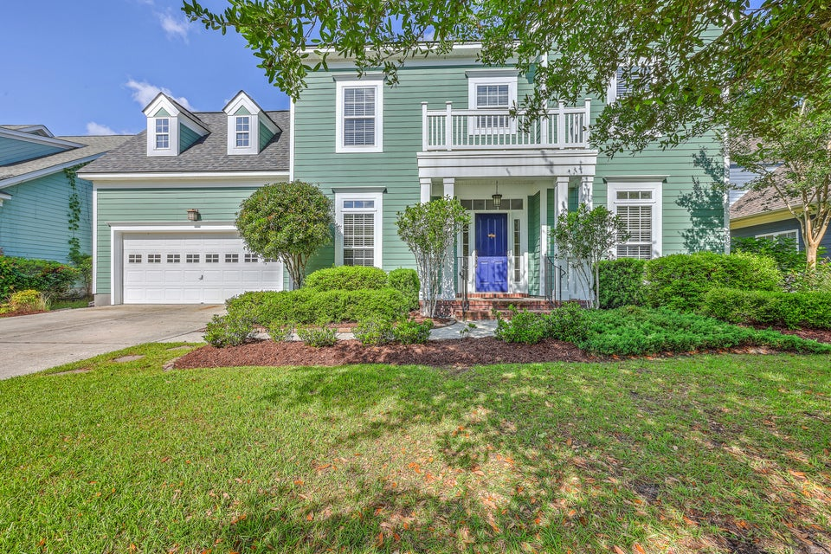
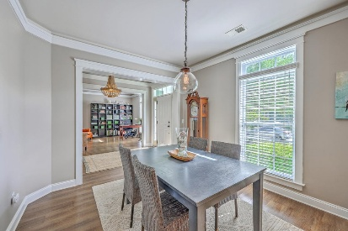
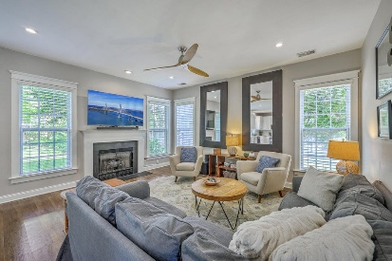
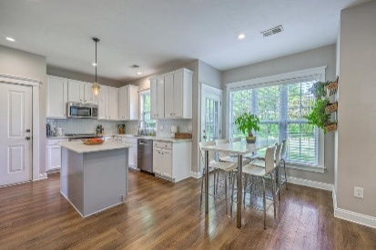
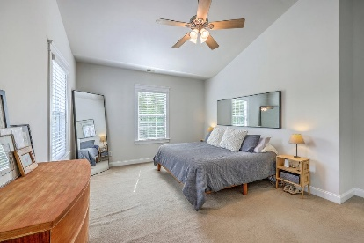
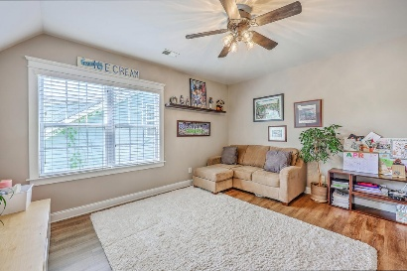
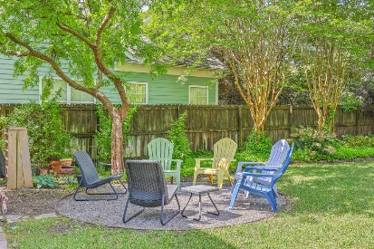
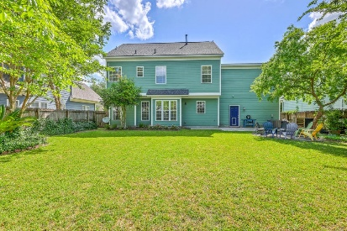


219 Silverwood Lane
Legend Oaks Plantation | Summerville, SC 29485 | MLS# 25012057 | $450,000
OPEN HOUSE
SUNDAY 5/18 FROM 1-3
$10,000 SELLER CREDIT
Beautiful home with modern updates and an exceptional layout is a must see! Step into this spacious and stylish home and be wowed by the attention to detail. The open floor plan flows seamlessly from room to room, ideal for both everyday living and entertaining. A brand new roof, newer HVAC, newer stainless appliances and LVP flooring ensure peace of mind and contemporary appeal. The flex room off of the foyer, currently used as a home office offers versatility to suit your lifestyle. The kitchen is a true standout, featuring solid surface countertops, a center island, 42'' cabinets with crown moulding, a wide pantry and a light-filled eat-in area. A separate dining room provides a formal space for gatherings. Upstairs, the primary en-suite impresses with cathedral ceiling, a garden tub, separate shower, and dual vanities. The bonus room, which is generously sized, can serve as a 5th bedroom, media space, playroom, or home gym. Enjoy the outdoors in the spacious backyard with partial fencing and a cozy fire-pit area, perfect for relaxing or entertaining. Award winning DD2 schools with Beech Hill elementary in walking distance. Membership to Legend Oaks Plantation golf and pool is an additional fee but not mandatory to join. Don't miss this well maintained, move-in ready home with room for everyone and upgrades throughout!
Enjoy a virtual tour!
Beth Mandell
M 803-463-7734 | O 843-871-2121
bmandell@century21properties.com
www.bestcarolinahomedeals.com
Century 21 Properties Plus of Summerville | 568-A Savannah Highway | Charleston, SC 29407

