Slide 1
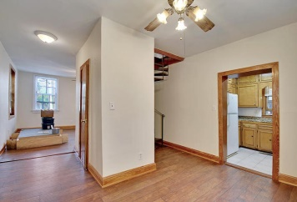
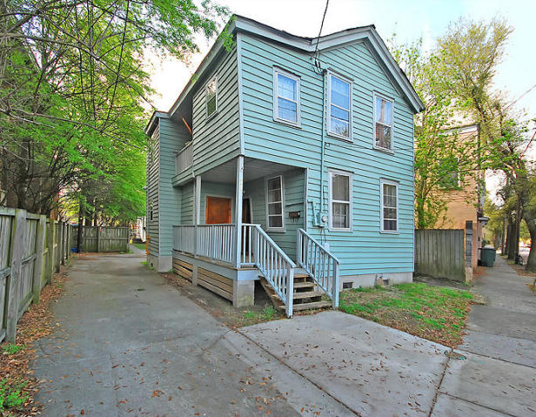
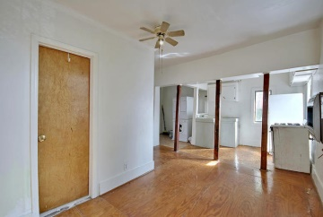
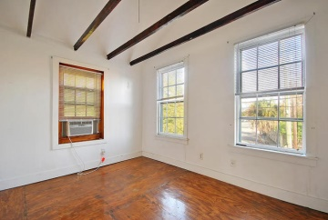
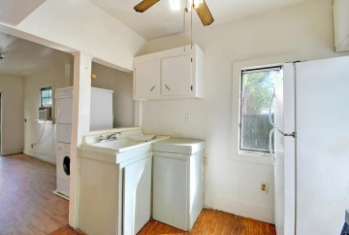
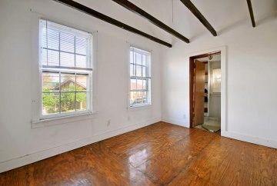
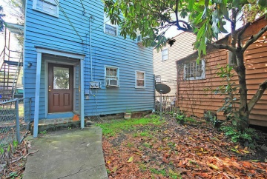
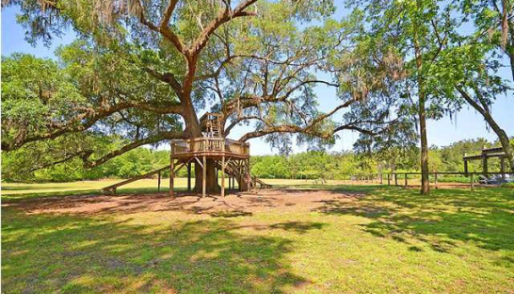
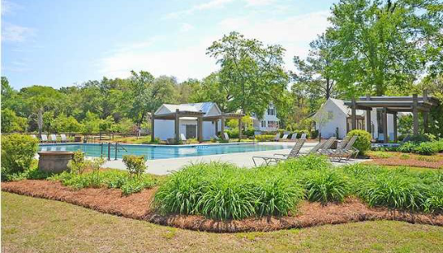
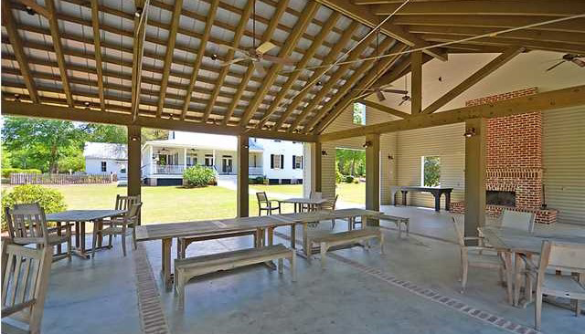

21 Chapel Street | Units A, B, & C Mazyck-Wraggborough | Charleston, SC 29403 MLS# 15008060 | $ 697,719
Attention Investors!
NO FLOODING HERE!!
Properties like this one do not come on the market often. Three rental units in downtown Charleston close to everything! OFF STREET PARKING…3 parking spots in the back and 2 spots in the driveway. 98% occupancy on these units in the past 2 years. Unit A has a New HVAC, New roof 2009, marble in the kitchen & bathrooms, New stove, New refrigerator, New foundation, all thresholds are hand-made from African Sapele wood (type of mahogany), Drainage system installed for standing water removal, Unit B has New heating system 2015. PRIME LOCATION! You can walk the gorgeous Ravenel Bridge or visit Charleston’s Market, both just 1 mile away. The College of Charleston, Charleston Law School & Marion Square are an easy walk or bike ride. Walk only 4 blocks to King Street's famous shopping or Meeting Street's best restaurants. Only 3 blocks to the South Carolina Aquarium. The Bier Garden restaurant is just across the street and the Post Office is only 1 block away. Harris Teeter & Bi-Lo (grocery stores) are within 4 blocks. Just one mile to the interstate and The BEACH is only 13 minutes drive! Put up one wall & add 1 or 2 doors to make Unit C a 2 or 3 bedroom unit and boost rental income to $49,800 per year on the low end!
Call or email for details: (843) 214-8451 or Robin@ThePhillipsRealtyGroup.com

