Slide 1
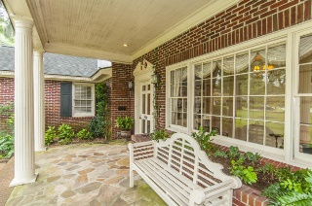
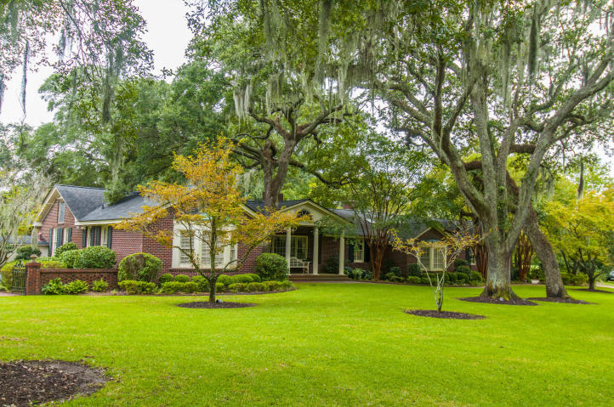
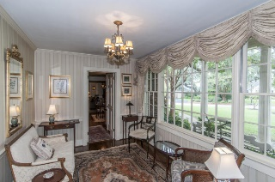
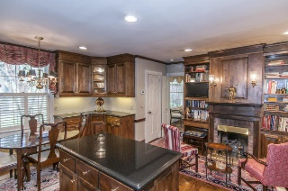
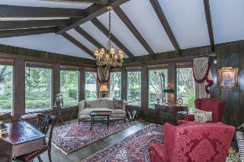
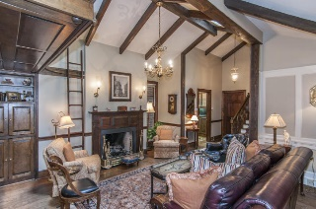
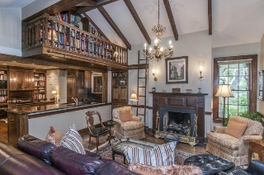
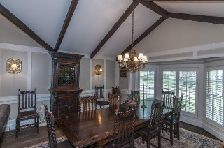
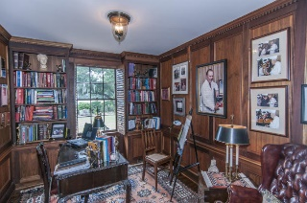
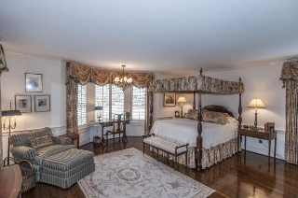
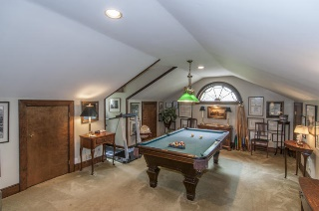
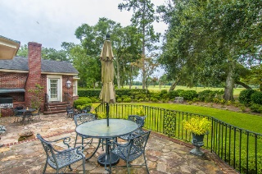
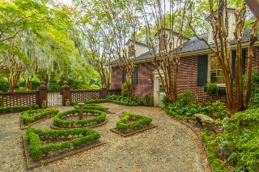
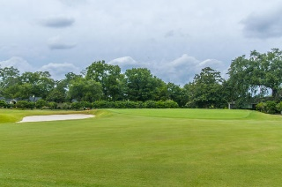
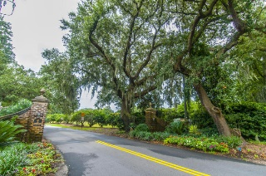


21 Country Club Drive Country Club of Charleston ~ Charleston MLS# 15024530 ~ $1,800,000
Stunning Estate in Country Club of Charleston
Rare opportunity to live in the exclusive Country Club of Charleston community. A stunning estate situated on over 3/4 of an acre boasting magnificent live oak trees, meticulously maintained landscaping and overlooking the 13th hole of the Country Club golf course. Enjoy single level living with formal and casual living spaces allowing for easy entertaining both inside and out. The custom designed kitchen complete with sitting area and fireplace flows easily into the family room and informal dining room creating an inviting space for family and guests. A generously sized master suite which has access to the terrace and takes advantage of the golf course views, two guest rooms, a beautiful wood paneled study and office nook complete the left wing. The formal dining room, and great room are situated on the back of the home allowing for easy access to the terrace and kitchen. The fourth bedroom and full bathroom are located over the garage and is currently used as a media/pool room. With heavy moldings, exquisite paneling, custom built cabinetry and plantation shutters throughout this home will not disappoint.
Katherine Cox REALTOR
Mobile - (843) 568-3193
katherine.cox@carolinaone.com
www.carolinaonerealestate.com
Carolina One Real Estate
2713 Highway 17 North
Mt. Pleasant, SC 29466

