Slide 1
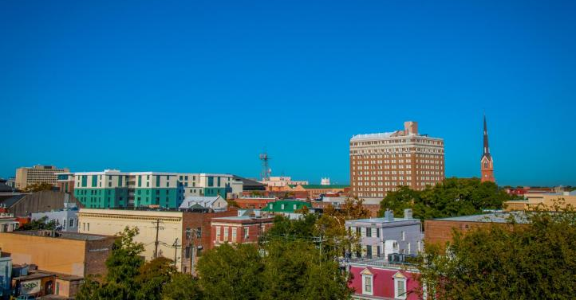
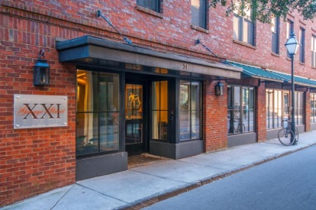
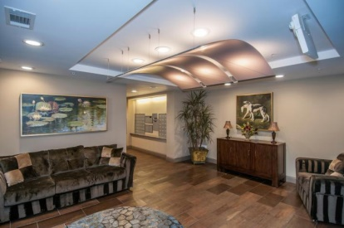
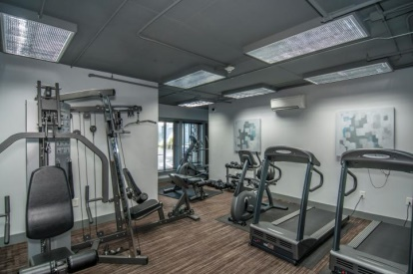
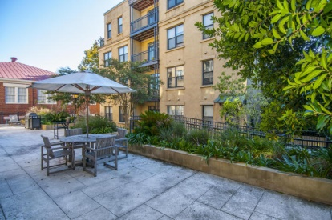
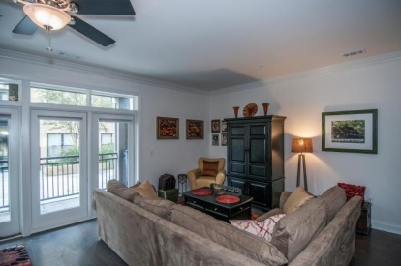
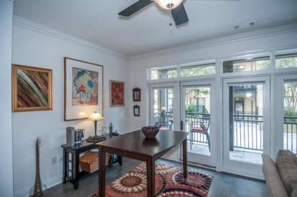
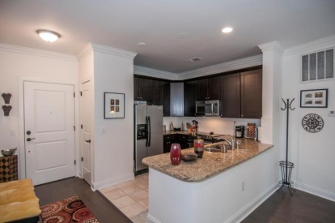
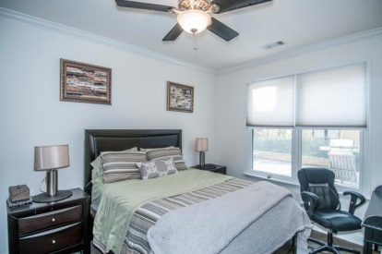
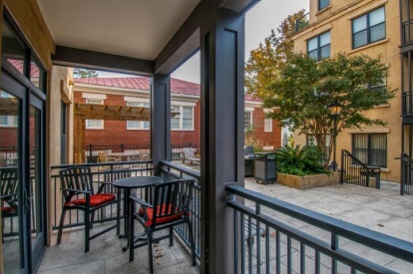
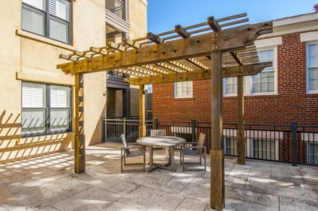
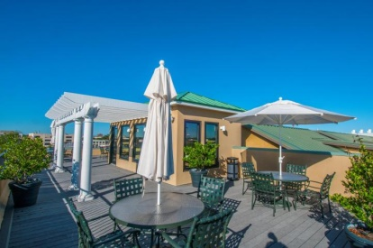
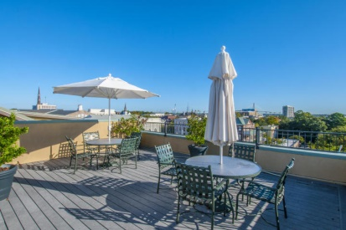


Luxurious 1 Bedroom Condo in the Heart of Downtown
21 George Street #108
George And Society | Charleston, SC 29401 | MLS# 15005670 | $470,000
Exclusive and private Pied-A-Terre in a prime location in the heart of Charleston.
2 off street parking spaces with private garage with electronic garage door opener, identified with #7 in both parking spaces.
Stackable washer/dryer, wood burning fireplace in the living room, rear patio, central heat & air.
Very quiet location tucked away on Horlbeck Aly. Serene patio on the front of the town home for relaxing and reading, yet steps away from King and Meeting Streets!
HOA includes exterior maintenance and flood insurance. This home can be eligible for 0.5% of the loan amount cash back towards closing costs. Ask me how!
Patricia Lehman Byrne
Mobile - (973) 868-1039 Patricia@kwluxuryhomes.com
luxurypropertiesincharleston.com
Keller Williams Realty Charleston West Ashley
1180 Sam Rittenberg Ste 105
Charleston, SC 29407

