Slide 1
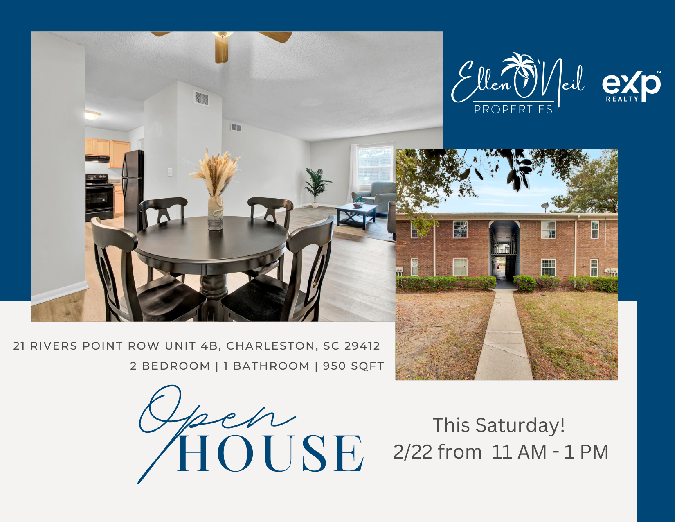
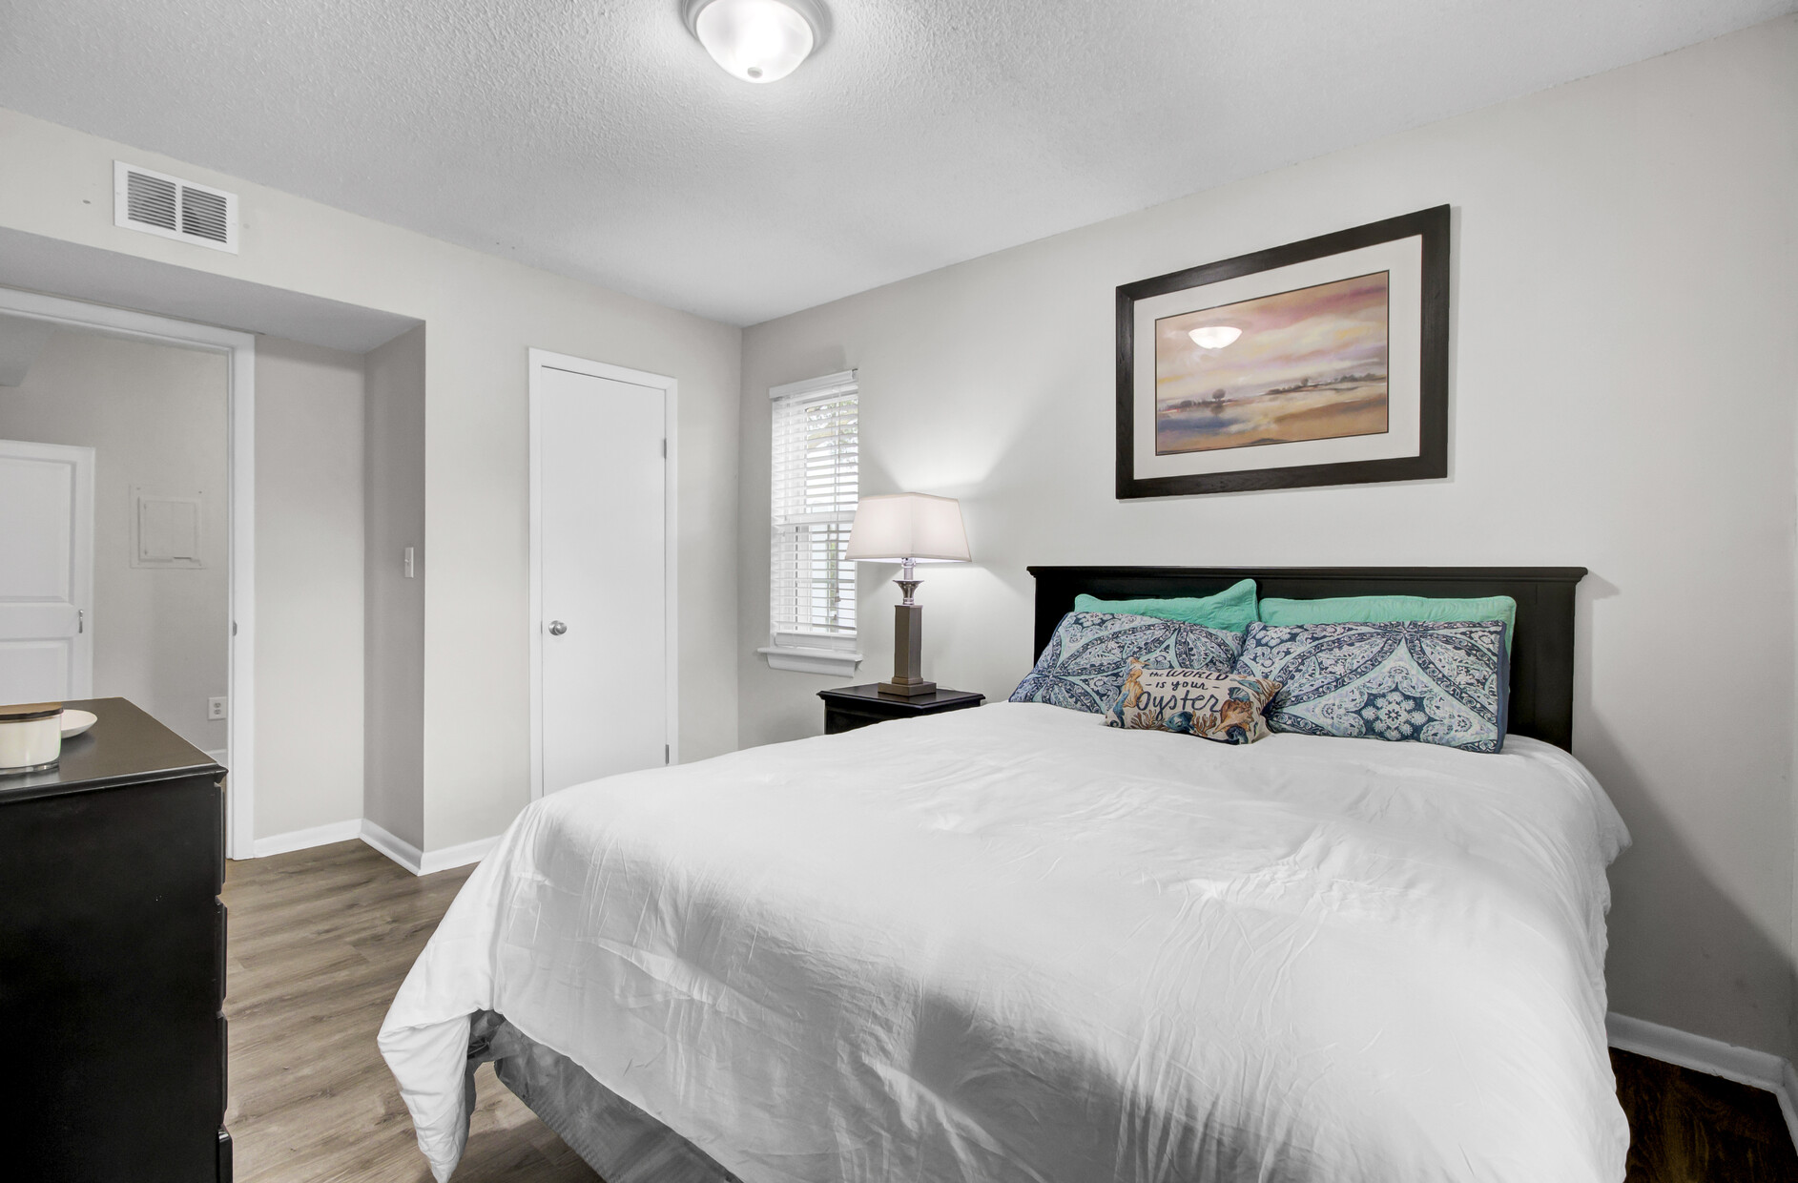
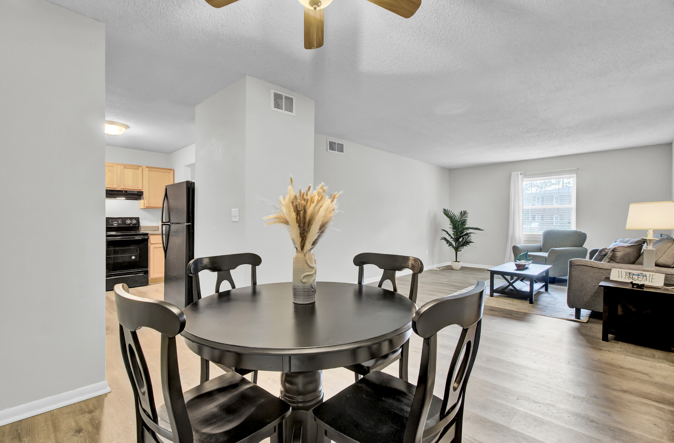
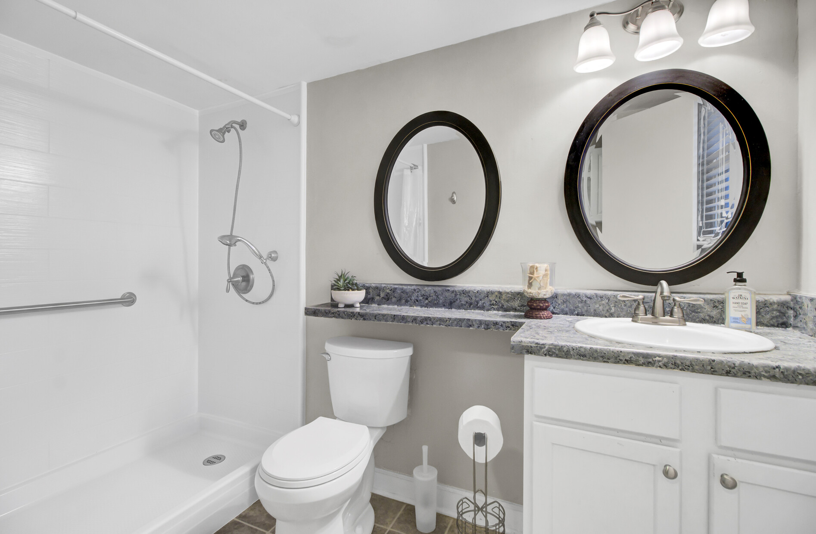
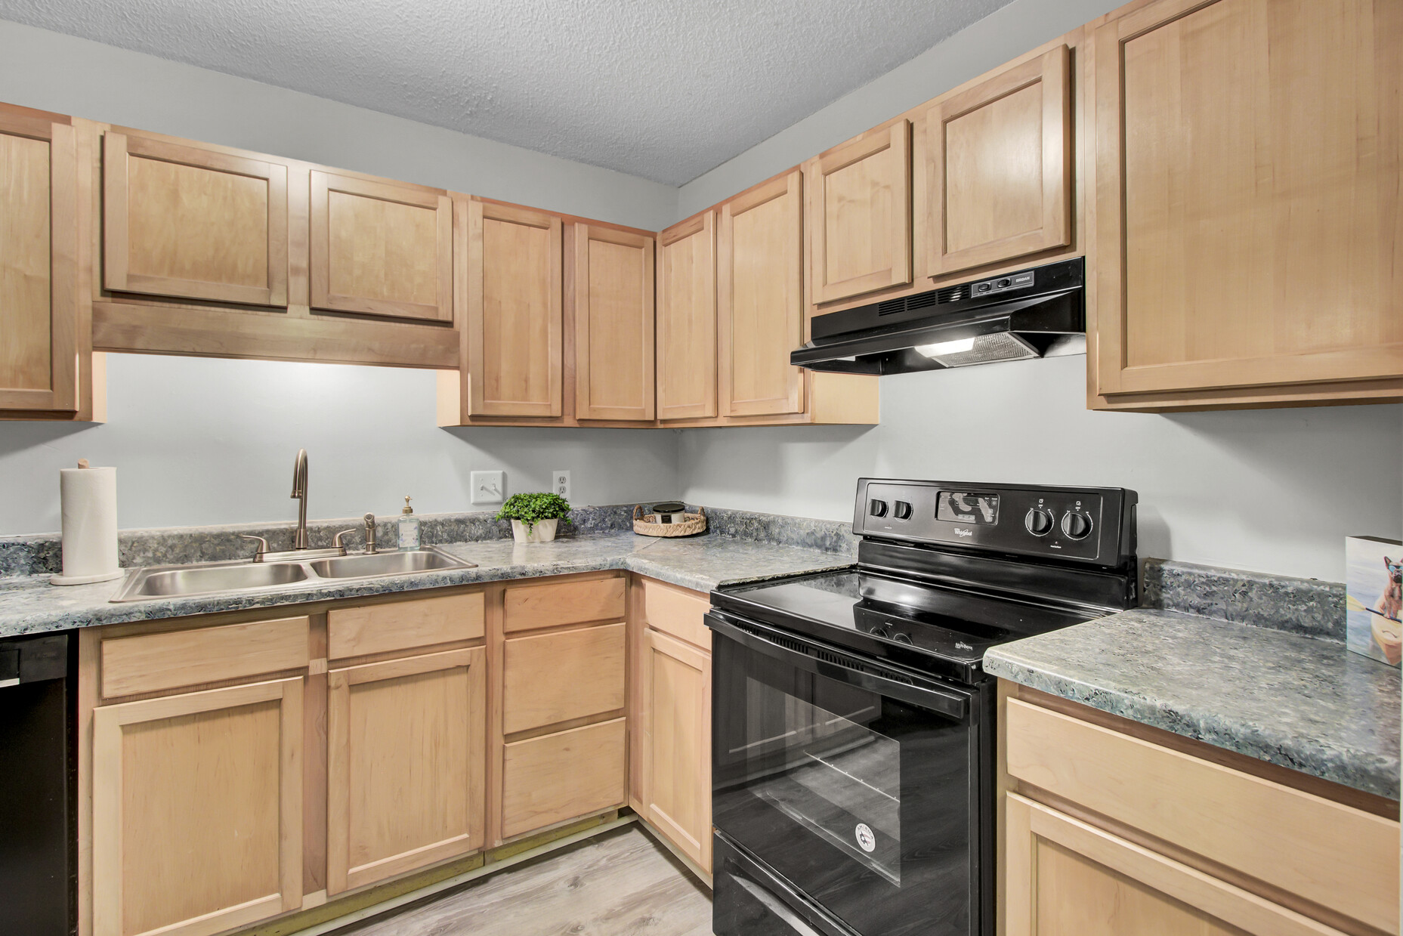
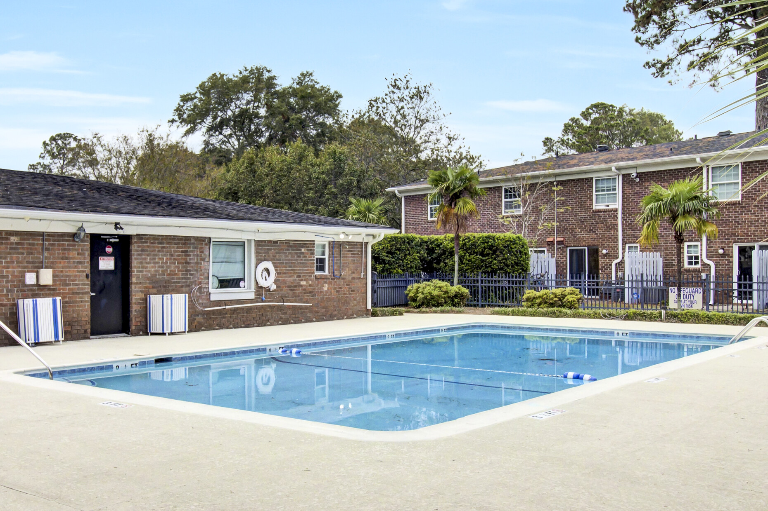
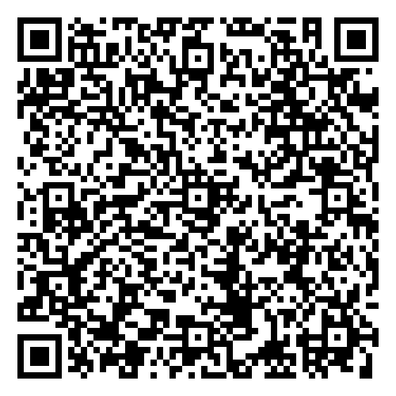
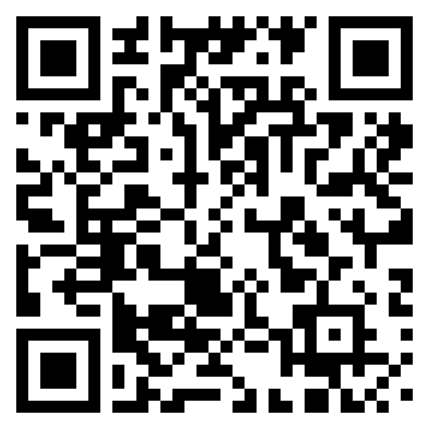

Charming First-Floor Condo in Rivers Point
Open House Sat, Feb 22, 11 AM - 1 PM
21 Rivers Point Row 4B
Rivers Point Row
Charleston, SC 29412
MLS# 24027601 | $264,900
VIRTUAL TOUR
VIDEO TOUR
🏡 Rare First-Floor Condo in Rivers Point – No Stairs!
A fantastic opportunity awaits in the sought-after Rivers Point community on James Island! This spacious 2-bedroom, 1-bathroom condo offers convenient, single-story living with no stairs and an unbeatable location.
✨ Property Highlights:
✔ First-floor unit – easy, no-stairs access
✔ Expansive family room & generously sized bedrooms
✔ Community pool & basketball courts for added recreation
✔ Walk to Starbucks, Aldi & Planet Fitness for everyday convenience
✔ Just 10 minutes to Folly Beach & Historic Downtown Charleston
📢 Join Us for an Open House – Saturday, Feb 22, 11 AM - 1 PM!
Come see why this move-in-ready condo is the perfect full-time residence, vacation getaway, or investment opportunity.
📩 Don’t miss out—schedule your private tour today or stop by the Open House!
VIDEO TOUR
Ellen O'Neil
Broker/Owner, ABR, e-PRO, CNE
Charleston Realtor of Distinction
843-300-8530
www.EllenONeilProperties.com

