Slide 1
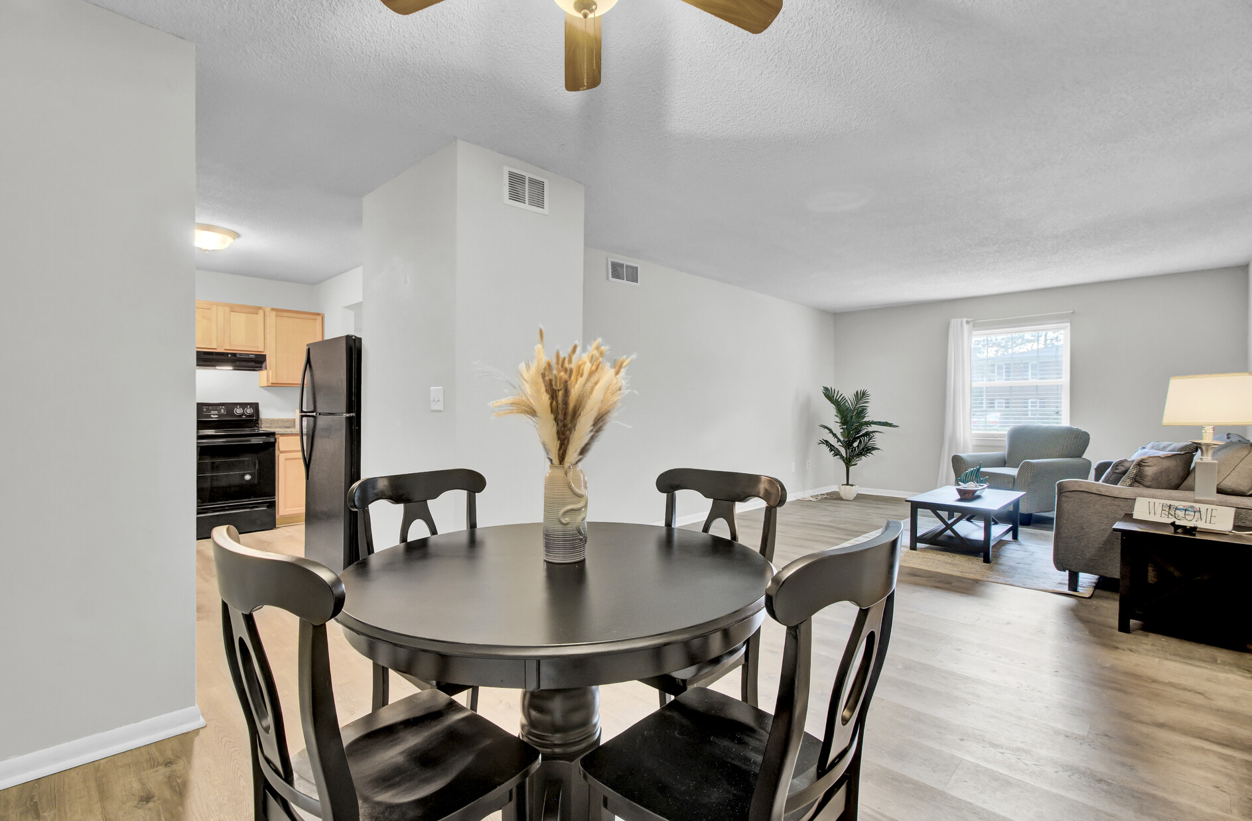
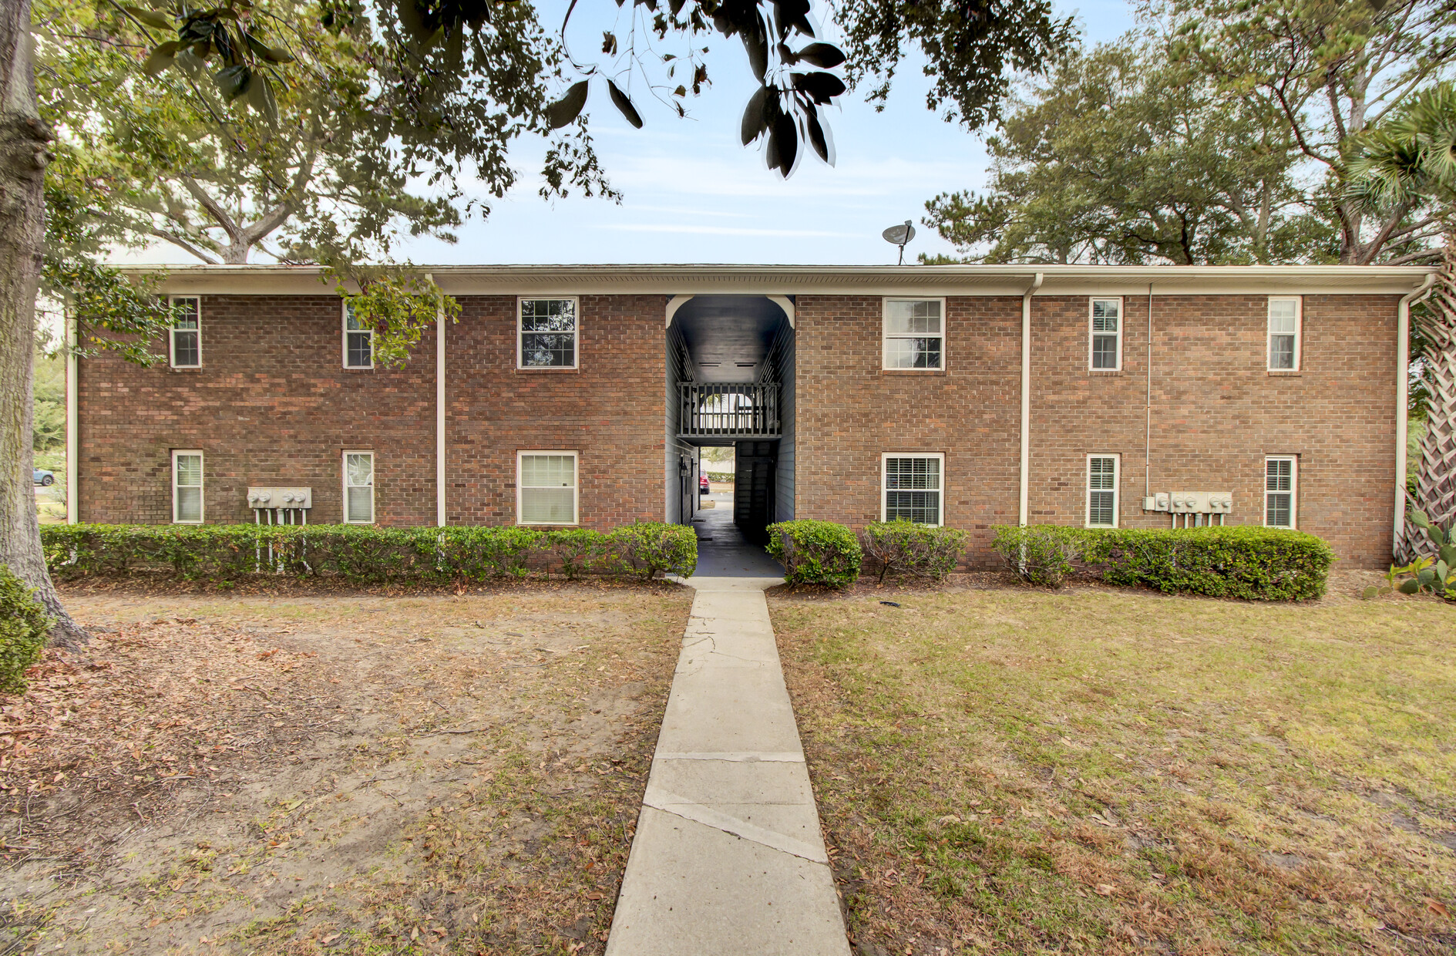
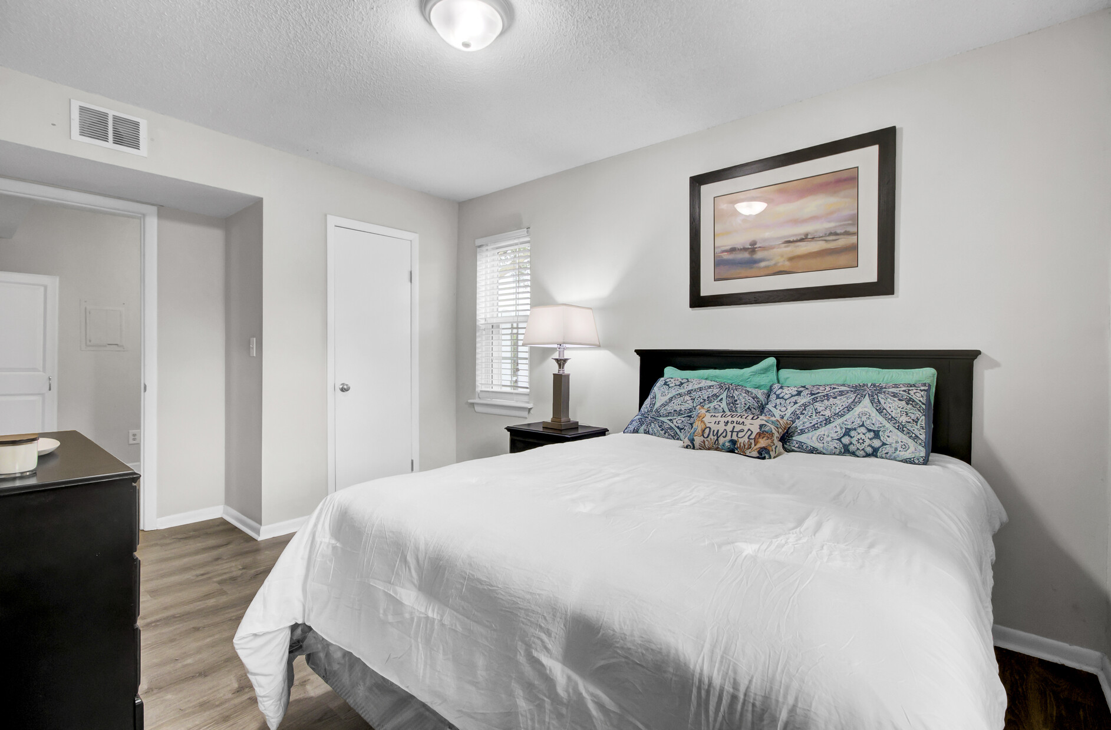
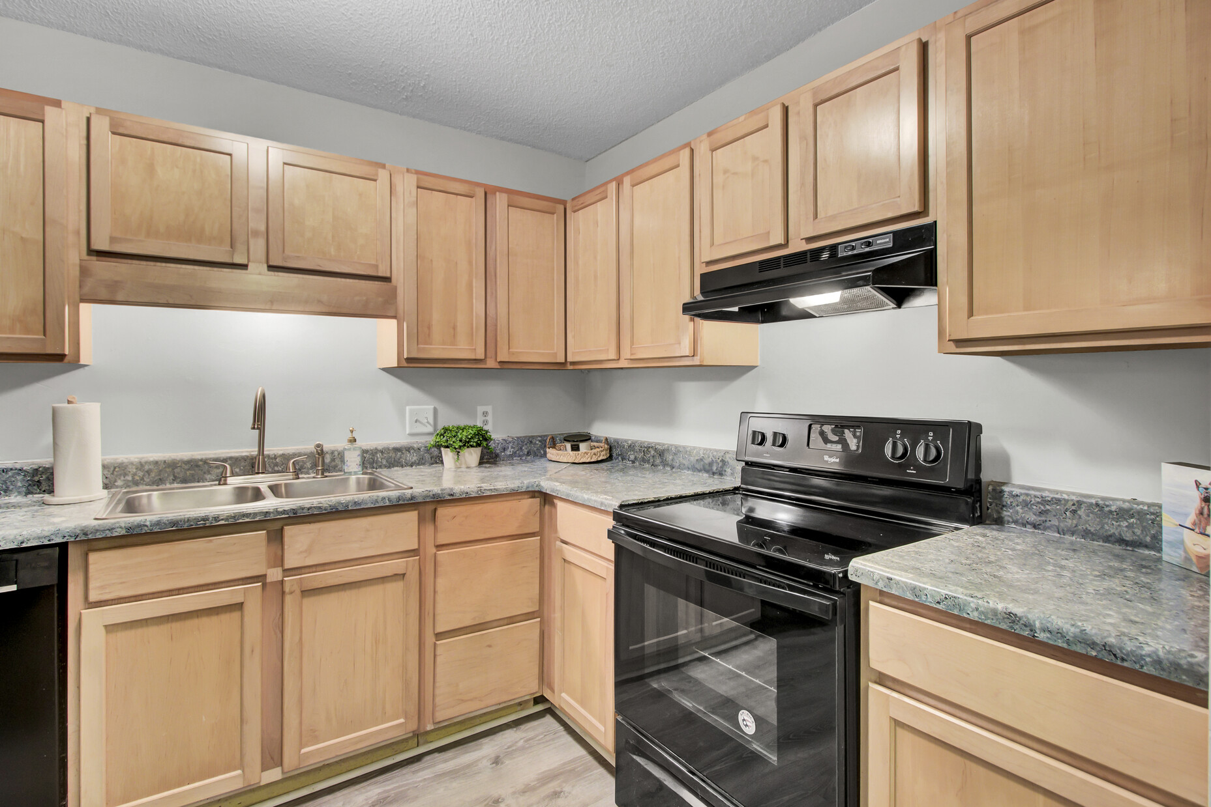
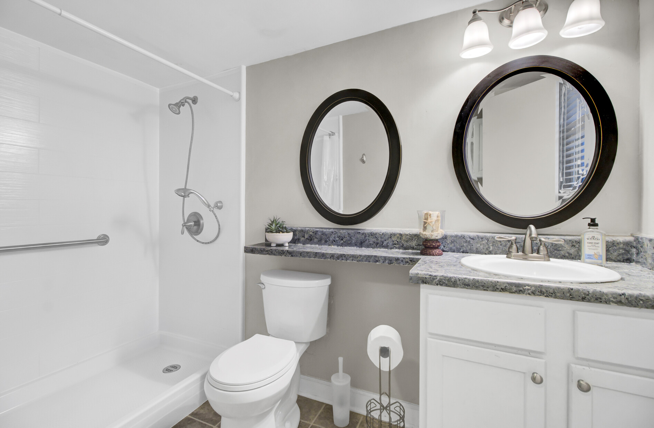
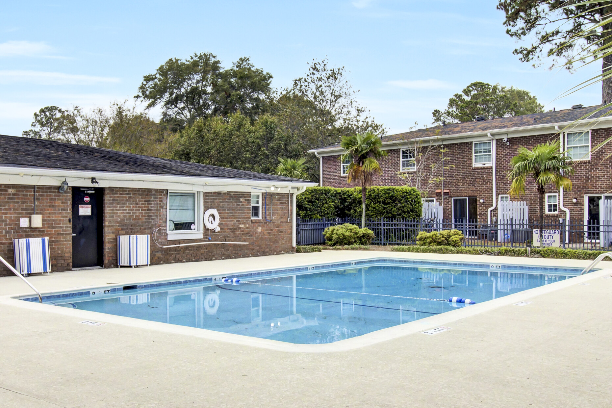
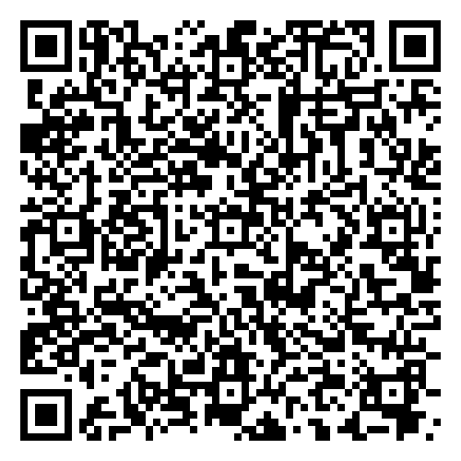
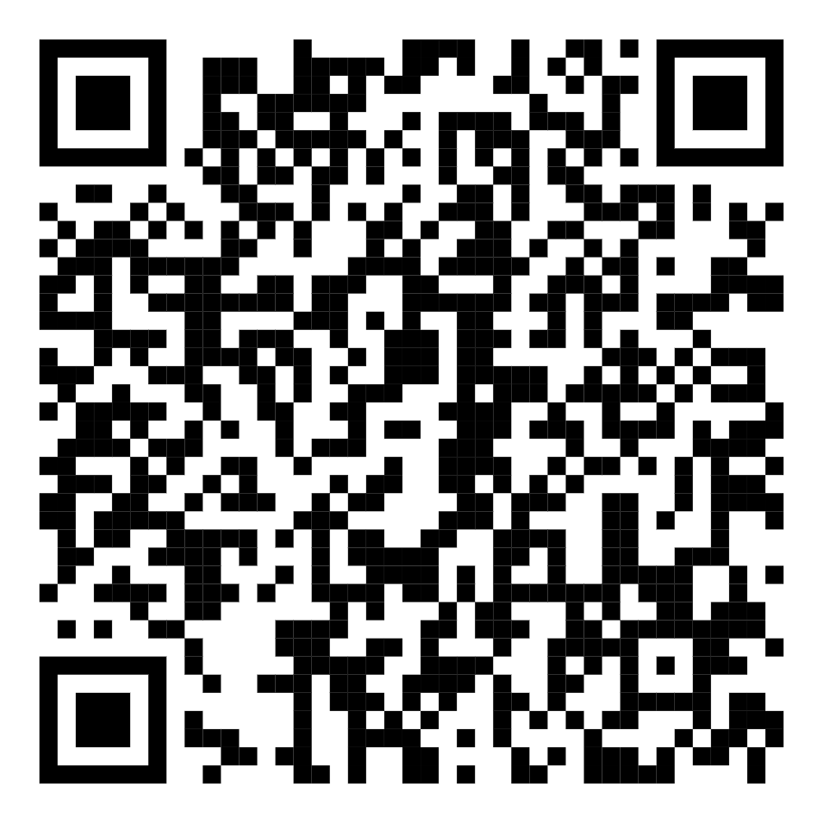


Just Listed!
Rare First-Floor Condo in Rivers Point - Prime Location & No Stairs!
21 Rivers Point Row 4B
Rivers Point Row
Charleston, SC 29412
MLS# 24027601 | $274,900
VIRTUAL TOUR
Video Tour
New listing in popular Rivers Point community on James Island!
This is a rare two bedroom condo on the first floor- no stairs! Single story living at its finest. The unit boasts a huge family room and each bedroom is generously sized. The community offers amenities including a pool and basketball courts.
Starbucks, Aldi and Planet Fitness are all in walking distance to this unit located conveniently off Folly Rd. Ten minutes to the beach and ten minutes to historic Downtown Charleston. This condo would make a perfect residence or vacation getaway. Don't delay - show today!
VIRTUAL TOUR
Ellen O'Neil
Broker/Owner, ABR, e-PRO, CNE
Charleston Realtor of Distinction
843-300-8530
www.EllenONeilProperties.com

