Slide 1
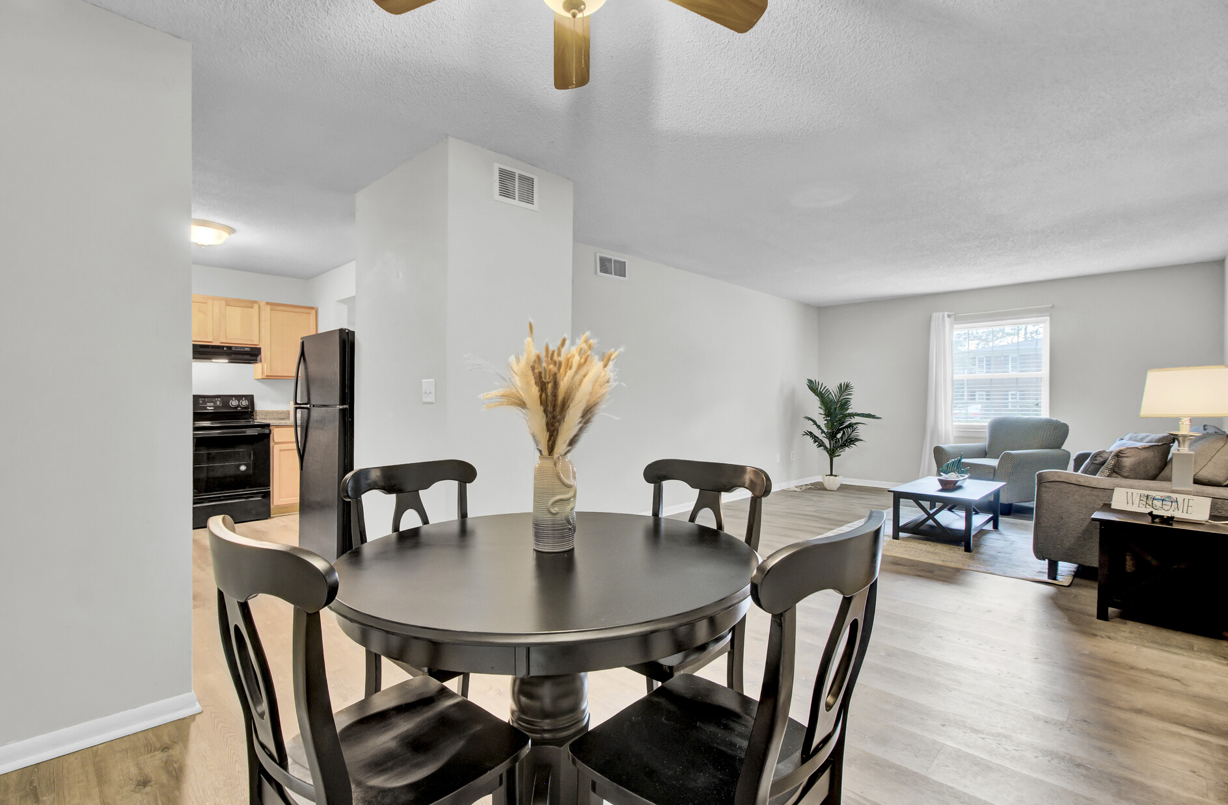
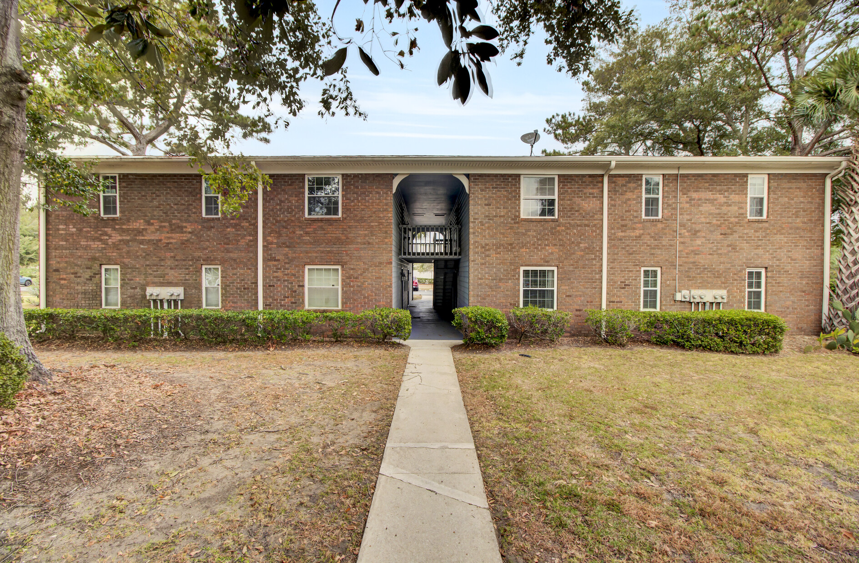
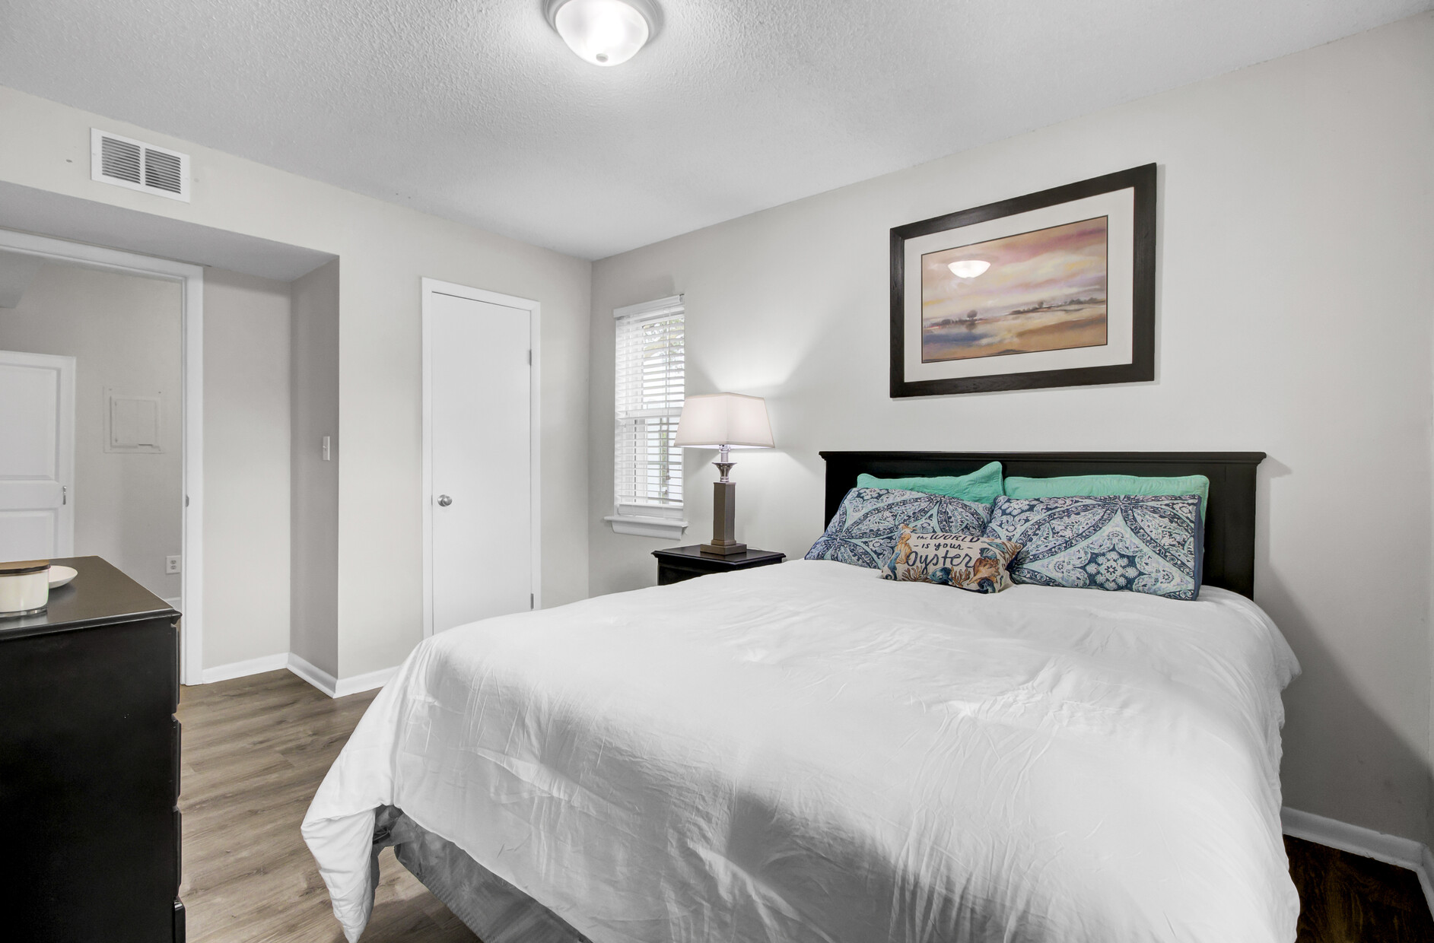
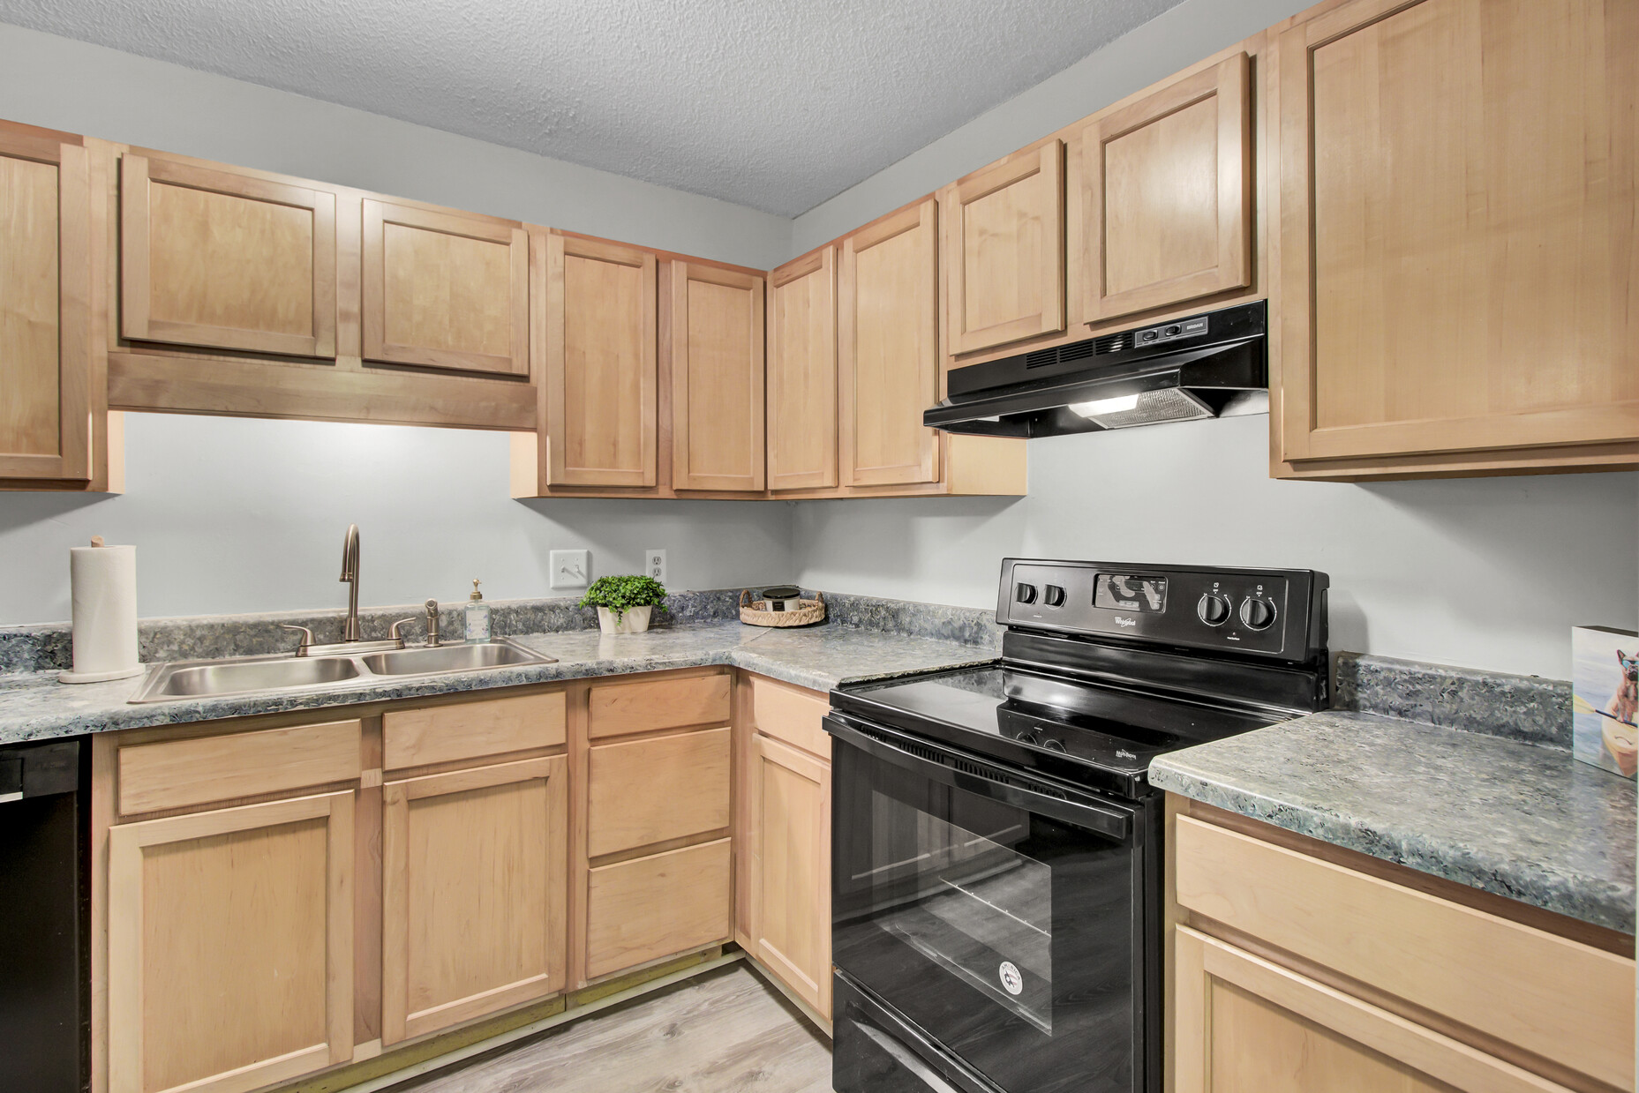
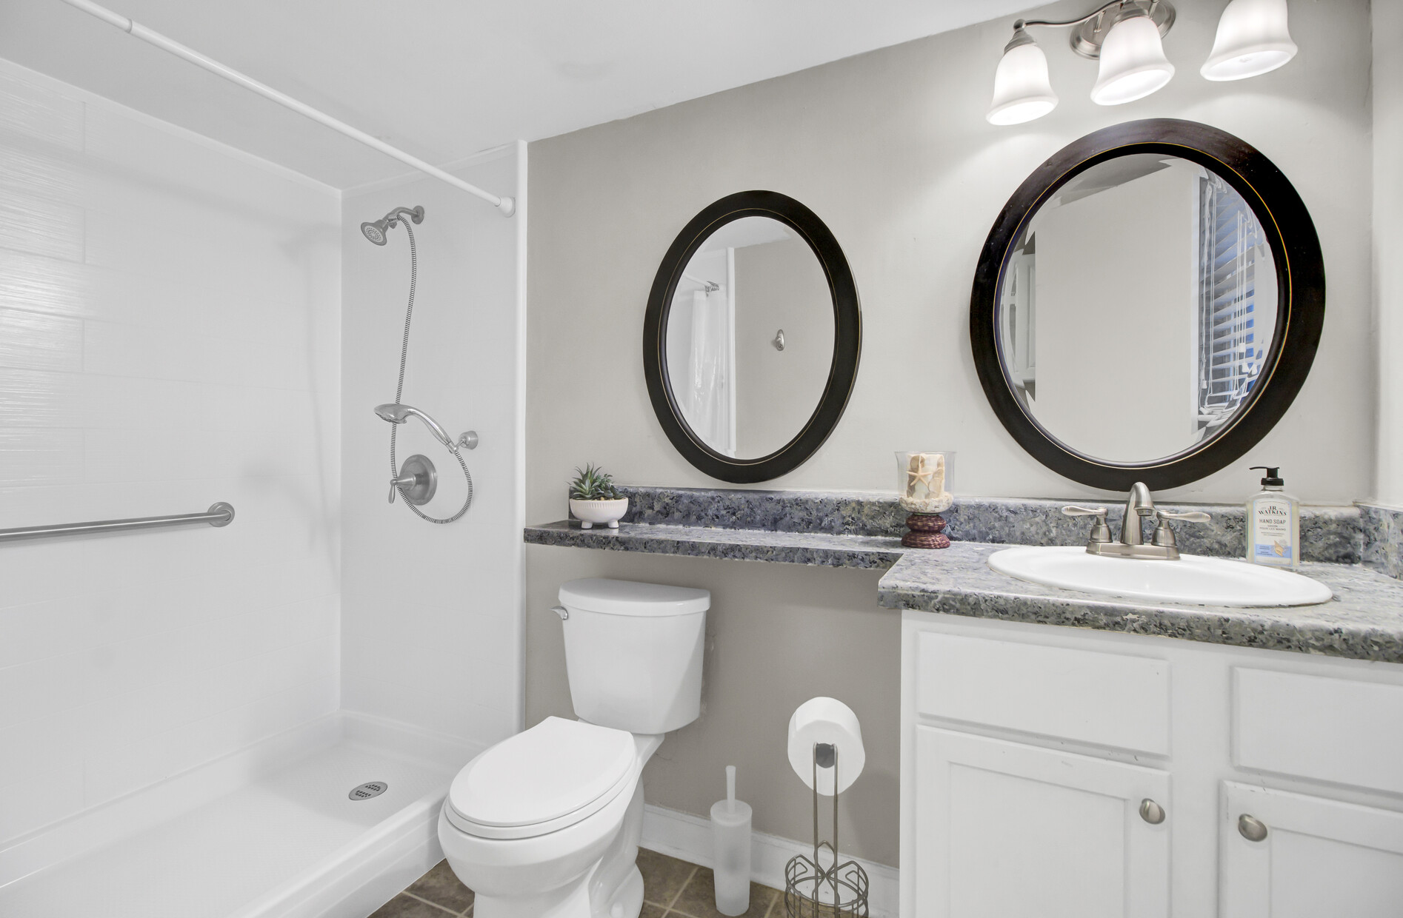
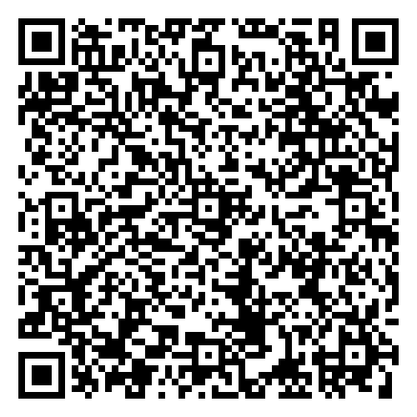
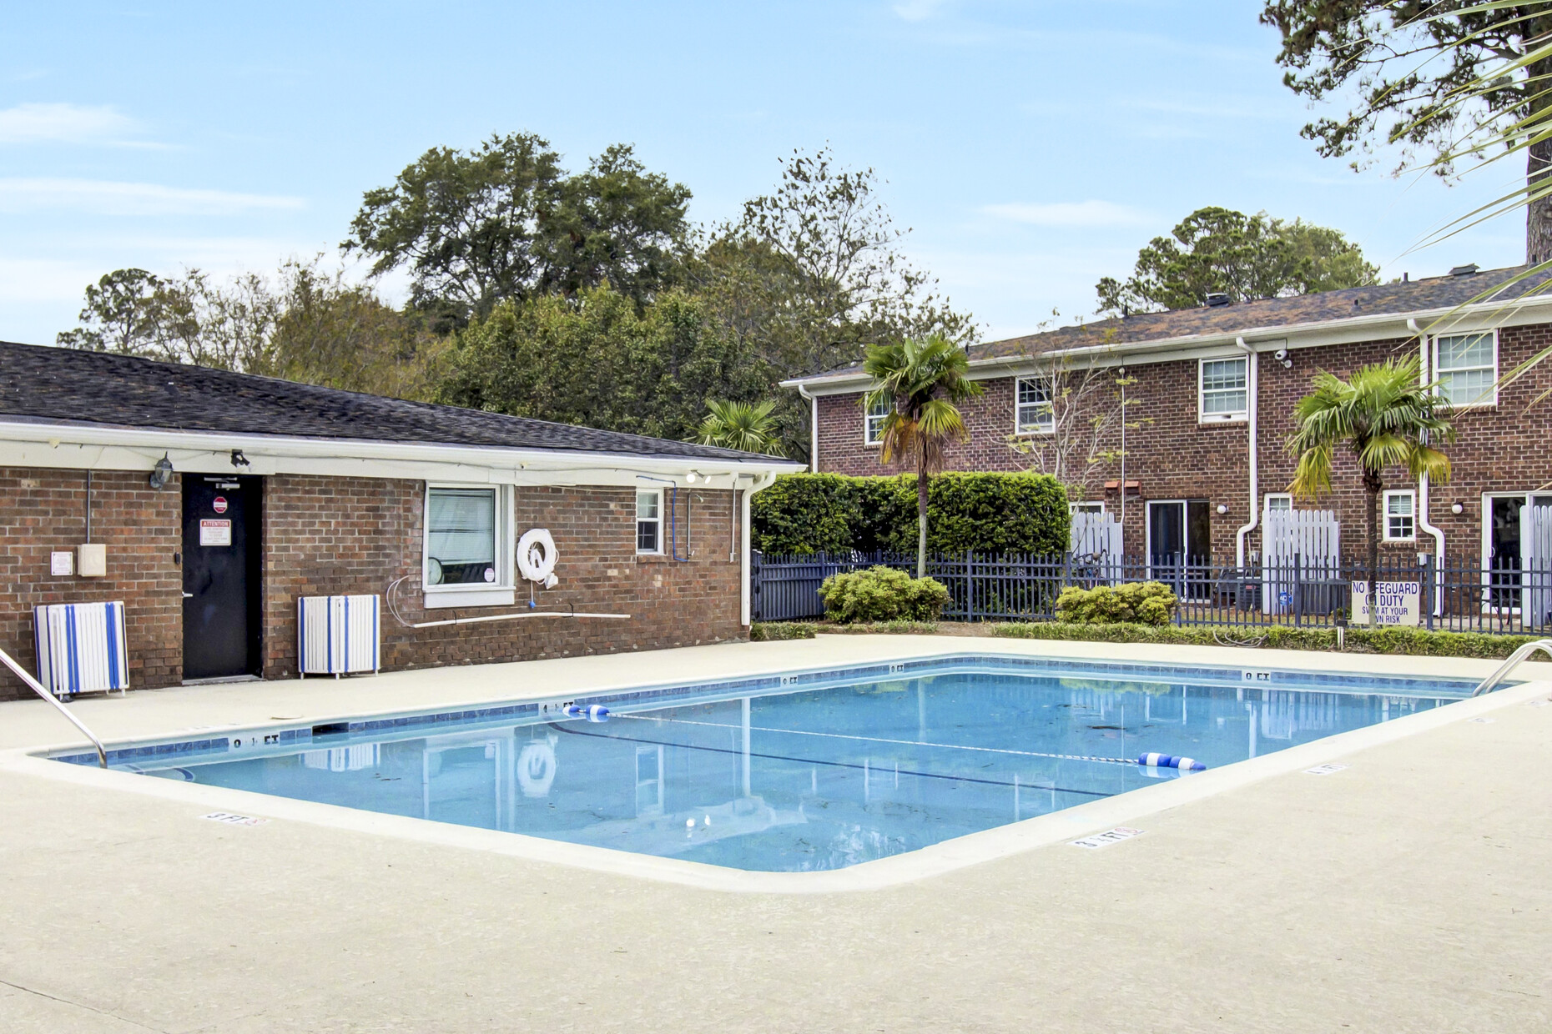
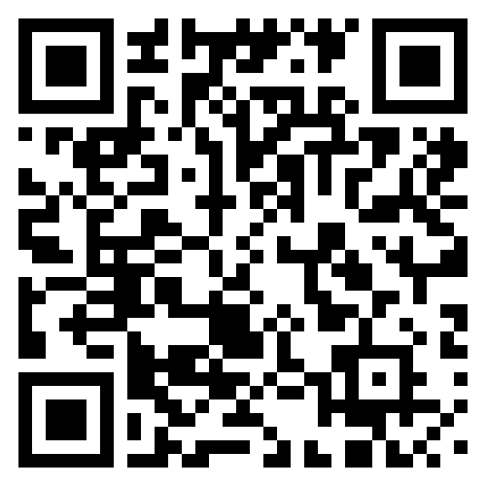

📢 Price Reduced 📢
VIRTUAL TOUR
21 Rivers Point Row 4B
Rivers Point Row
Charleston, SC 29412
MLS# 24027601 | $264,900
VIDEO TOUR
Don’t miss this incredible opportunity to own a first-floor, no-stairs condo in the highly sought-after Rivers Point community on James Island! This spacious 2-bedroom unit features a large family room, generously sized bedrooms, and unbeatable convenience.
Enjoy fantastic community amenities like a pool and basketball courts, and take advantage of the prime location—just a short walk to Starbucks, Aldi, and Planet Fitness. Located off Folly Road, this condo is only 10 minutes to the beach and 10 minutes to Downtown Charleston.
Whether you’re searching for the perfect residence or a vacation getaway, this condo checks all the boxes. With the new price of $264,900, now is the time to act!
📩 Contact Ellen to schedule your showing before it’s gone!
VIDEO TOUR
Ellen O'Neil
Broker/Owner, ABR, e-PRO, CNE
Charleston Realtor of Distinction
843-300-8530
www.EllenONeilProperties.com

