Slide 1
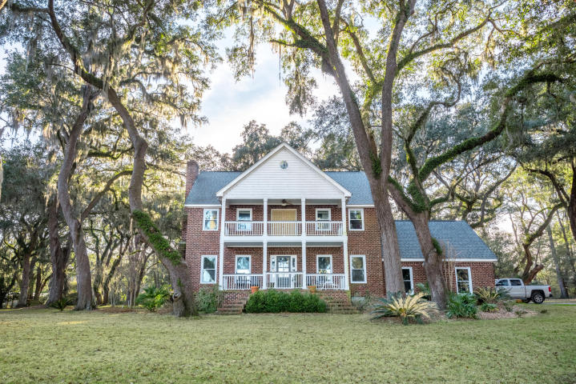
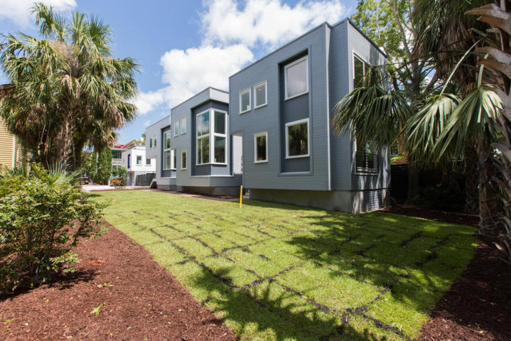
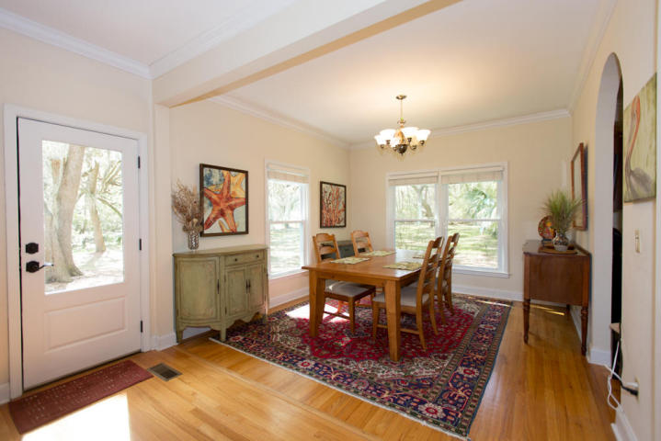
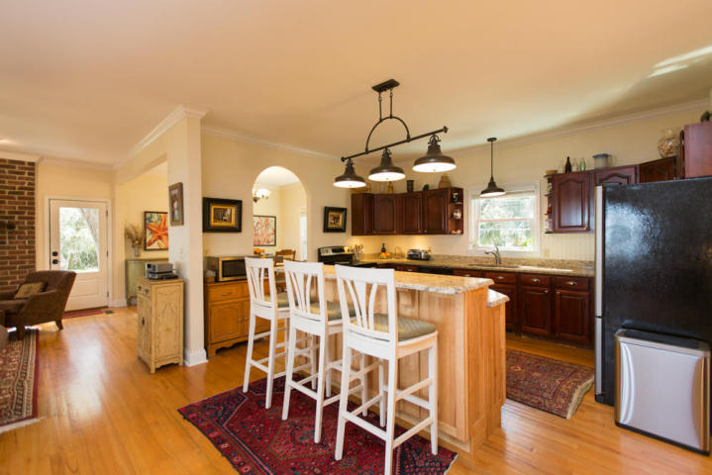
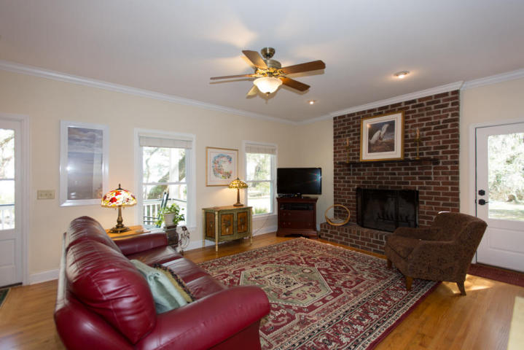
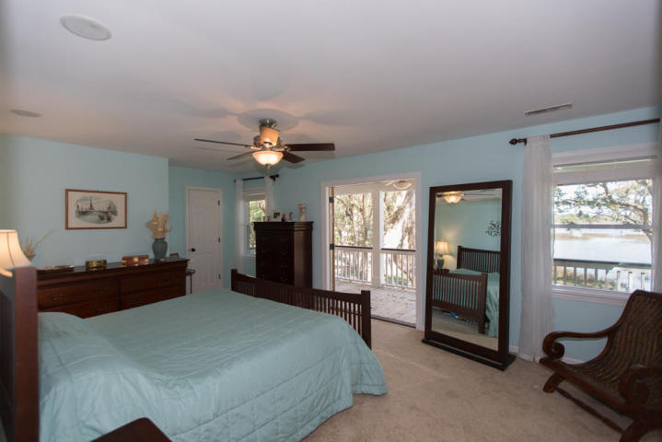
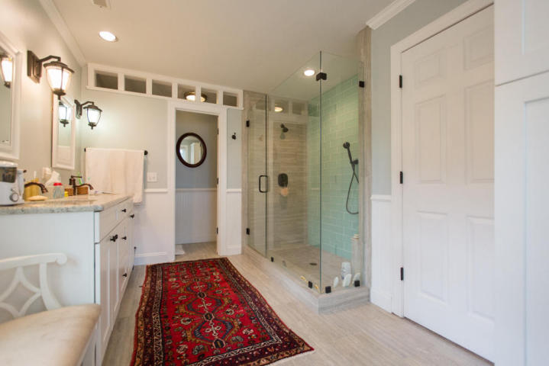
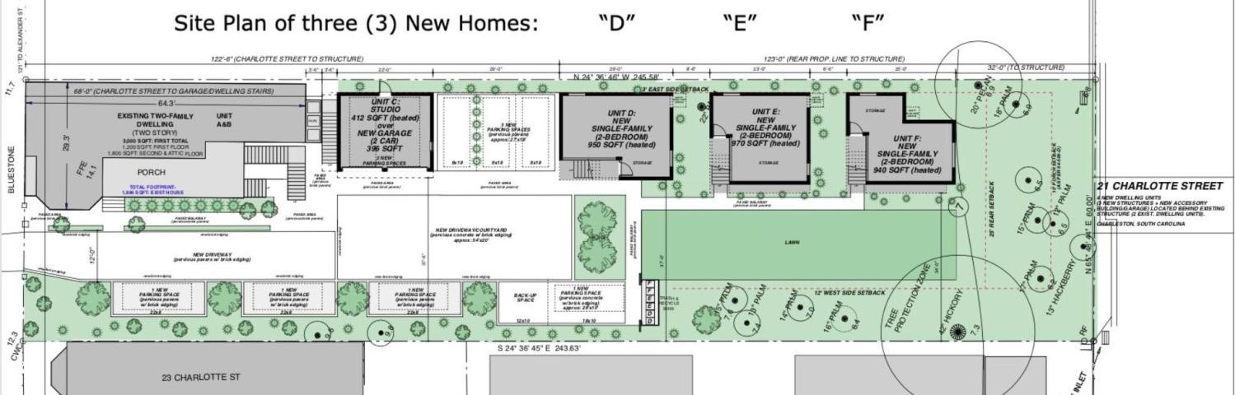
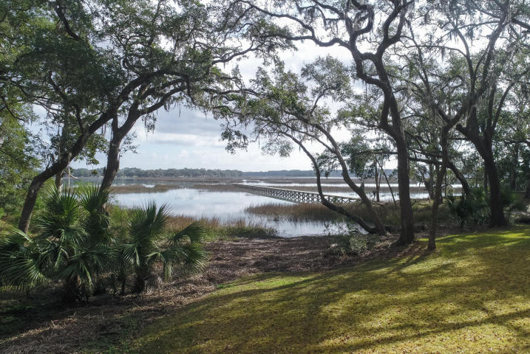

Three Homes Open for Tours
Thursday, 9/10 from 11-1
21 Charlotte Street
Wraggborough | Charleston, SC 29403
MLS# 20014980 | Unit D | $625,000 | 2 Bed | 2.5 Bath | 964sf
MLS# 20021517 | Unit E | $645,000 | 2 Bed | 2.5 Bath | 1,018sf
MLS# 20021521 | Unit F | $675,000 | 2 Bed | 2.5 Bath | 1,050sf
Come see this quiet oasis tucked away in Charleston's charming Wraggborough neighborhood. Designed and built for high-efficiency and low maintenance. Walk to everything. Off-street parking. Viking appliances. Available now.
Marion Jackson
Mobile - (843) 442-4404
marionjacksonrealtor@gmail.com
Charleston Property Brokers | 151 St. Philip St. Apt A | Charleston, SC 29403

