Slide 1
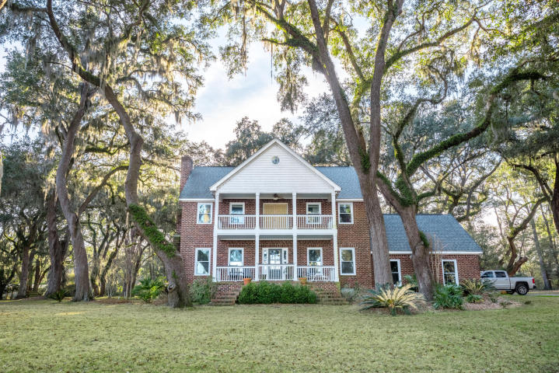
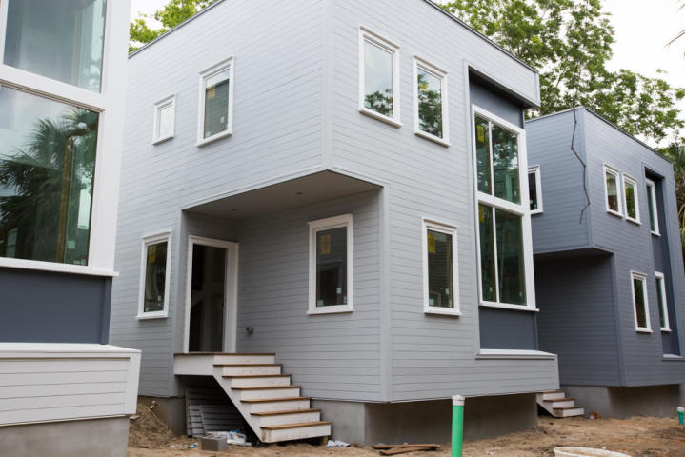
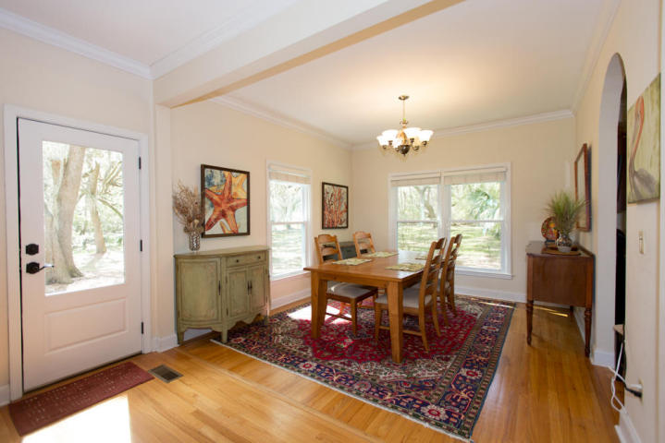
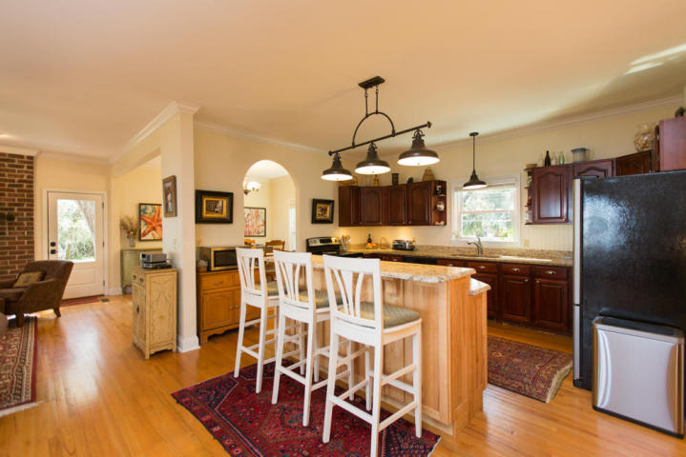
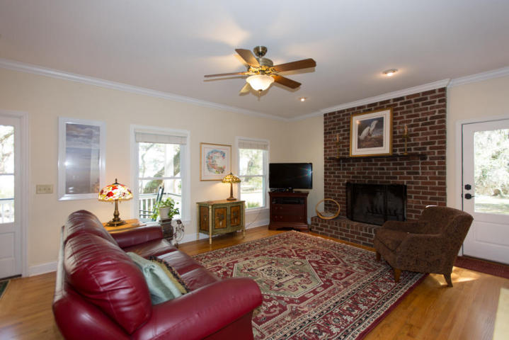
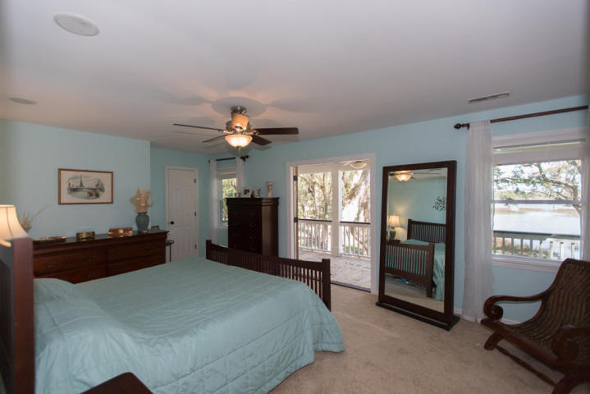
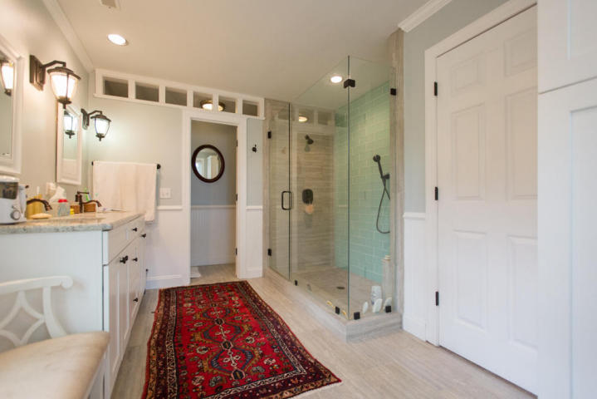
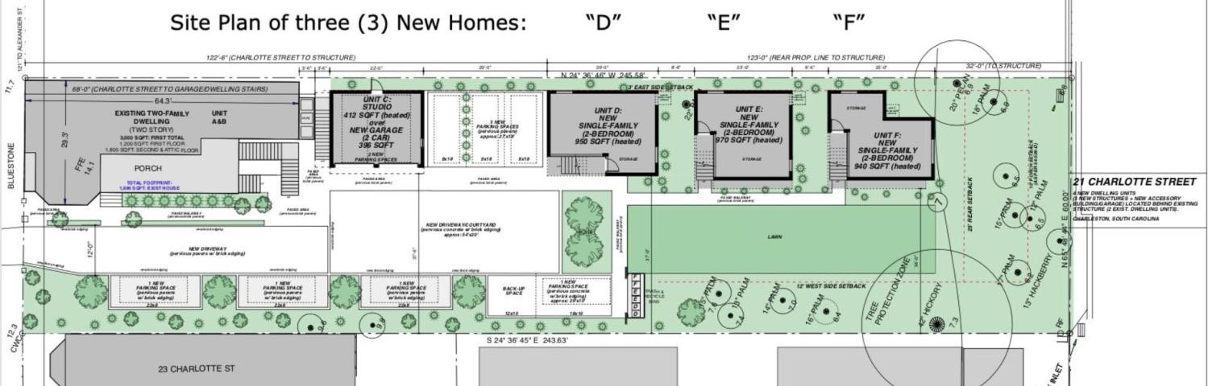
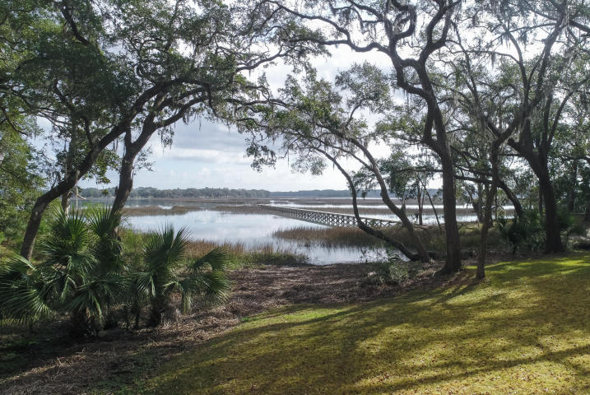

Wraggborough - New Construction - $679,000
21 Charlotte Street
Wraggborough | Charleston, SC 29403
NEW CONSTRUCTION in Wraggborough! Gated and quiet; three (3) new homes, each with two (2) bedrooms/ 2 baths upstairs, an open floor plan & half bath downstairs make a perfect second home or pied-a-terre in Charleston! Designed and built for high-efficiency and low maintenance, this home, Unit D, features an atrium, heart pine floors, Viking appliances, off-street parking, all set in a tranquil space in a superb location! Second and third (of 3) homes completed this summer. 'Come quickly and choose from a selection of counter-tops, interior hardware, floor-finishes and more!!!
Marion Jackson
Mobile - (843) 442-4404
marionjacksonrealtor@gmail.com
Charleston Property Brokers | 151 St. Philip St. Apt A | Charleston, SC 29403

