Slide 1
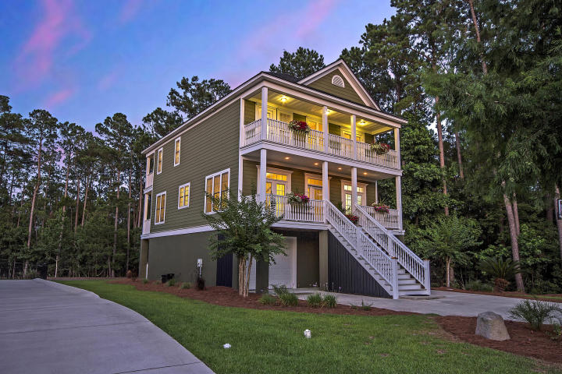
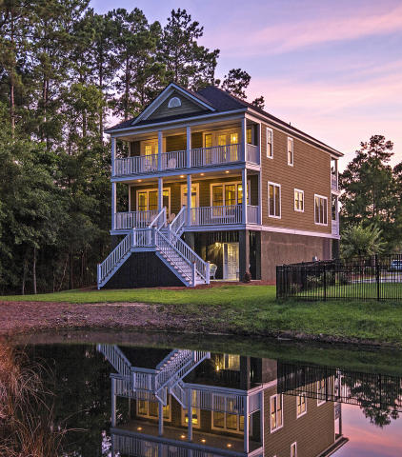
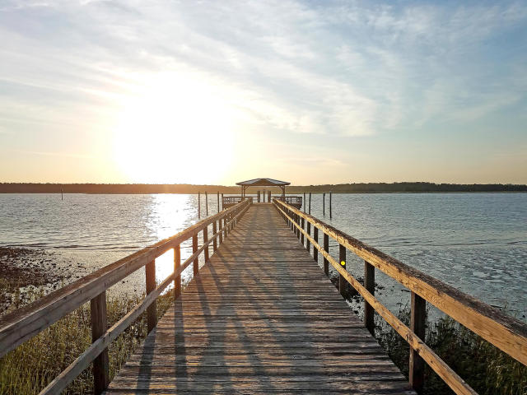

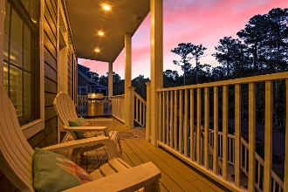
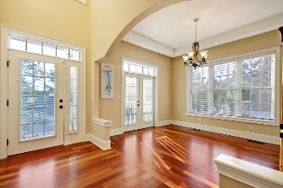
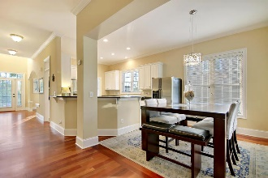
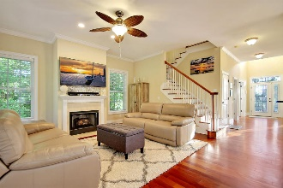



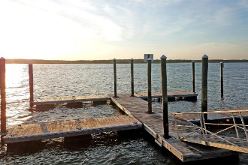
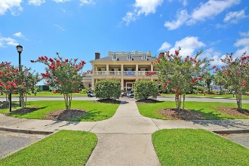
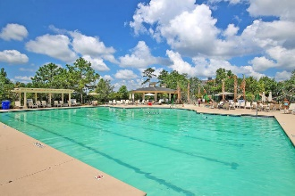

Price Reduced!
2200 Branch Creek Drive
Rivertowne Country Club ~ Mount Pleasant ~ MLS# 18017811 ~ $499,800
Immaculately-kept and situated on one of the most private lots in Rivertowne Country Club with double porches in both front AND back, views of both pond & marsh, a freshly-painted exterior, a NEW ROOF, & gorgeous low maintenance landscaping – this home will ''have you at hello.'' Brazilian cherry flooring, granite counters, stainless appliances, upgraded molding & trim work, tile flooring in the kitchen & baths, updated light fixtures, & built-in cordless blinds on each exterior door are just a few upgrades that make this home shine. Hop in your golf cart or on your bike & head to one of your neighborhood restaurants, shop for groceries, or enjoy the neighborhood amenities – all minutes away. Truly move-in ready & poised to impress, this home won't be around long.
Book a showing TODAY!
Additional details include:
Oversized garage is large enough for three cars, an exercise area, a workshop, and still has loads of storage space left over.
Master bedroom features views of the back pond, access to the back balcony overlooking the pond, a tray ceiling, multiple closets, and an ensuite bath with access to the front balcony.
Master bath features tile flooring, a large vanity with dual sinks, updated light fixtures, a large shower with tile surround, a soaking tub with tile surround and pendant lighting, a separate water closet, and access to the front balcony with views of the marsh.
Kitchen features granite counters, tile flooring, stainless steel appliances, freshly-painted white cabinetry, and ample cabinet storage and counter prep space.
Neighborhood amenities include a deep water dock on the Wando River with a covered pier head and several slips for docking, a boardwalk over marsh leading to the dock, walking trails, a large swimming pool, a play park, lighted tennis courts, basketball courts, a grill patio, and easy access to the Rivertowne Country Club LPGA golf course (with appropriate membership) and clubhouse with a restaurant and pro shop.
Restaurants, groceries, dry cleaner, etc. just a short bike, golf cart, or car ride away.
New roof in Spring 2018 with a transferable warranty.
New main floor HVAC unit in 2015.
Upgraded molding throughout.
Built-in cordless light-filtering blinds on every exterior door.
Freshly-painted exterior (including porches).
Freshly-painted cabinets in kitchen.
New stainless steel hinges on all exterior doors.
Transferable home warranty.
Transferable termite bond with Terminix.
Julie Nims julie@mattoneillteam.com 843-580-6310

