Slide 1
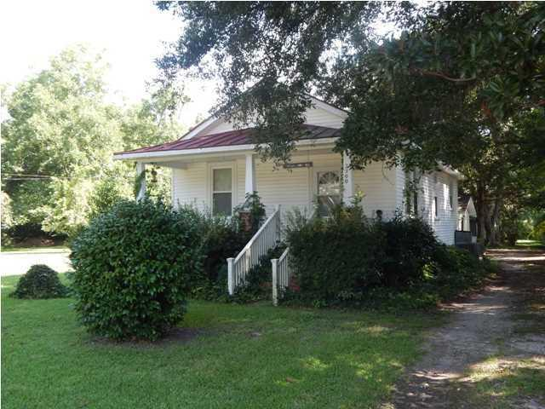
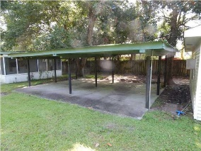
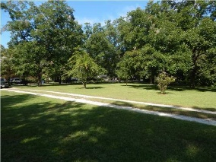
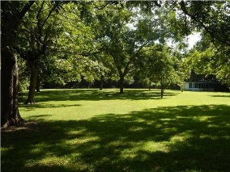
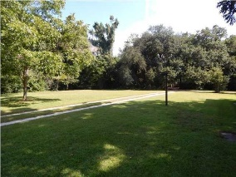
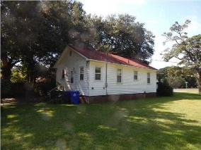

2200 Oakland Road Pierpont ~ Charleston ~ MLS# 1424395 ~ $249,000
Great property for development
This is a lot, with a small cottage, a carport and a small storage or other type of structure attached to the carport.
The home is AS IS. This is a great property for a developer, or to build a lovely home on.
There are beautiful pecan trees and the lot is fully "grassed". The home is vacant.
Carolina One Real Estate
2713 Highway 17 North
Mt. Pleasant, SC 29466
Terry Hamlin
(843) 830-3946
terry@thamlinproperties.com

