Slide 1
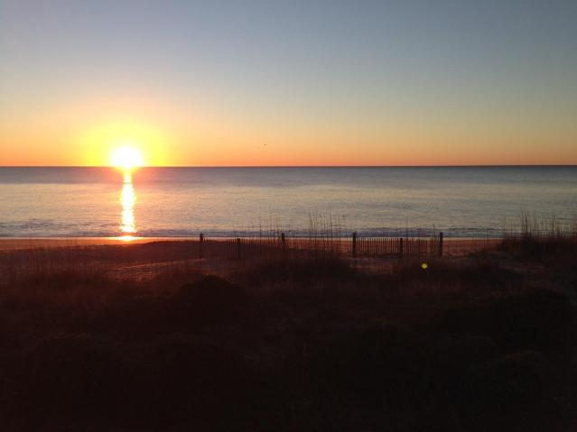
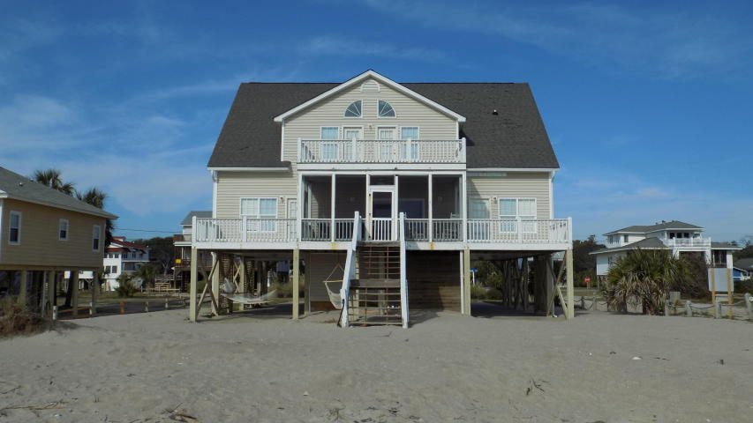
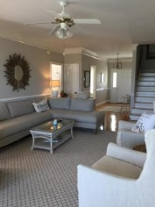
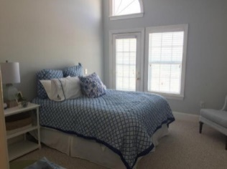
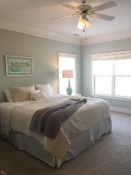
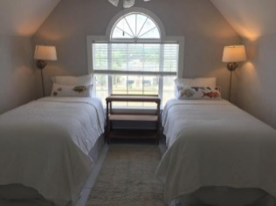
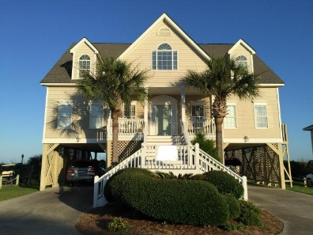
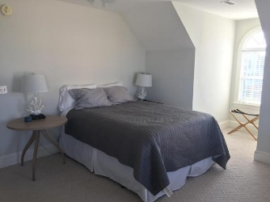
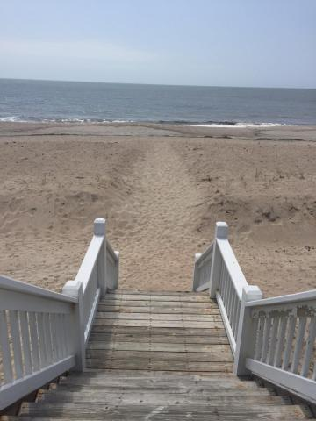

Best Beachfront Home On Edisto Beach
This custom built home sits on a large private lot in a more secluded area of Edisto Beach. The home features multiple outdoor decks as well as a screened in porch for year around enjoyment. The main floor offers a tremendous kitchen with bar, double wall ovens, an island with cooktop and unrestricted views. The large dining area is just off the kitchen and opens to the oceanfront deck. The family room opens to the screened porch and decks and features a gas fireplace and plenty of room for a large gathering. The main floor master bedroom offers private access to an oceanfront deck, walk in closet, large bath with dual vanities, shower and jetted tub. The main floor also features a private guest bedroom and bath as well a large entry hall with powder room and a laundry room. Upstairs features 4 or 5 large bedrooms. Two of the bedrooms open to a sundeck with incredible views and each have a private bathroom. There is another bedroom with private bath and two bedrooms that share a bath. One of the rooms that share a bath is currently being used as a 7th bedroom or could be used as an upstairs study or playroom. Under the home is a storage area which contains the homes reverse osmosis system and plenty of room for the toys. In addition there is an outdoor shower, dual parking areas, entry into the house and private access to the beach. Don't miss this incredible home.
2201 Point Street
Edisto Beach, SC 29438
MLS# 17031860 ~ $1,395,000
Wonderful 6 or 7 bedroom/6.5 bath oceanfront home on desirable Point St.
Best location on the beach
Tremendous rental potential
~
Frank Thornhill
(843) 224-7997
frank@askfrankrealestate.com
The Boulevard Company, LLC
35 Broad Street
Charleston, SC 29401 www.askfrankrealestate.com

