Slide 1
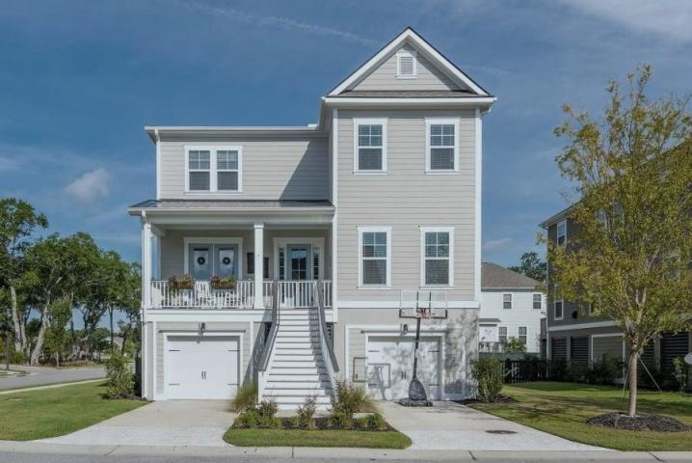
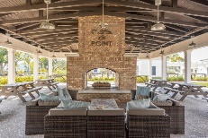
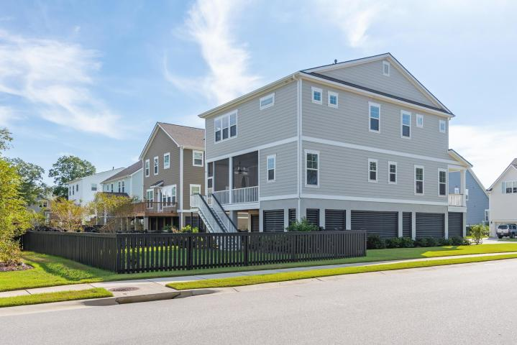
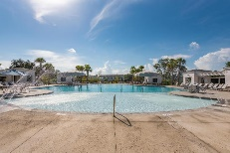

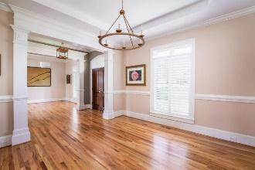
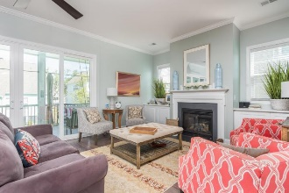
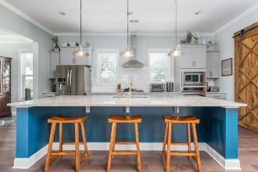
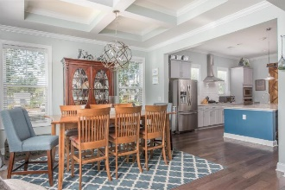
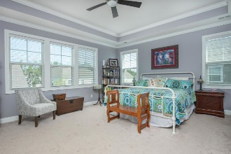
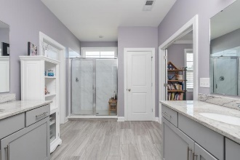
2202 Skyler Drive Oyster Point · Mount Pleasant, SC 29466 · MLS# 18027045 · $674,999
Darrell Creek Elevated Home With Elevator & Salt Pool
Better than New Moore Plan in Oyster Point ~ Price Reduced
5 Bedroom 4 Bath Elevated Home! 4 Miles To The Beach
Gorgeous light filled 5 bedroom, 4 full bath home on a corner lot in the highly desirable waterfront community of Oyster Point. Just two years young! (Builder's warranty is still in place.) Enter the home from the rocking chair front porch and through the foyer. Note the beautiful moldings, custom light fixtures, and hardwood floors that appear throughout all the main areas of the first floor. To the left of the foyer is the dining room with coffered ceiling and full light French doors leading to the front porch. A double doorway leads from the dining room to the kitchen, which features a huge island with breakfast bar, granite countertops, white subway tile backsplash, custom cabinetry, stainless steel appliances and a large walk-in pantry.
A custom made barn door separates a little nook off the kitchen that can be used for an office or storage. The kitchen is open to the spacious family room which has a gas fireplace and built in cabinets on either side. Note the oversized sliding glass doors that lead to the huge screened porch overlooking the fenced-in back yard. There is one bedroom and one full bath on the main level of the home. Upstairs are a large bonus room, the master suite, 3 additional bedrooms, 2 additional full bathrooms, and the laundry room.
Upgrades the current homeowners have made include: professionally painted interiors, custom built barn door, professionally installed and painted fence in backyard, custom light fixtures, ceiling fans installed throughout the house, outdoor ceiling fans on oversized screened in porch.
This house is on a great corner lot, strategically placed for maximum privacy, and in close proximity to the pool, playground, tennis courts, workout room and amenity center. The raised floor plan and numerous large windows and glass doors allow for prime views of the grand oaks and lowcountry landscape.
Oyster Point is a friendly, close-knit community with many neighborhood events, from 4th of July firework displays to a Thanksgiving turkey trot race around the neighborhood. The dock is a special place, as are the fort and the trail system! Tax records show a 6% tax ratio which would be for a 2nd home or investment property. A primary homeowner will pay about 1/3 of this amount. The taxes listed in the listing show what the current owners paid as their primary home!
Andrea Rogers
(843) 532-3010 | andrearogers1@gmail.com | www.andrearogersrealtor.com
AgentOwned Preferred Group | 1400-G Palm Blvd | Isle Of Palms, SC 29451

