Slide 1
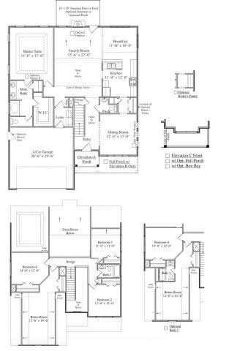
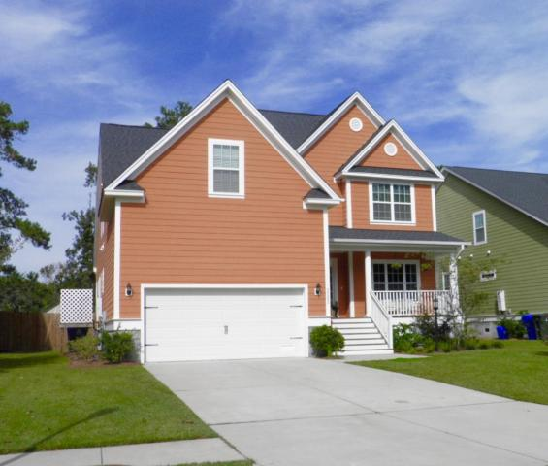
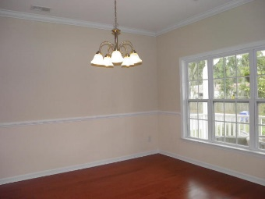
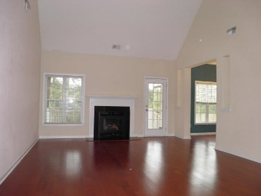
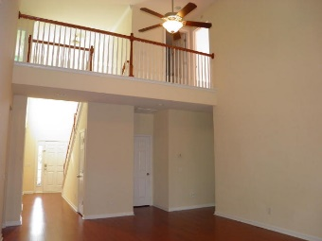
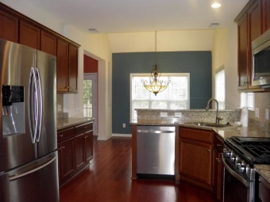
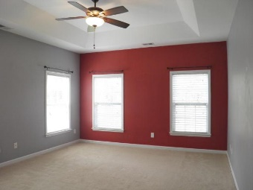
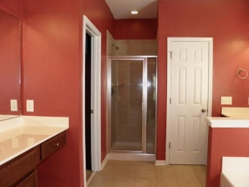

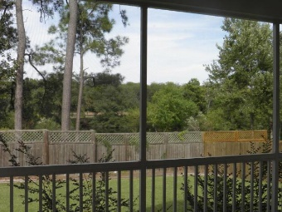
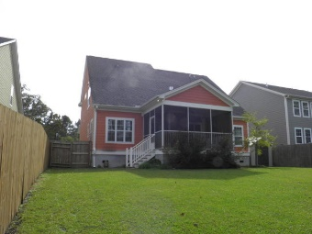

2202 Terrabrook Lane Charleston ~ MLS# 15027588 ~ $417,000
REPAINTING IN MAIN LIVING AREAS COMPLETED!!!!
Freshly painted! Neutral colors are now present in Family Room and Dining Room!
Wonderful newer construction home on James Island in very convenient location. There are 4 bedrooms with large flex room that could be used as a 5th bedroom. This is one of the largest plans in the neighborhood and features grand vaulted ceilings and an open floor plan. The vaulted foyer opens to a separate dining room to the right with butlers pantry adjoining the kitchen. Kitchen boasts updated stainless appliances with a gas range, convection oven and granite counters. Master bedroom is on the first floor with a large master bath and a closet with custom storage built in. Master bath has a separate shower and garden tub and two vanities each with its own sink.
Nice sized family room has a gas fireplace and vaulted ceiling. At the rear of the home is a generous 12 x 16 screened porch with views of the lake behind. Enjoy your southern suppers on your back porch overlooking your private yard with a water view! Upstairs are three nice sized bedrooms, two baths and a large flex room over the double garage. All full baths are tiled.
The home is located in the more desirable and newer Phase III of Terrabrook towards the Stono River end of the street. This home was under contract and buyer's financing fell through on day of closing. All inspections and repairs have been completed. This home is in fantastic condition and is move-in-ready!

