Slide 1
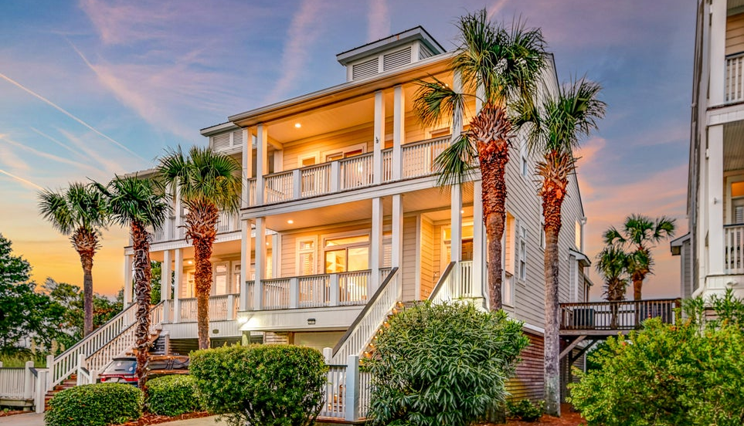




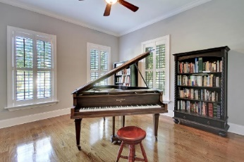
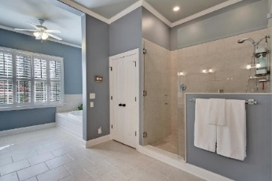
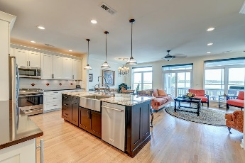
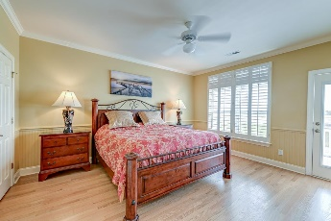
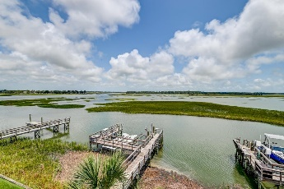
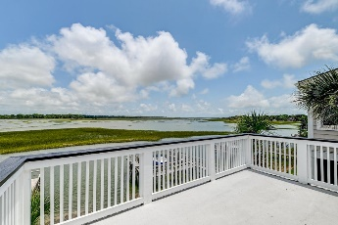
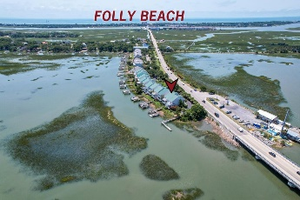
Price Reduced!
Happy Hour Broker Open House Friday, Nov 22 from 3-5
$100 Gift Card Giveaway
Price Improvement
2202 Folly Road Waterfront Point ~ Charleston, SC 29412 ~ MLS# 24016851 ~ $1,249,999
**Water Lover's Paradise on Folly Creek**
Walk right out your backyard onto your dock with your own boat lift and head to Morris Island. This stunning property offers breathtaking views and quick access to the sandy shores of Folly Beach. Imagine waking up to a sunrise view of the water, taking your boat or kayak out for a morning adventure, and then strolling across the street to Crosby's Seafood for the freshest catch. In the evening there are sunset view from the study and upstairs bedrooms. Every room has a view! With Folly Beach just a mile away, a day of sun, sand, and surf is always within easy reach. Living here feels like being on vacation every day. More importantly you have an elevator to take you to the upper levels of this home.
From the moment you lay eyes on this home, you'll recognize its unique charm. Designed to maximize its incredible waterfront location, the property boasts ample decking to embrace outdoor living. Tropical landscaping surrounds the home, enhancing its inviting exterior. Double front porches offer a warm welcome as you approach. Step inside to discover elegant details such as oak flooring, crown molding, plantation shutters, an open floor plan, and abundant natural light.
To the left of the foyer, double doors lead to a versatile study with built-in shelving and access to the front porch. As you proceed down the hallway, your gaze will be captivated by the expansive water views. The updated kitchen is a chef's dream, featuring stainless steel appliances (including a new dishwasher), beautiful cabinets, quartz countertops with a granite island, a stylish backsplash, a farmhouse sink, and a beverage fridge. The reverse osmosis system for the ice machine and sink is a thoughtful touch. The kitchen seamlessly flows into the dining area and the living room, which boasts a gas fireplace, built-in shelving, and access to the screened porch with its stunning views. The main level also includes a powder room and one of three stops for the convenient elevator.
Upstairs, the primary bedroom is a true sanctuary. This spacious retreat features two separate walk-in closets, a sundeck overlooking the water, and an updated ensuite bath with a dual sink vanity, a roomy soaking tub, and a frameless step-in shower. On the front side of the upper level, you'll find two additional bedrooms, both with access to the upper front porch and phenomenal views. A bathroom with a stunning tile shower and a separate laundry room with a convenient sink completes this level.
The covered patio and beautifully landscaped yard are easily accessible from the screened porch or the four-car garage. Just steps from your back door, the dock features an 8,500-10,000 lb boat lift, electric (on a separate panel), and water. Additional noteworthy features include extra insulation under the house, a professionally screened porch, and a storage closet in the garage. The HOA covers annual pressure washing and quarterly pest control, and there's also a convenient community dock. Downtown Charleston is less than 9 miles away, making this location both tranquil and convenient.
Don't miss this opportunity to own a slice of waterfront paradise where every day feels like a holiday.
True Edwards true@mattoneillteam.com 843-442-6253

