Slide 1
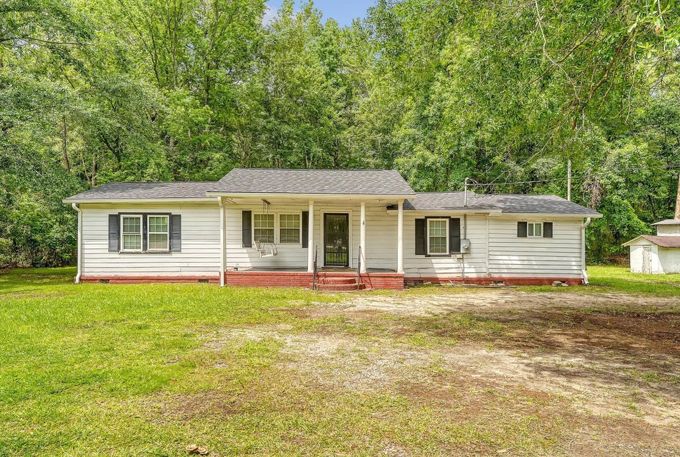
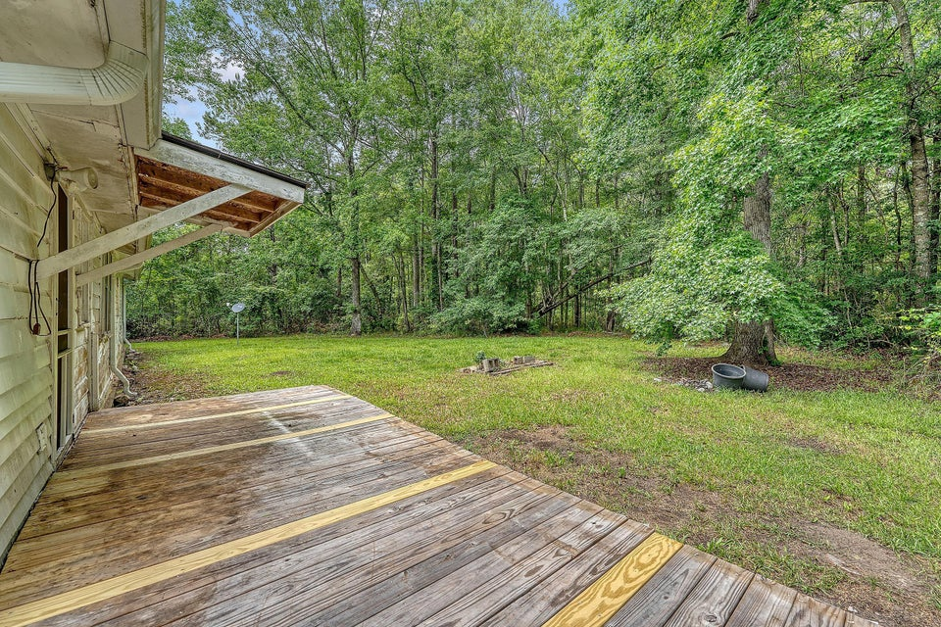
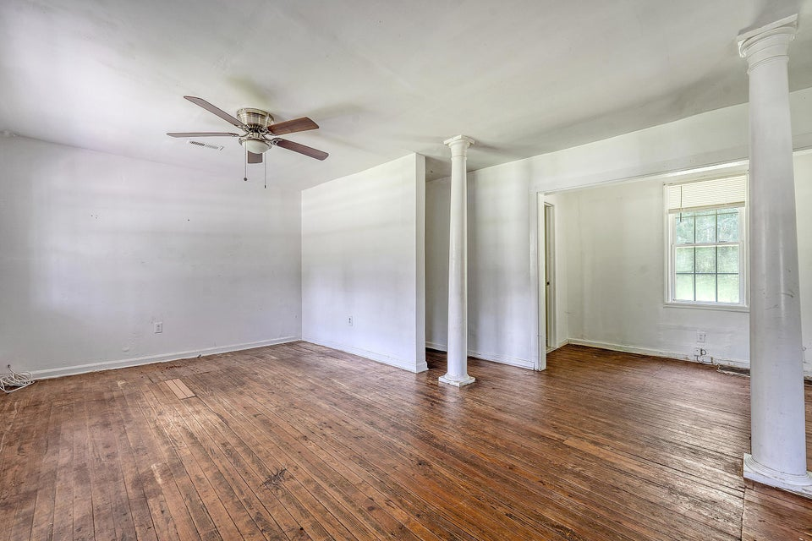
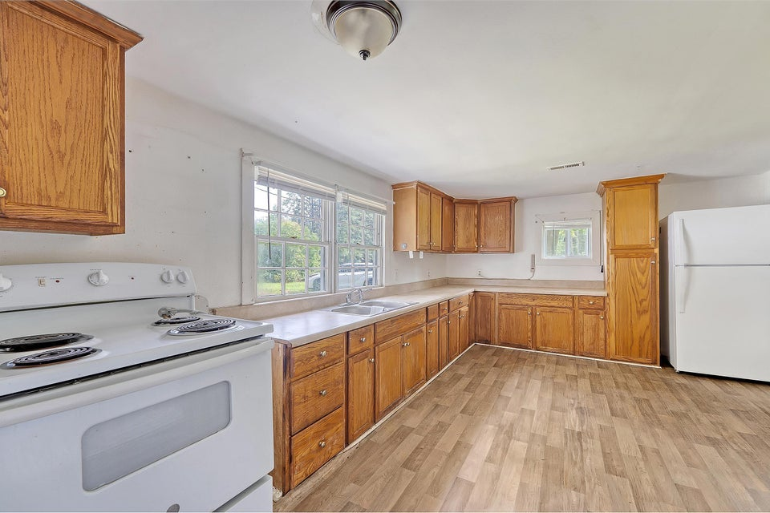
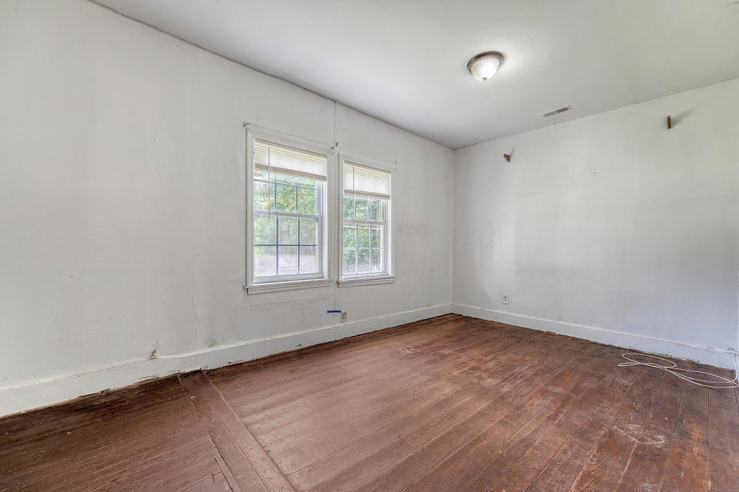
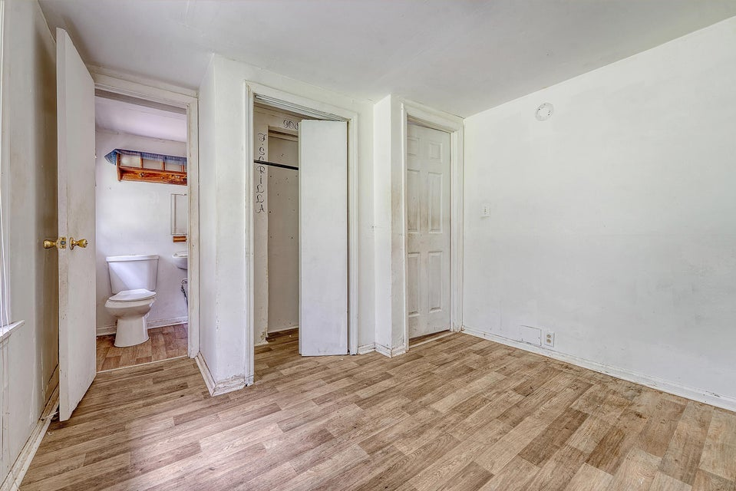


PRICE IMPROVEMENT!
CHARMING HOME WITH PRIVACY, UPGRADES & NO HOA IN A PRIME LOCATION!
2202 SC HWY 61
RIDGEVILLE, SC 29472 | MLS# 25015124 | $249,000
Nestled in a peaceful, quiet area offering plenty of privacy, this property is a rare opportunity for buyers seeking space, convenience, and value. Located in the sought-after Dorchester District 2 school zone, the home is ideally positioned near Ridgeville, Summerville, and just minutes from the upcoming Google Data Center campus—making it a smart investment for the future. Recent improvements include a newer roof and newly installed gutters, providing added peace of mind for maintenance-conscious buyers. Enjoy the freedom of no HOA and a spacious backyard bordered by mature trees that create a natural wooded boundary—perfect for privacy and outdoor enjoyment.
With a little TLC, this home presents endless possibilities. Whether you're looking to renovate and customize or invest and hold, this property delivers potential in all the right places.
Property is being sold AS IS. The seller will not be making any repairs.
Don't miss this opportunity...schedule your showing today and imagine the possibilities!
David Hotchkiss
843-695-7015
davidhotchkissrealtor@gmail.com
davidhotchkiss.erawilderrealty.com
ERA Wilder Realty | 1282 State Rd | Summerville, SC 29486

