Slide 1
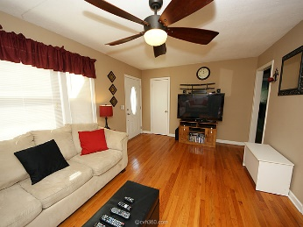
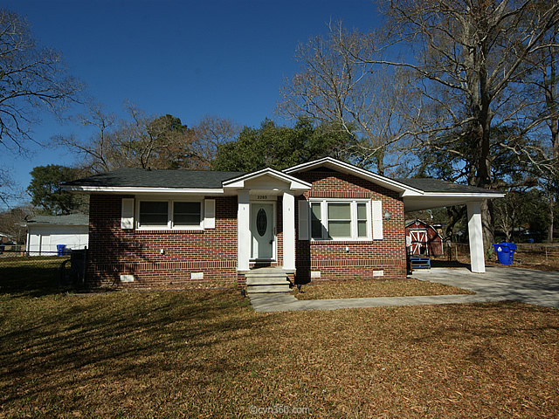
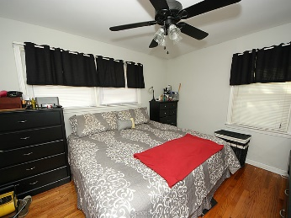
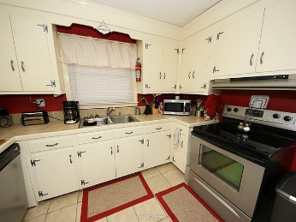
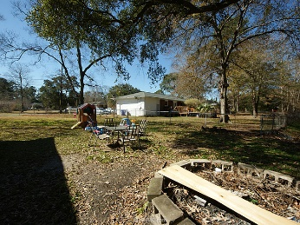
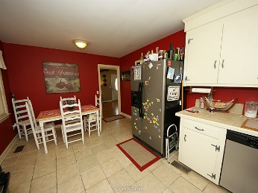
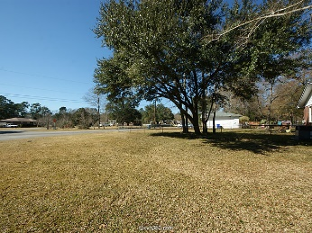
Open House, Saturday, April 16th from 11:30a-1:30p
2203 Church Creek Drive
Springfield ~ Charleston, SC 29414 ~ MLS# 16002621
Just Reduced to $159,900
Looking for a cozy home with a large yard? We have a nicely maintained brick ranch with a 2/3 acre lot in Springfield. The house features a den that could be made into a third bedroom with adding a closet & door. New energy efficient windows were added in 2013, a new roof in 2009 and the HVAC was replaced in 2010. The kitchen has tile counter tops and the living room and bedrooms have original wood floors. Conveniently located just off Ashley River Rd this neighborhood does not have a formal HOA so bring your boat. There's great outdoor space with this huge corner lot so come enjoy the fire pit. Residents are eligible to join Canterbury Woods pool and clubhouse for under $300 a year.
Mike Goldston, Realtor
mikesellscharleston@gmail.com | 843-343-7026 | www.cometocharlestonsc.com
Brand Name Real Estate | 4 Carriage Lane, Suite 106 | Charleston, SC 29407

