Slide 1
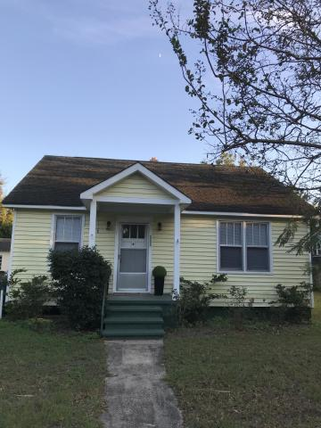
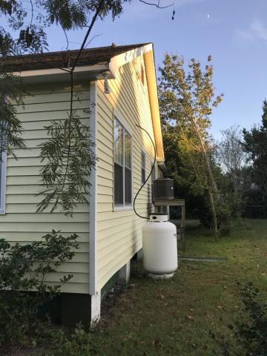
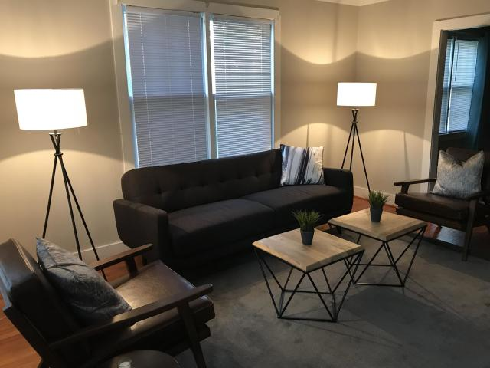
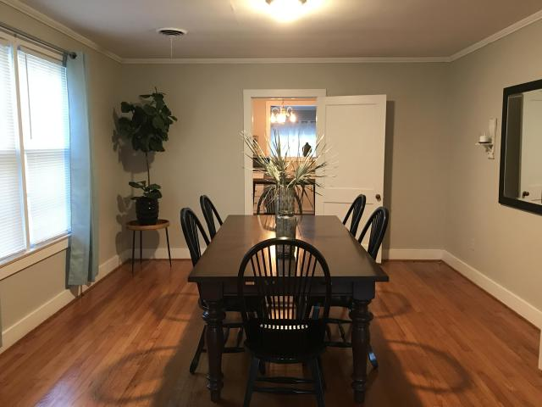
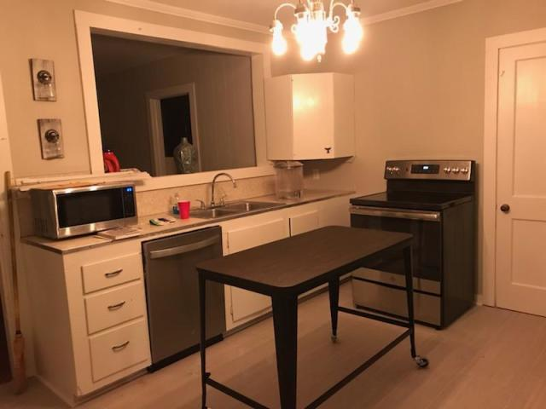
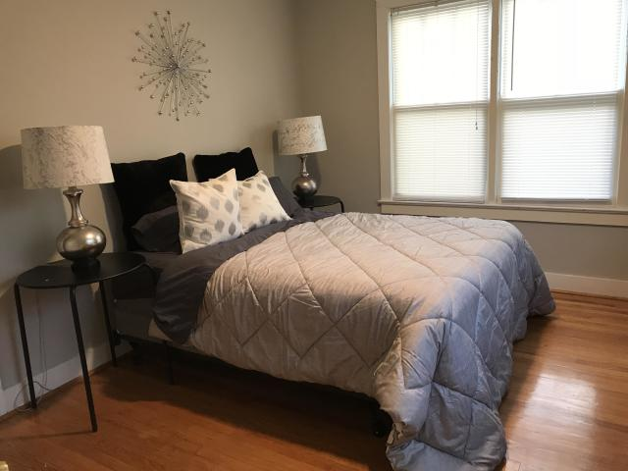
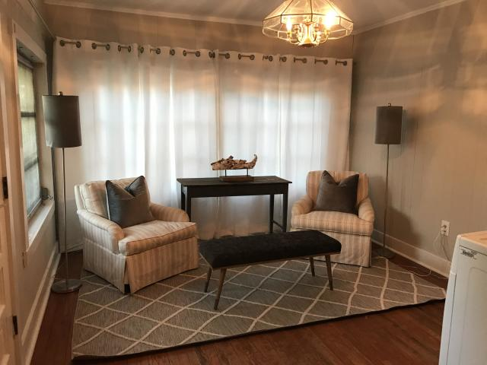
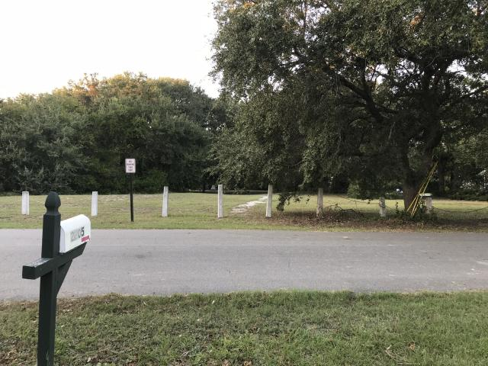
Furnished House For Rent
2205 Myrtle Avenue
Sullivans Island, SC 29482
MLS# 20000431 | $3,500/Mo
4 bedroom, 1.5 bath home, furnished rental within walking distance to restaurants & the beach. The house is across from the Sullivans Island Historic Cemetery. New paint, washer/dryer, stainless steel kitchen appliances, & ceramic tile flooring in bathrooms & kitchen. Exterior storage room does not convey.
Charles Salmonsen
M (843) 224-0300 | O (843) 388-6613 | charles@salmonsen.com
Salmonsen Realty | 864 Lowcountry Blvd Ste B | Mt Pleasant, SC 29464

