Slide 1
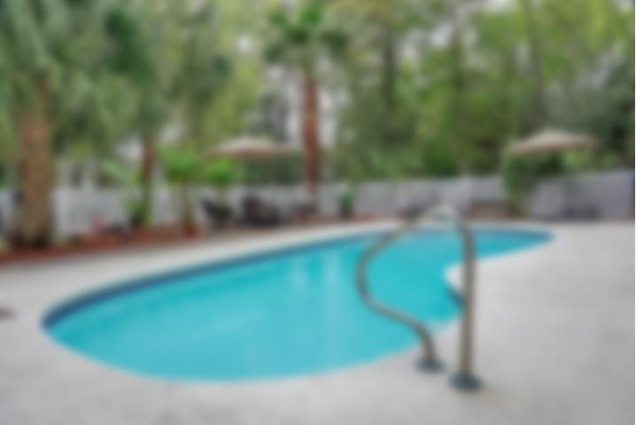
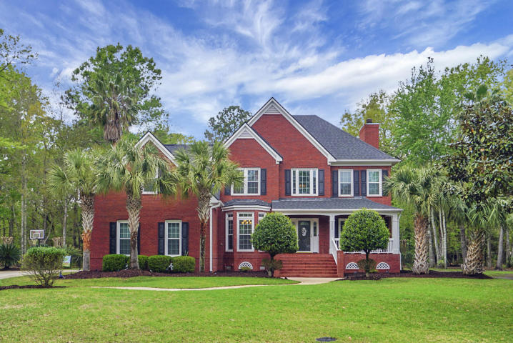
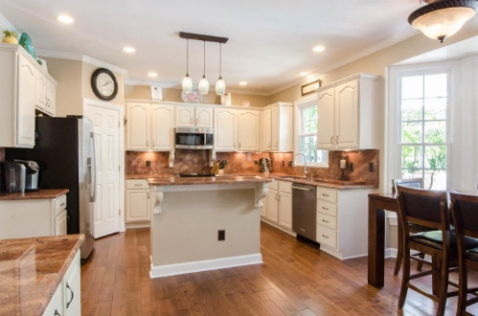
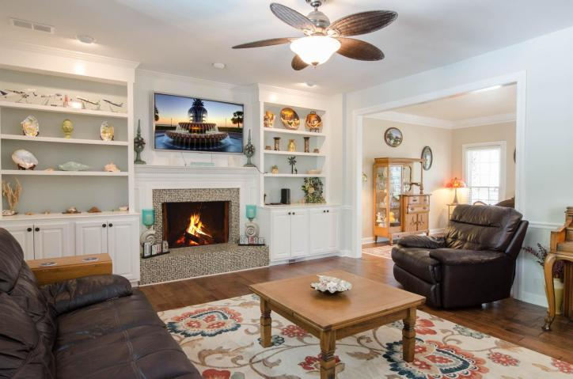
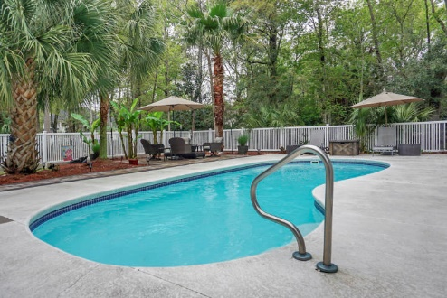
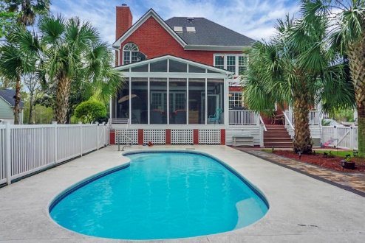


Open House Thursday 11a-2p Check Out This Beautiful New Home And Enjoy A Light Lunch
$24,900 Price Improvement!
Executive Pool Home in Dunes West!
2206 Old Jay Lane
Dunes West | Mount Pleasant | MLS# 20008688 | $664,000
5 Bedrooms | 3½ Baths | 3,175 sf
This executive brick home on a quiet Dunes West cul de sac is ready for you to move right in & enjoy the summer! Situated on a beautifully landscaped & private 1+ acre lot, this fabulous family home has it all. Enter the spacious foyer & see the Brazilian maple hardwood flooring throughout the main floor. The soaring ceiling has a gorgeous stained glass chandelier with a motorized pulley system for easy cleaning & changing light bulbs! Formal living & dining rooms flank the entry with wainscot in the dining room & crown moulding throughout. The spacious kitchen has an island, built in desk & dinette. It opens to a family room with a beautiful gas fireplace & built ins. Upstairs are five bedrooms & three baths, including guest suite with private bath. The master bedroom has a lovely tray ceiling, his & her walk in closets & master bath with tile shower, jetted tub & his & her vanities. Two other bedrooms share a bath. Fifth bedroom is currently being used as a music room. A walk up stair leads to the partially finished attic bonus room & storage space.
The backyard is an entertainer's dream with a large screened porch, deck with pergola & gorgeous in ground saltwater pool. Round this out with a custom paver patio & fire pit for your family's year round enjoyment. There's even a dog washing station in the garage with hot & cold running water!
Sellers have invested in many home improvements including new roof, HVAC, new double tilt energy efficient windows, transferrable termite bond, paint, carpet, & more. Home is also pre-wired for a generator.
Lovely views and abundant wildlife make this home a year round haven.
Video Walk-through: https://youtu.be/P8JkRoBusXI
Lisa Burdick
413-348-9841
lisaburdickrealtor@gmail.com
Home Solution Real Estate Services
PO Box 80966
Charleston, SC 29416

