Slide 1

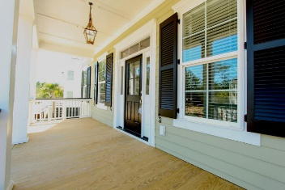
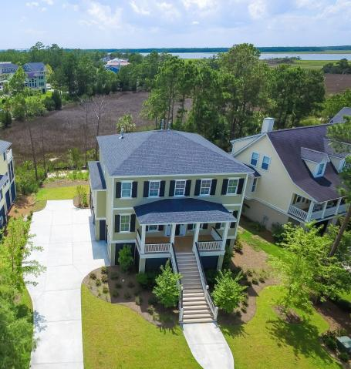
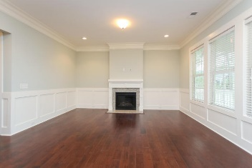
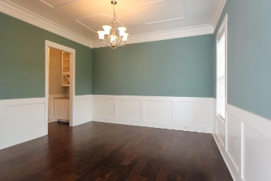
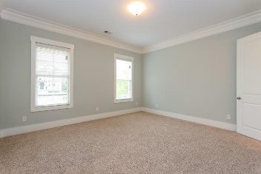
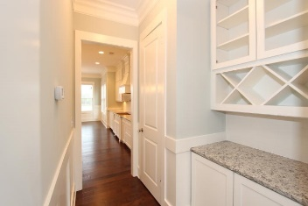
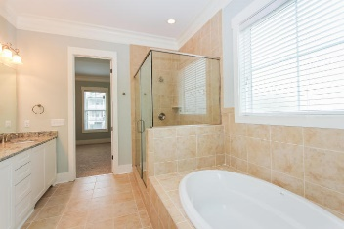
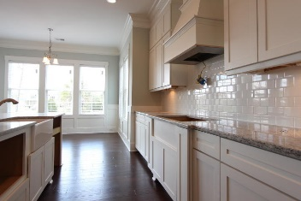
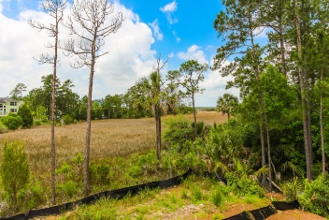

2207 Branch Creek Drive
Rivertowne Country Club :: Mount Pleasant
MLS# 1421692 :: $659,990
Ready Now: The Perfect custom home is located on an amazing marsh and river front lot. Simply breathtaking views of the Wando River! This architecturally distinctive, elevated, bright and open home offers amazing sunsets. Meticulously maintained, this home is filled with upgrades, character and charm. The Front Porch is great for Rocking Chairs and/or a swing. The Appliances included a Over the Range Hood, Stove, Built-in Oven and Dishwasher. Granite counters, custom cabinets and a huge granite island make this home a chef's dream and fantastic for entertaining family and guests. A comfortable eat-in kitchen area offers plenty of space and marsh views. The great room, which flows seamlessly from the kitchen, features high ceilings, and a fireplace. An oversized screened porch is in the rear of the home and offers privacy and great views of the marsh, creeks, and river. This home has 5'' Hand-scraped Hardwood Floors in the Foyer, Kitchen, Dining Room, and Eat-in Breakfast area. In the Bathrooms you will find Tile, and superior carpet in the bedrooms. The master bedroom is on the Main Floor and the Bathroom has Double Vanities, Garden Tub and separate Tiled Shower. A half bath is located on the first floor. Upstairs features a massive multi-purpose room and another full bath- there is space for a media and gaming room, an office, and bedroom area. Drive under parking provides room for multiple autos, lots of storage and work space. This home is located in a premier Mt Pleasant golf & country club neighborhood. Amenities include: a fantastic deep water community dock on the Wando River with room for several boats (intended for day and 48 hour overnight storage), ''Arnold Palmer Signature'' golf course, clubhouse, pro shop, two bars and restaurants, pool, play park, and clay tennis courts. Your neighborhood HOA fee covers use of all the amenities. Private Golf Country Club membership is available. At the front of the neighborhood are a Harris Teeter grocery store, restaurants, and other retail. You are just 20 minutes from the Isle of Palms and Sullivan's Island beaches, 25 minutes from historic downtown Charleston, and a quick 30 minutes from the airport. Rivertowne feeds top ranking Mount Pleasant public schools.
Chris Eller
EPRO, GRN, SFR, REALTOR, CRS
(843) 343-3359
iconicdevelopments@gmail.com
GFH Realty, LLC
498 Wando Park Blvd Suite 1125
Mt. Pleasant, SC 29464
www.gallowayfamilyhomes.com

