Slide 1
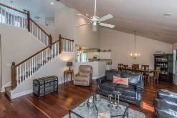
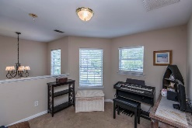
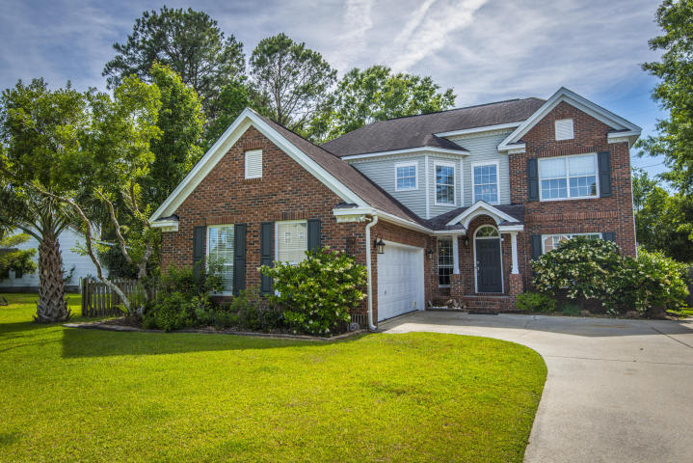
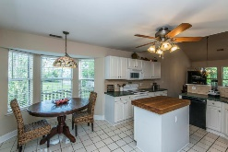
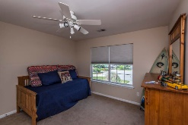
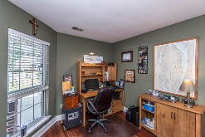
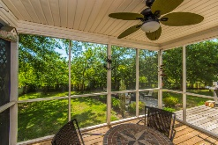
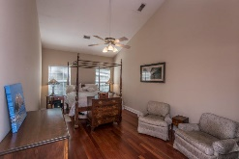
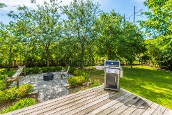
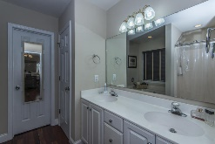
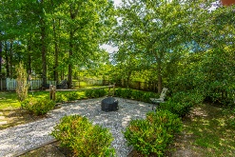
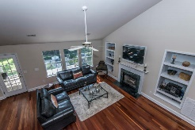
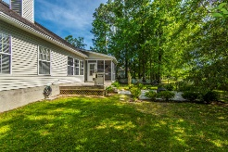
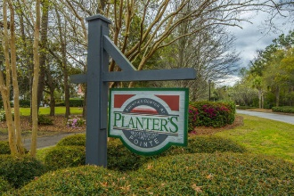
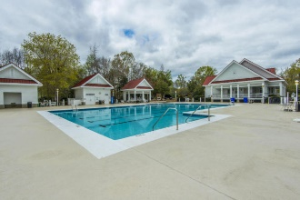
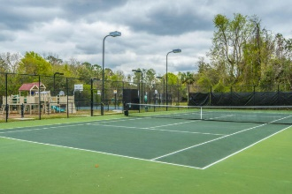
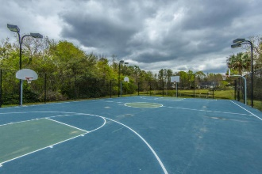
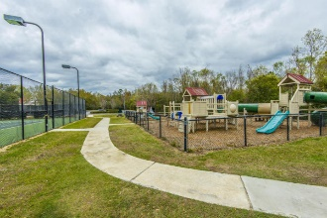
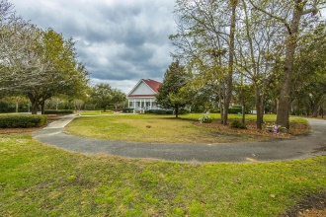


2207 Hearthstone Way Planters Pointe ~ Mount Pleasant, SC 29466
Great Buy - Cul-de-sac
Located on a tree-lined cul-de-sac in the back of a quiet neighborhood, this beautiful brick traditional home offers an open floor plan with plenty of space for entertaining indoors and out! You'll note the soaring ceilings and abundance of natural light as soon as you enter. Rich wood tones in the hardwood provide a perfect anchor for the bright and neutral color pallet found throughout the home. Just off of the foyer is a study, accessible through French doors. The living room is generously sized and boasts a vaulted ceiling and wall of windows to the backyard. The gas log fireplace, with it's custom mantle, is flanked by built-in display cases. Open to the formal dining space, this room begs to host parties and family celebrations!
Asking $419,000
MLS# 18013146
2,504 SqFt
3 Bed/2½ Baths
Great community loaded with amenities
Don Dawson 843-514-0452 ddawson@carolinaone.com Carolina One Real Estate • 2713 Highway 17 North • Mount Pleasant, SC 29466
www.TeamDawsonSC.com

