Slide 1
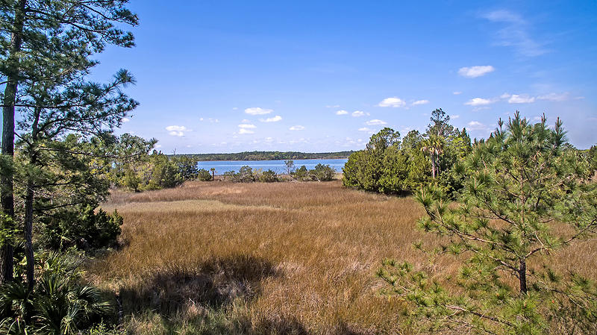
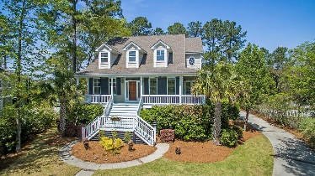
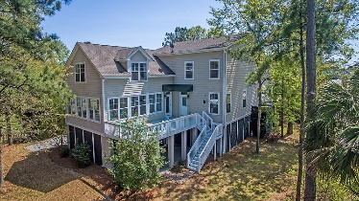
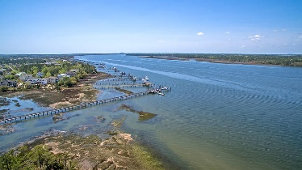
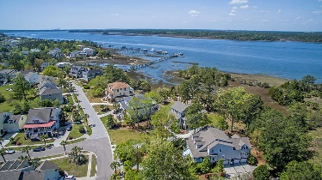
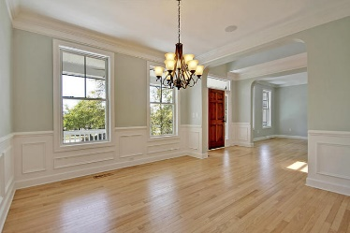
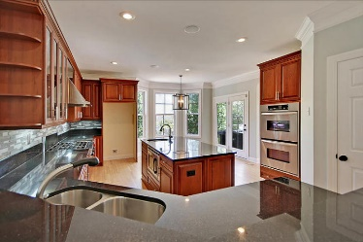
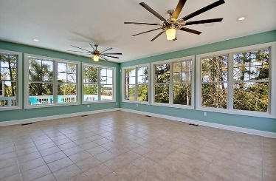
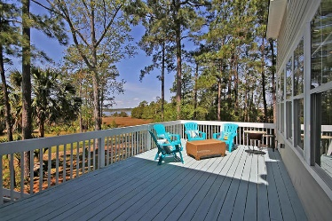

2207 N Marsh Drive
Rivertowne Country Club · Mt Pleasant
MLS# 18009785 · $700,000
Gorgeous Listing
New Listing
Spectacular Wando River Views!!
Beautiful EXECUTIVE home on large level lot with STUNNING views of the Wando River. The bright and welcoming foyer has handsome hardwood floors and opens to a GOURMET kitchen featuring cherry wood cabinetry, granite countertops, an oversized kitchen island with prep sink & garbage disposal, pantry, stainless steel appliances including double gas wall ovens, a built-in under counter microwave, dishwasher & 6 Burner gas range-a true chef's delight. One of the BEST FEATURES of this home is the large sunroom with its expansive views of the Marsh & Wando River beyond. This perfect entertainment space has an abundance of natural light, wine fridge and bar area, and enough room to dine & relax inside while having direct access to the large, outdoor deck which has a natural gas grill hook-up. The master bedroom suite has breathtaking views and is on the main living level with a lavish ensuite spa-like master bath that boasts a custom shower with glass & stone accents that complement the premium granite countertop. No detail has been missed even the shower curbs match the countertop granite! Frameless glass shower enclosure with large whirlpool tub perfect for relaxing and makes this bathroom one you might not want to leave! Also on the main level is a dining room, flex room that could be an office or living room, and large laundry room. The second level has three large bedrooms that share a GORGEOUS bath with granite vanity, soaking tub, and separate shower. Finally, above the sun room is a phenomenal media room equipped with blackout curtains that any movie lover enthusiast would envy. The 3 car garage has room for up to 5 cars and enough STORAGE space for even the biggest hoarder! Rivertowne on the Wando in Mount Pleasant is a wonderfully landscaped neighborhood with community dock, play park, community pool, club house and golf course memberships available! The neighborhood is close to local shopping and grocery stores and is a short drive to downtown Charleston with 5-star restaurants, world class shopping and iconic history as well as a short drive to the beaches, the airport, Boeing and Daniel Island. Come take a look because you will not find another home that offers as much as this one: grand views, a chef's delight and entertainer's dream!
Call today to see!
Stan Huff
843-670-2835
stan.huff@agentowned.com
Jill Marcacci
843-297-5590
jill@agentowned.com
www.agentownedrealty.com
AgentOwned Realty Co. Preferred Group, Inc. | 824 Johnnie Dodds Blvd | Mt Pleasant, SC 29464

