Slide 1
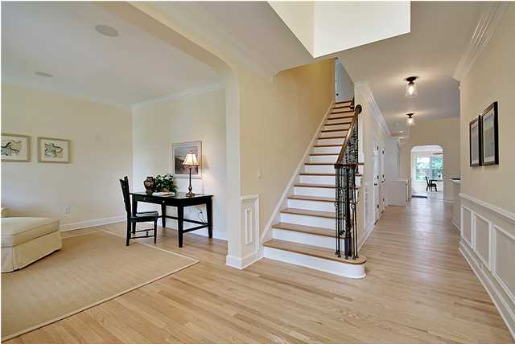
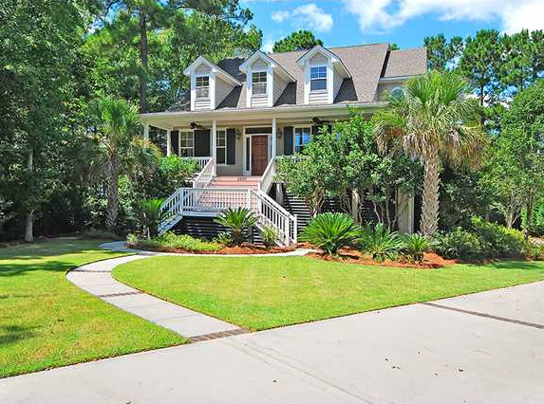
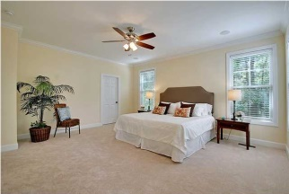
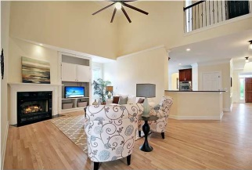
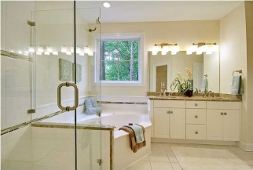
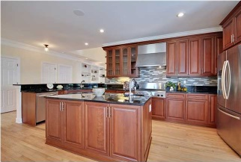
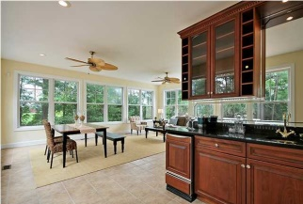
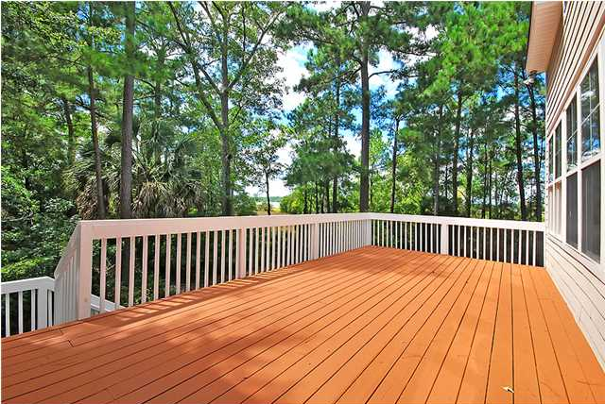
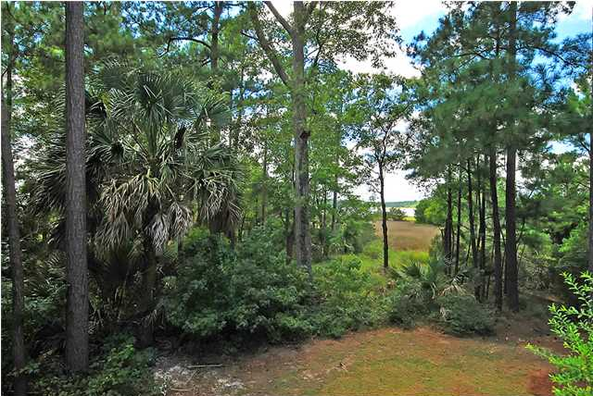
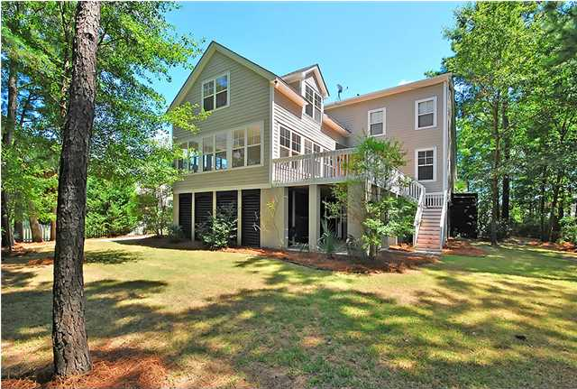
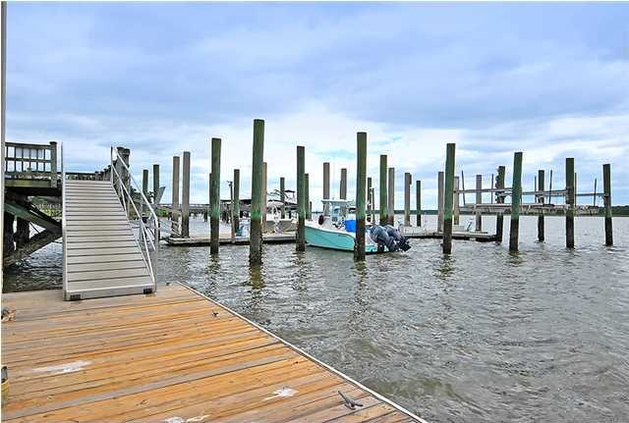

2207 North Marsh Dr | Mount Pleasant
MLS# 1423374 | $715,000
Move-in-Ready with Tons of Upgrades!
BEST PRICE per Sq. Ft. Marsh Front Home in Rivertowne! ** This Semi-Custom Marsh Front Home has undergone EXTENSIVE RENOVATIONS ** This is the home you have been waiting for! ** Enjoy your new home’s stunning curb appeal with beautifully landscaped grounds that include an irrigation system & upgraded landscape lighting… Even working exterior shutters. ** The bright and welcoming foyer opens to a Gourmet Kitchen featuring cherry wood cabinetry, granite countertops, a large kitchen island with prep sink & garbage disposal, stainless steel appliances including a NEW French door refrigerator, double gas wall ovens, a built-in under counter microwave, dishwasher & 6 Burner gas range. ** One of the BEST FEATURES of this home is the large sunroom with its expansive views of the Marsh & Wando River beyond. This PERFECT ENTERTAINMENT SPACE is bright and airy with enough room to dine & relax inside, while having direct access to the large, outdoor deck which has natural gas grill hook-up. You even have a mini-bar with ice maker! ** The Master Bathroom boasts a custom shower with glass & stone accents that complement the premium granite countertop. No detail has been missed… even the shower curbs match the countertop granite! Frameless glass shower enclosure with new fixtures and a large whirlpool tub make this bathroom one you might not want to leave! ** The 3 car garage has room for up to 5 cars and enough STORAGE space for even the biggest hoarder! ** The community dock is only 4 doors down from your home to make boat access easy! ** The entire home has been repainted, including all doors, walls, ceiling & trim. All new HVAC units, exterior doors, exterior & interior lighting, new hardware throughout, refinished hardwood floors, and new plush carpet in bedrooms. ** GOLF MEMBERSHIPS are available. ** CLOSE TO EVERYTHING.. you have a grocery store complex just minutes from your home, great shopping, dining & schools. ** Community Amenities include a neighborhood pool, tennis court & clubhouse. ** So many more features to tell you, so COME & SEE IT TODAY!
Call or email for details: (843) 214-8451 or Robin@ThePhillipsRealtyGroup.com

