Slide 1

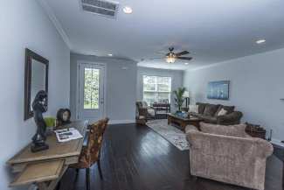
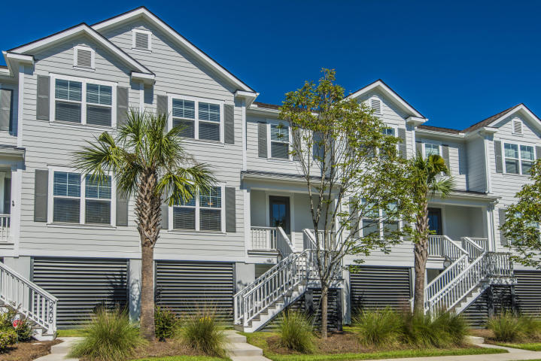
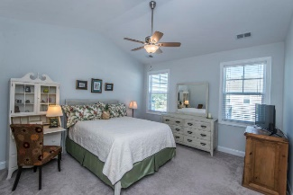
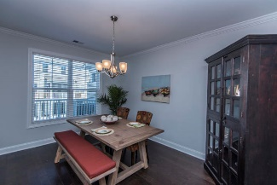
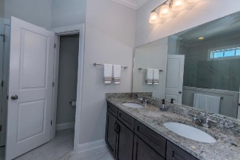
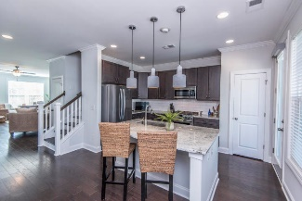
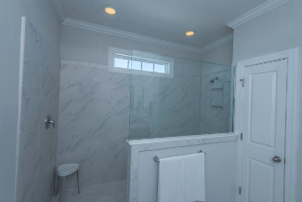
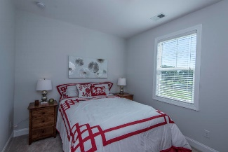
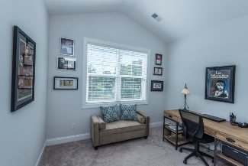
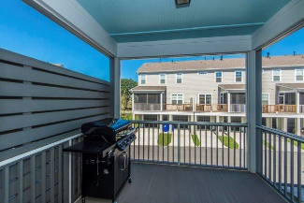
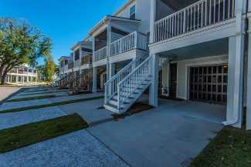
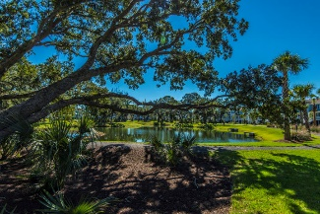


Price Reduction in Oyster Point
2208 Hamlin Sound Circle Mount Pleasant, SC 29466 | MLS# 18027884 | $415,000
Beautiful townhome overlooking Center Park with views of the fully stocked pond and gorgeous live oaks. This 3 Bed, 2.5 Ba towhnome boasts an open floor plan with 9 ft. ceilings, hardwood floors, fireplace, upgraded kitchen with granite countertops and stainless appliances. This unit is one of the few with a back stairwell leading to the deck and main living area. On the second floor is the master bedroom, along with 2 additional bedrooms and a laundry room. The Master comes equipped with a Spa shower and a huge closet. This home is elevated with a drive under garage with plenty of storage for 3 cars, kayaks, golf carts, etc.
Enjoy the Olympic swimming pool, tennis courts, playground, fitness center, firepits, and over 5 miles of walking trails. Located in close proximity to the beach, shopping, downtown and award winning schools. A $2,200 Lender Credit is available and will be applied towards the buyer's closing costs and pre-paids if the buyer chooses to use the seller's preferred lender. This credit is in addition to any negotiated seller concessions.
Debbie Rogers (843) 990-2915
deborah.rogers@carolinaone.com
www.DebbieRogersSellsCharleston
Carolina One Real Estate | 2713 Highway 17 North | Mt. Pleasant, SC 29466

