Slide 1
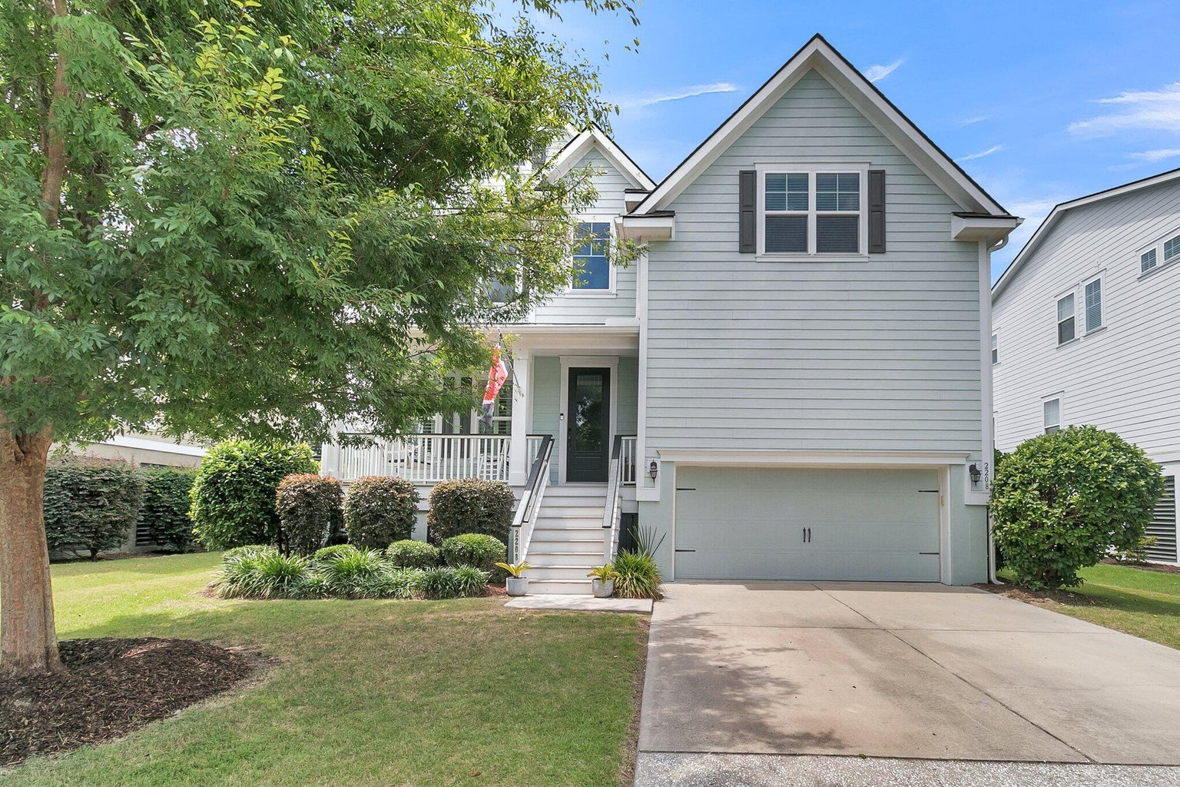
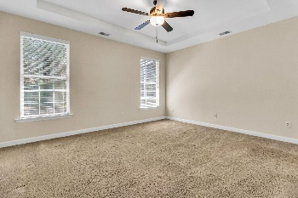
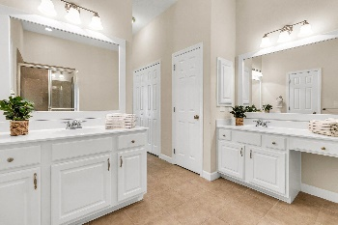
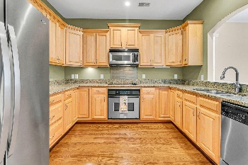
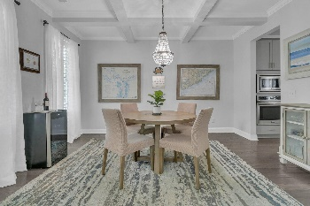
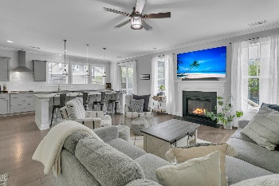
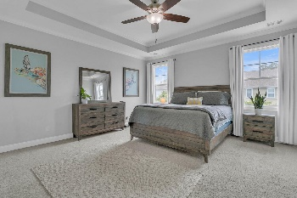
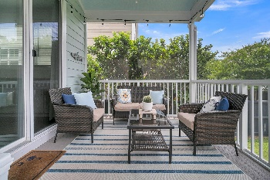
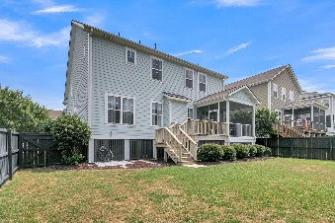

2208 Skyler Drive
Oyster Point · Mount Pleasant, SC 29466 · MLS# 24022195 · $999,000
3% Buyer's Agent Commission & $10,000 Buyer Flex Money
Seller offering up to $10,000 in buyer flex money to be used for closing costs, pre-paids, financing, or rate buy down with acceptable offer! Stunning 5 bedrooms 3 bath home under 1 million in desirable Oyster Point! Upon entering the home, you are greeted with coastal elegance, an open floor-plan, handsome hardwood floors, coffered ceilings, and an abundance of natural light. To the left is a flex room that could be a formal dining room or first-floor office. Continuing in is the modern chef-inspired gourmet kitchen featuring a HUGE island with seating for four, gorgeous countertops, gas cooktop, stainless steel appliances, deep single bowl sink, oversized pantry, eat-in area, and pendant lights! The large charming family room with gas fireplace is open to the kitchen and has views of the backyard. Guest bedroom on the main level with a full bathroom is perfect for overnight guest! The oversized primary bedroom suite is on the second level and has a relaxing spa-inspired ensuite bathroom with a magnificent tiled walk-in shower with frameless glass, a dual sink vanity, and a walk-in closet. This bathroom is a must-see! The massive versatile bonus room could be a media room, teen suite, upstairs office, or playroom. Finally, there are two additional nicely sized bedrooms upstairs that share a full bath and a spacious laundry room. The screened-in porch and deck overlook the fenced backyard and are ideal for relaxing with a cool beverage and BBQing with family and friends. Less than 10 minutes to the beach, Oyster Point is golf cart friendly and offers residents an unbeatable combination of location and leisure. Amenities include a resort style pool, pavilion, fitness center, clubhouse, tennis/multi-sport courts, park, and community dock. In the summer months enjoy live music on the community green space, visiting food trucks on weekends, and social clubs.
Stan Huff
843-670-2835
stan.huff@agentowned.com
Jill Marcacci
843-297-5590
jill@agentowned.com
www.agentownedrealty.com
AgentOwned Realty Co. Preferred Group, Inc. | 824 Johnnie Dodds Blvd | Mt Pleasant, SC 29464

