Slide 1

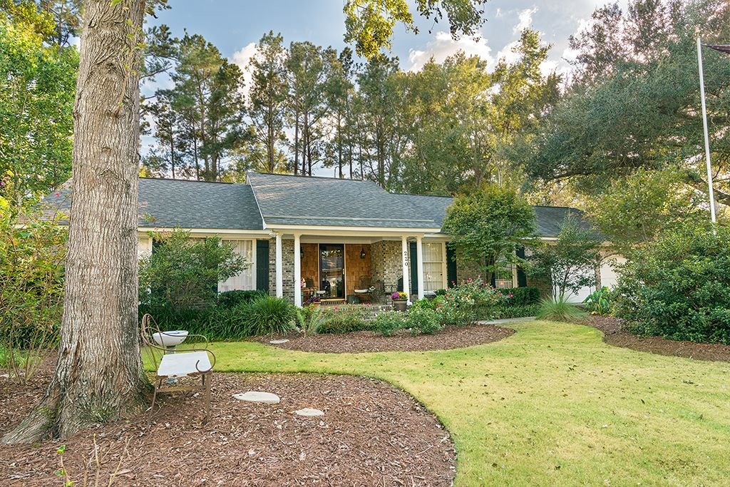

Coming Soon!
Jacqui Swain
Office (843) 871-1710
Mobile (843) 295-9484
jacquiswainc21@gmail.com
www.JacquiSwain.c21.com
220 Brailsford Road Quail Arbor V · Summerville, SC 29485 · $245,000
2,451 sq ft
5 beds · 2 baths
Welcome home to this charming 5 Bedroom 2 bath brick ranch home in a well-established neighborhood in Summerville. Home has ample living space, large kitchen, nice floorplan, wood burning fireplace in living room, sunroom with decorative wood trim on ceiling, hardwood and tile floors (vinyl in laundry room), spacious backyard with barn house chicken coop and separate man cave with pull down murphy bed.(currently being used for storage) Spacious FROG with large walk in closet (5th bdrm). With crown molding, fresh paint, lots of attention to detail, this is a Must See! Schedule your Private Showing today.
Century 21 Expert Advisors | 100 Seven Oaks Lane | Summerville, SC 29485-8514

