Slide 1
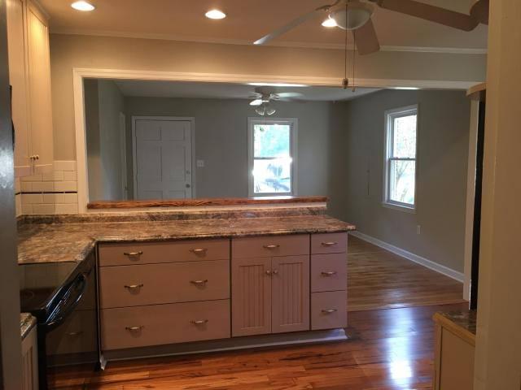
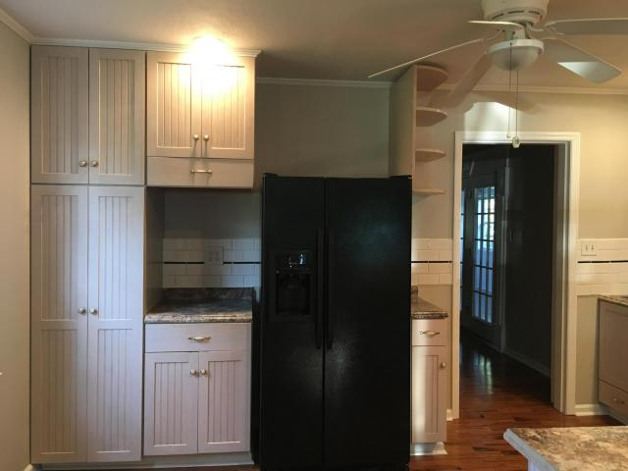
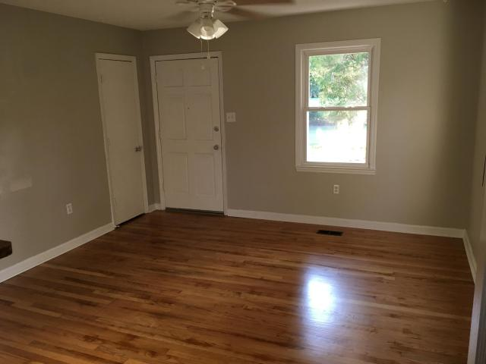
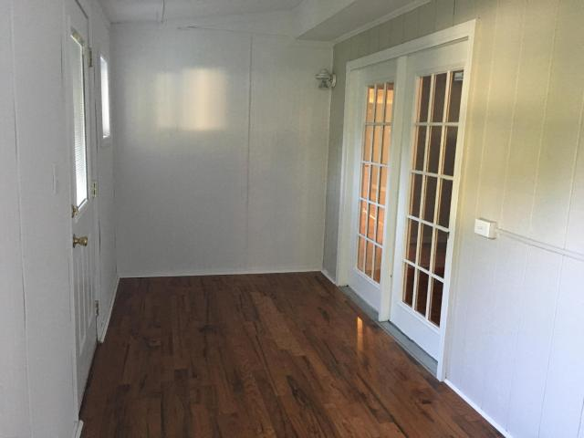
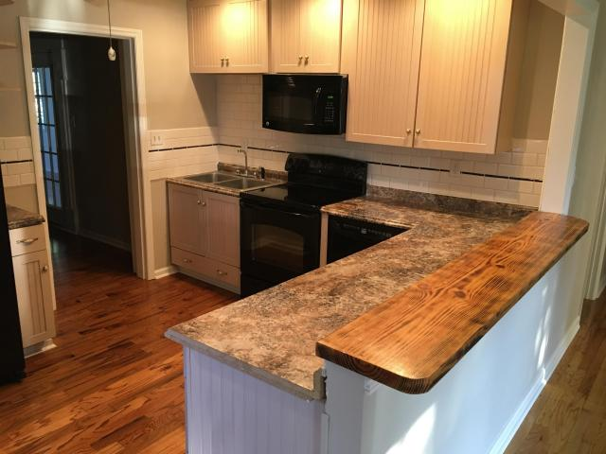
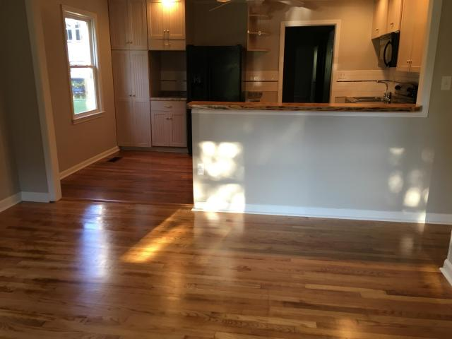


220 Broughton Road
Moncks Corner, SC 29461
MLS# 17023349 ~ $159,900
Open House Sunday, October 8th from 2pm-4pm
New Roof Architectural Shingles. 4 bedrooms and 2 baths that will accommodate any size family. Wow...what a nice surprise updated, bright open layout with Hardwood flooring throughout main living area, freshly painted walls, MBR huge walk-in closet, kitchen appliances updated and included, new kitchen countertops. Striking sunroom wood flooring. Storage building in enclosed backyard.
Cheri Hamner
843-364-4325
cheri.hamner@agentownedrealty.com
AgentOwned Realty Co. Premier Group, Inc | 141 A N. Main Street | Summerville, SC 29483

